Slide 1

Influence of volcanic eruptions on the bi-decadal variability in the North Atlantic
Didier Swingedouw, Juliette Mignot, Eric Guilyardi, Pablo Ortega, Myriam Khodri
EPIDOM
Evaluation of Interannual to decennial predictability starting from observations and models

Slide 2
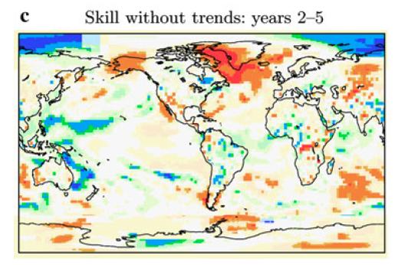
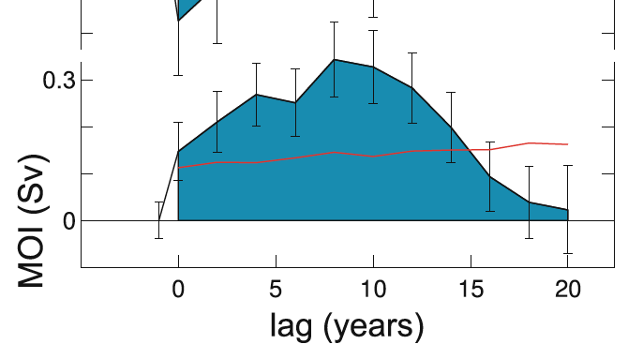
Background
t2m skill without trends: years 2-5
AMOC: a key player for decadal prediction
Volcanic impact on AMOC (Ottera et al. 2011, Iwi et al. 2010, Mignot et al. 2011…)
Bi-decadal variability in the North Atlantic:
  in several models (Frankcombe et al. 2010…)
  and in data (Chylek et al. 2011, Sicre et al. 2008, Divine et al. 2006… )
Van Oldenborgh et al. 2012
Zanchettin et al. 2012

Slide 3
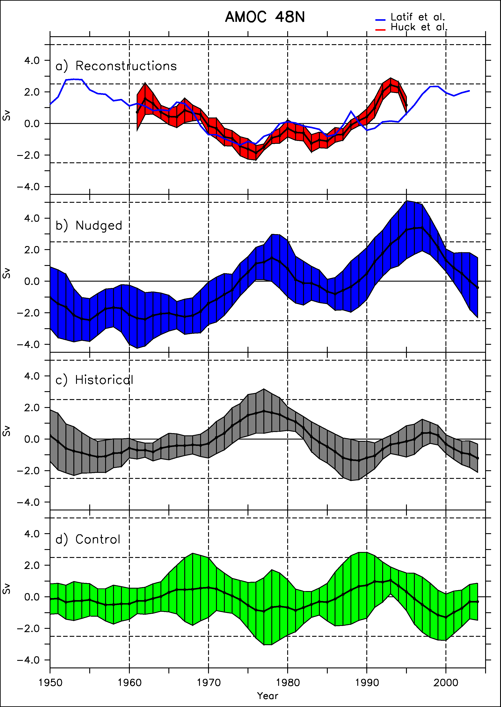
AMOC Initialisation
Reconstructions
Obs. (Huck et
IPSLCM5A-LR simulations nudged or free (with observed external forcings)
Two reconstructions of the AMOC
Agreement between nudged and reconstructions
Synchronisation also in the historical simulations
Nudged
Historical
Control
Swingedouw et al., Clim. Dyn. 2013

Slide 4
20-yr cycle in IPSL-CM5A-LR
Sea ice cover -,
SLP-
negative delayed feeedback
EGC +
10
yrs
3yrs
5yrs
T,’ S’ +
convection +
2yrs
9yrs
AMOC +
Escudier et al. Clim. Dyn. 2013
Notes:
Virer ?

Slide 5
20-yr cycle in IPSL-CM5A-LR
Sea ice cover -,
SLP-
negative delayed feeedback
EGC +
10
yrs
3yrs
5yrs
T,’ S’ +
convection +
2yrs
Mt Agung eruption
9yrs
AMOC +
Escudier et al. Clim. Dyn. 2013

Slide 6
Impact of volcanic forcing
Climatic index
Agung
15 yrs
Model free
1963
1982
1991
Time
2006

Slide 7
Impact of volcanic forcing
Climatic index
El Chichon
Agung
15 yrs
1963
1982
1991
Time
2006

Slide 8
Impact of volcanic forcing
Destructive interference?
Climatic index
El Chichon
Agung
Pinatubo
15 yrs
1963
1982
1991
Time
2006

Slide 9
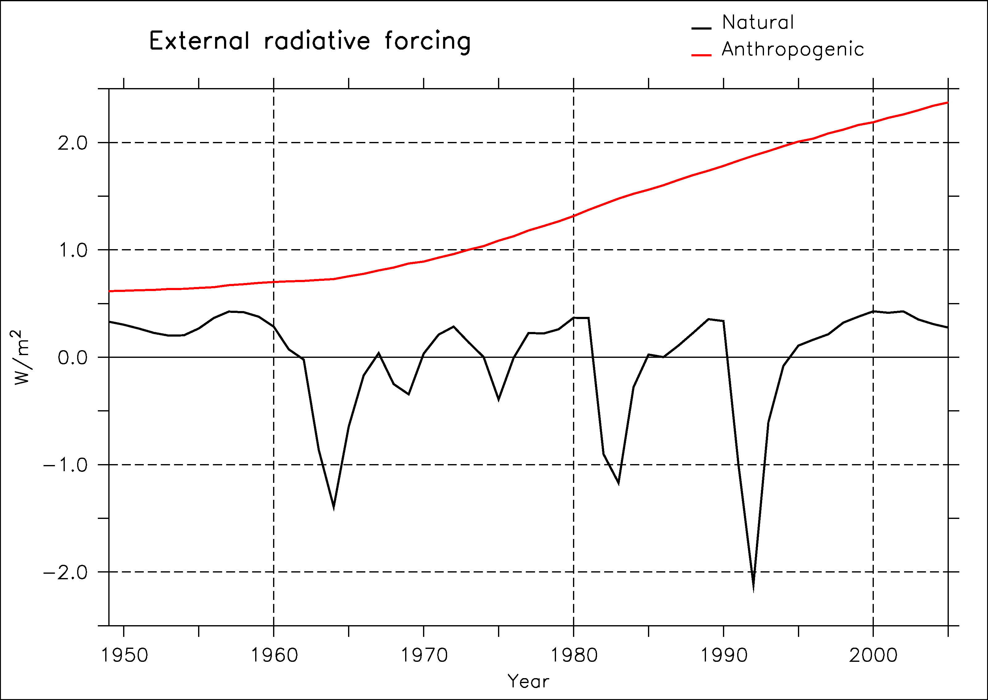
Experimental design
IPSL-CM5A-LR climate model
5-member historical ensemble (natural and anthropogenic forcing)
5-member initialised ensemble nudged with SST anomalies
5-member sensitivity ensemble without Pinatubo
CMIP5 ensemble
Comparison with existing in situ SSS data
A paleo-climate perspective
Agung
Pinatubo
El Chichon

Slide 10
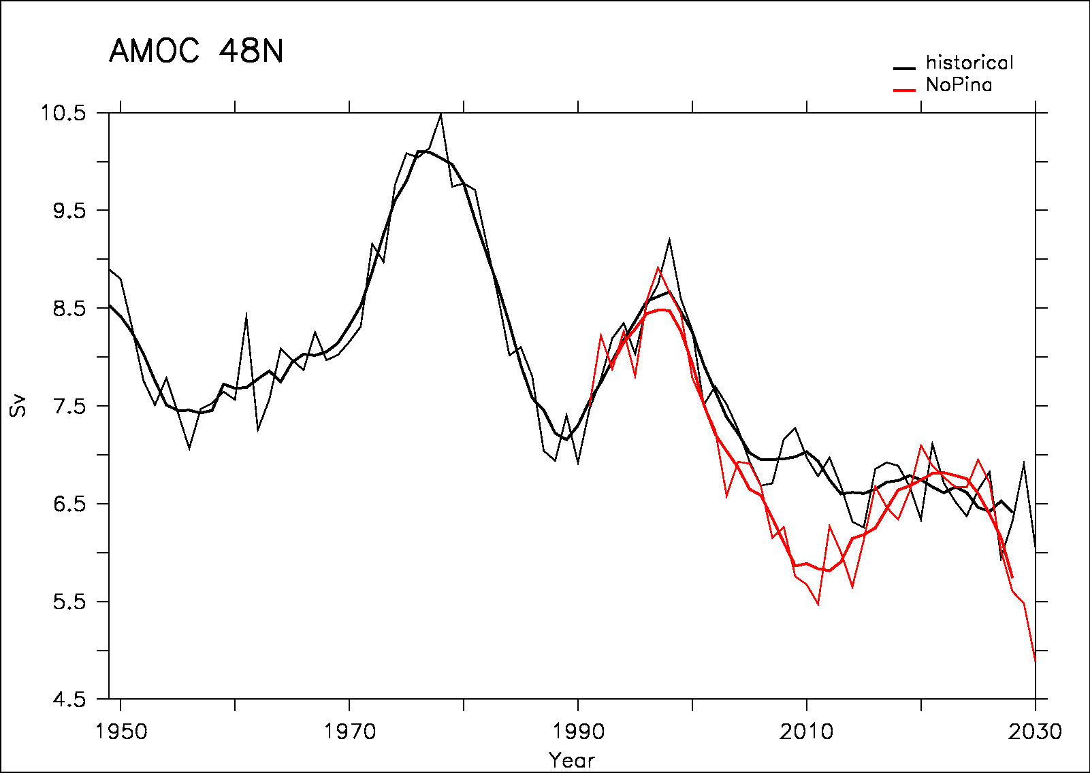
AMOC response in the IPSL-CM5A-LR model
Historical
No Pinatubo
The sensitivity ensemble without Pinatubo shows a larger decrease in the early 2000’s as compared to historical ensemble
Then a partial recovery in the late 2010’s

Slide 11
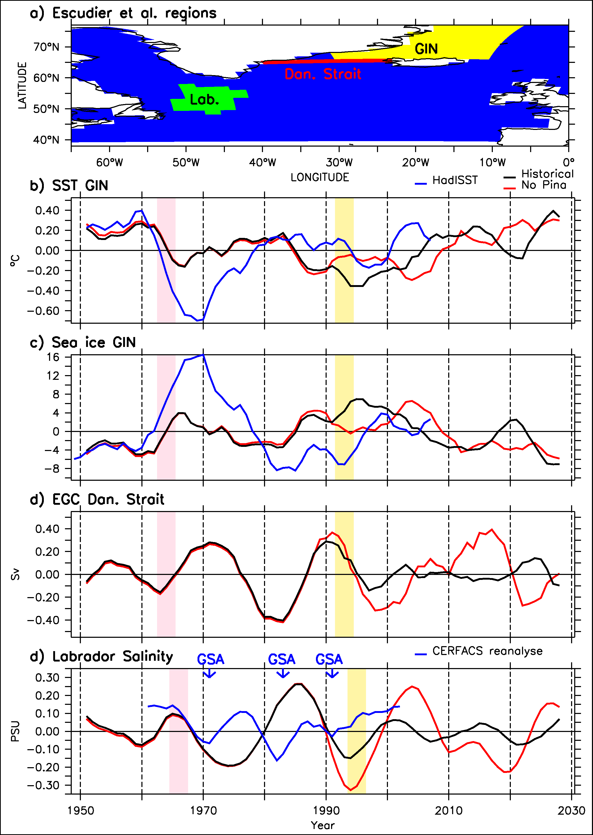
Mechanisms
Historical
No Pinatubo
HadISST
Pinatubo decreases SST and increases sea-ice cover in the GIN Seas
This interferes with variability of the EGC
This removes the salinity anomalies in the Labrador Sea
And then the convection and the AMOC variations

Slide 12
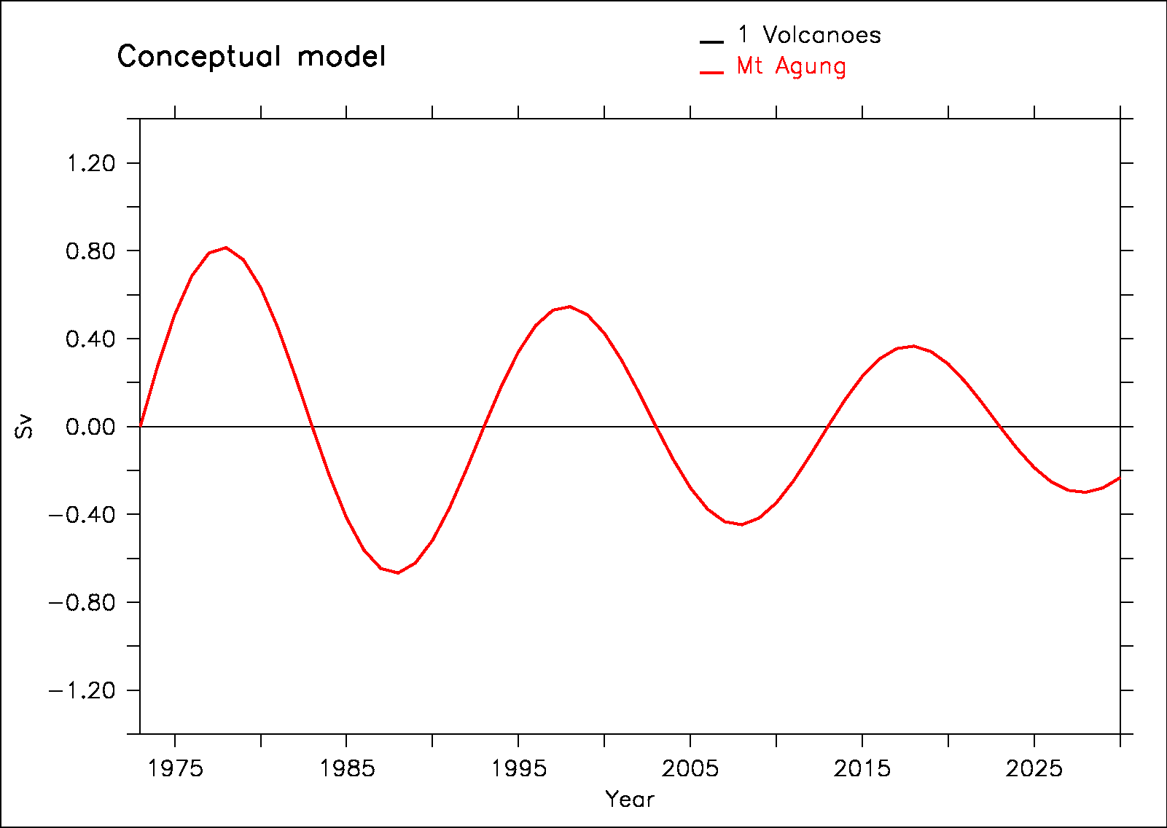
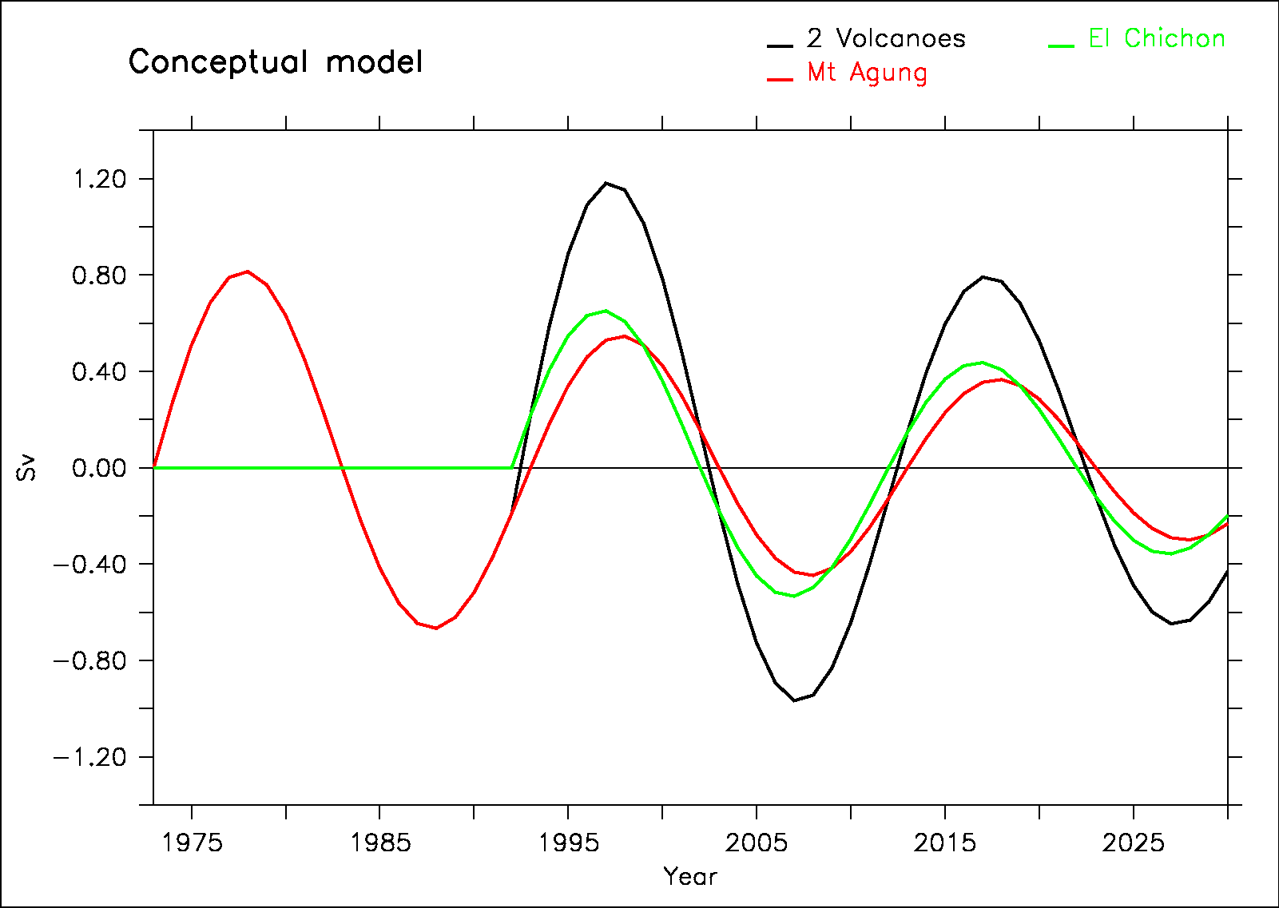
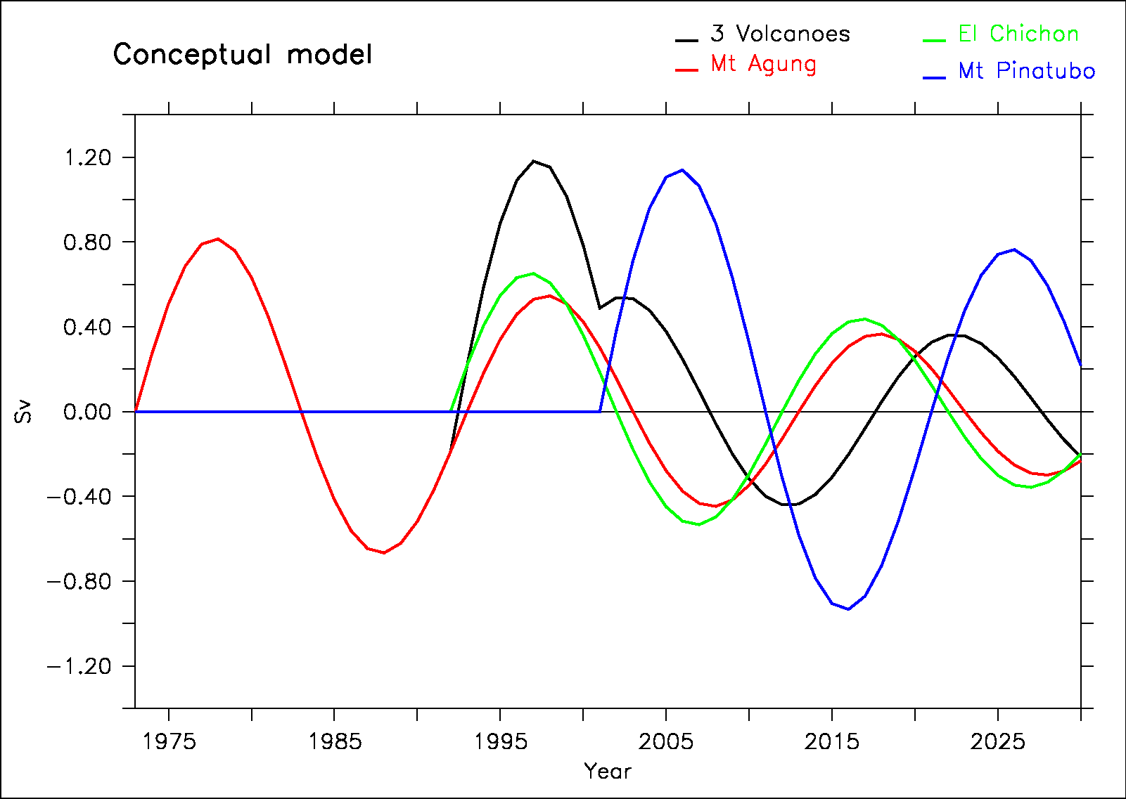
A conceptual model to explain AMOC variability in the model
We propose a conceptual model based on:
harmonic response to volcanoes
Linear response to radiative forcing (GHG)
Notes:
Mettre la somme en gras niveau 3 (le noir…)

Slide 13
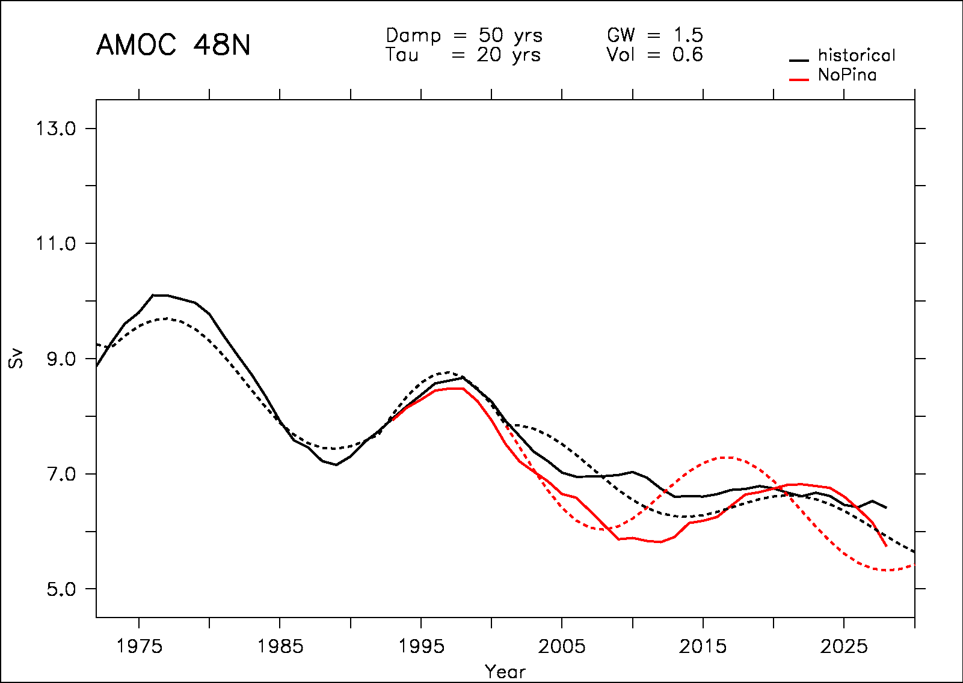
Comparison with IPSL-CM5-LR
We compare the conceptual model and the simulations
a=0.6 ; D=50 yrs
b=1.5

Slide 14
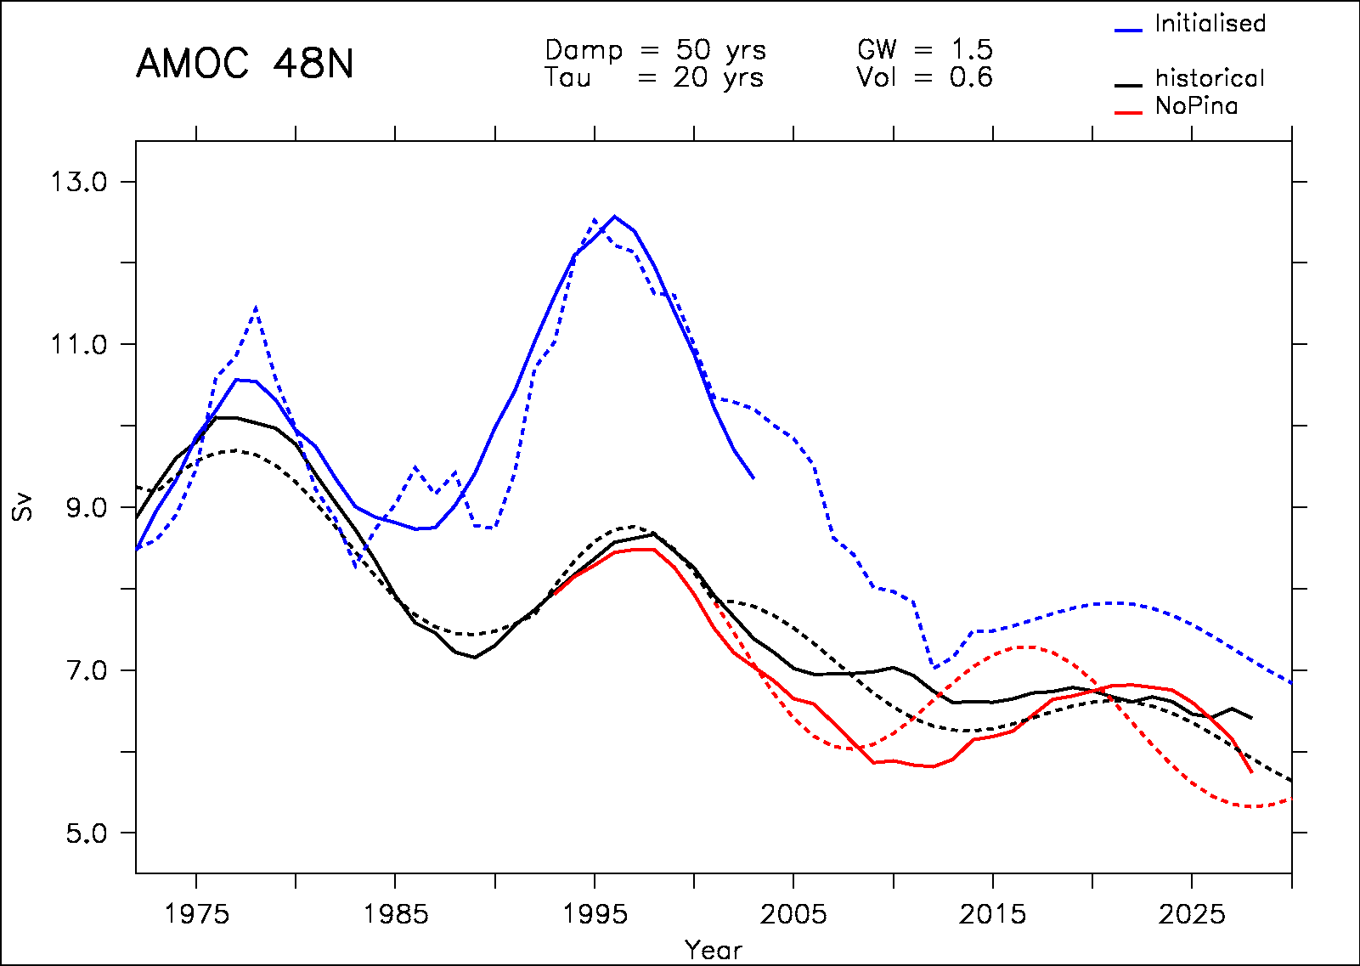
Role of observed NAO in the initialised ensemble
We add a term corresponding to observe NAO to explain AMOC variation in the initialised simulation
a=0.6 ; D=50 yrs
b=1.5 ; c=2

Slide 15
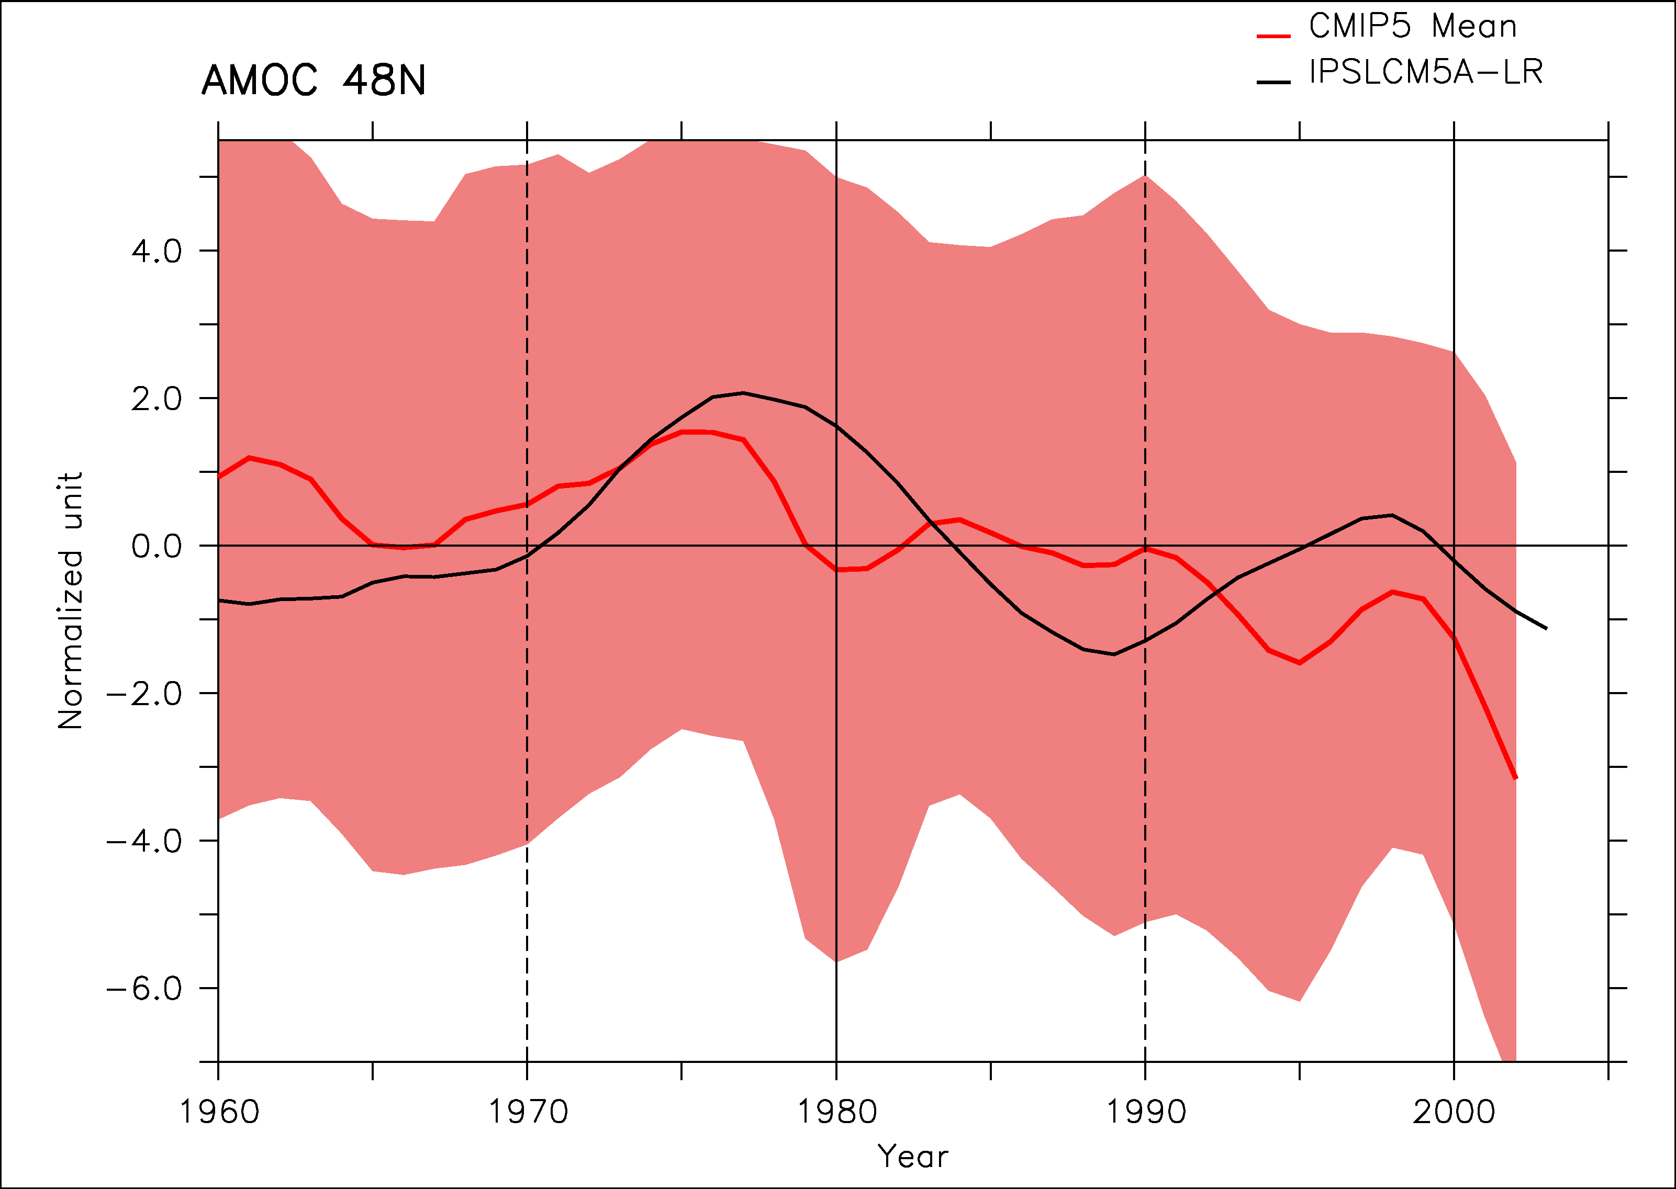
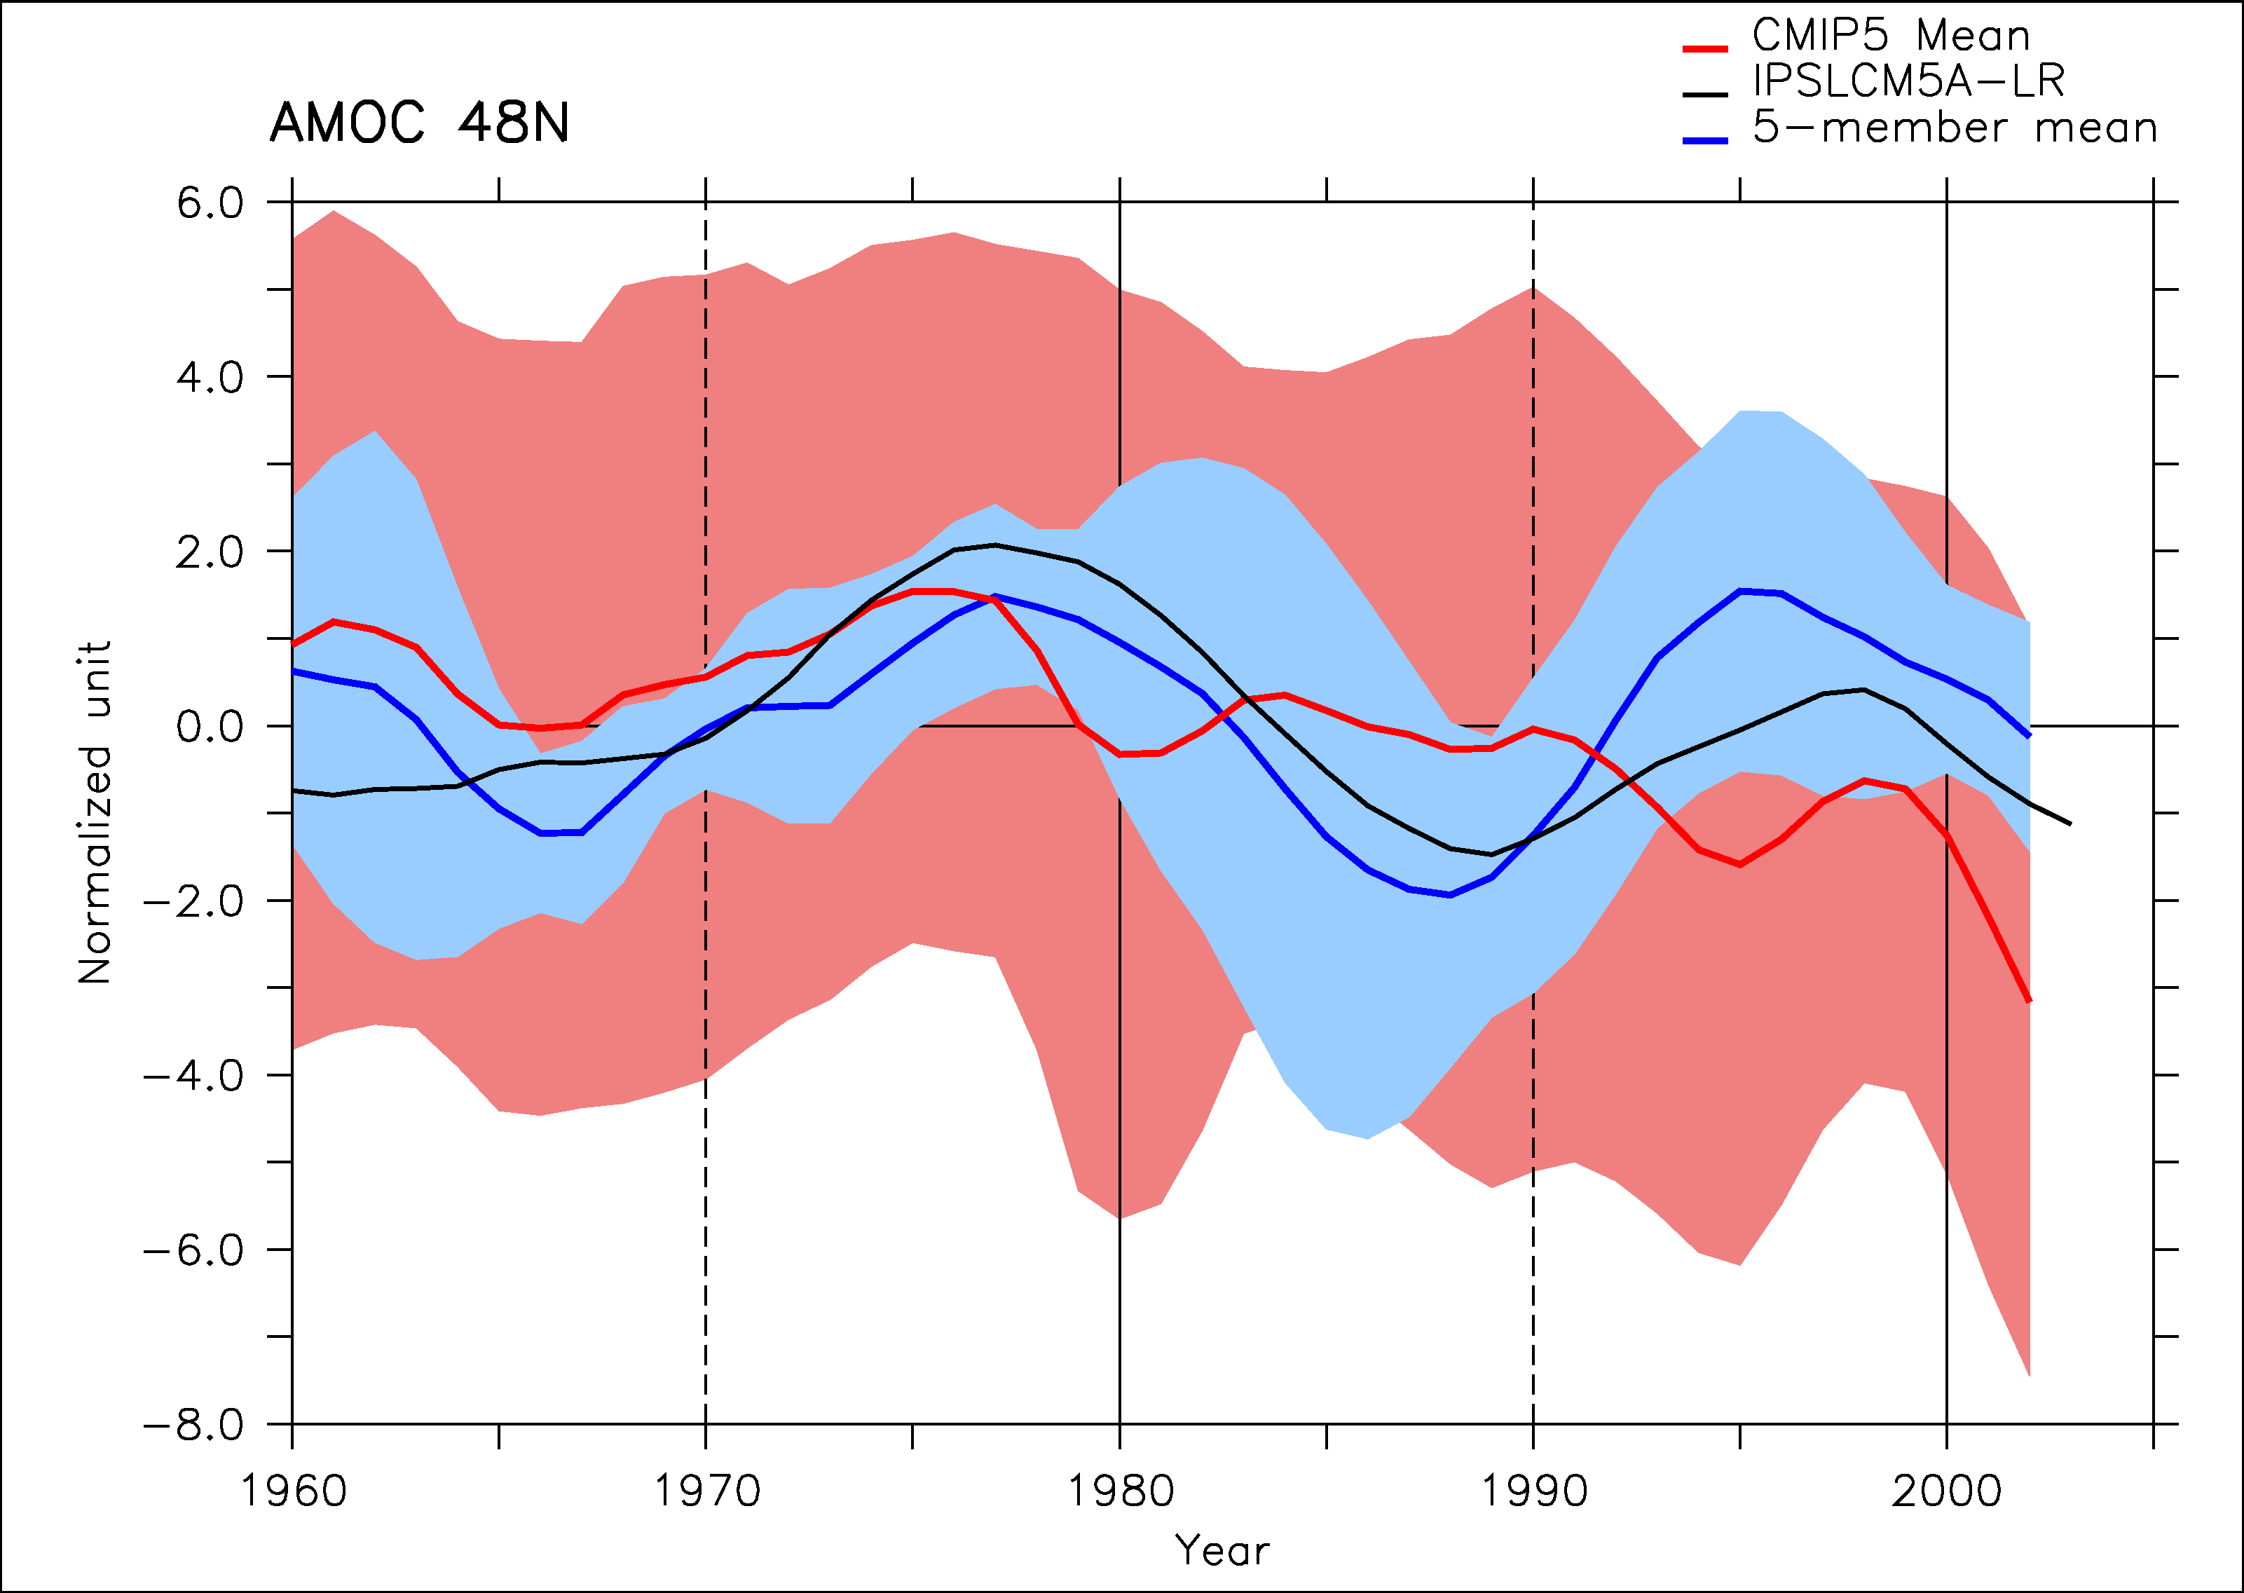
CMIP5 multi-model confirmation?
11 individual models (not different versions) from CMIP5 WITHOUT IPSLCM5A
The ensemble mean shows a maximum in AMOC just before 1980 as in IPSLCM5A
Large spread
5 models show a maximum of energy in the 12-30 yrs spectral band. Strong similarity of the response in these 5 models

Slide 16
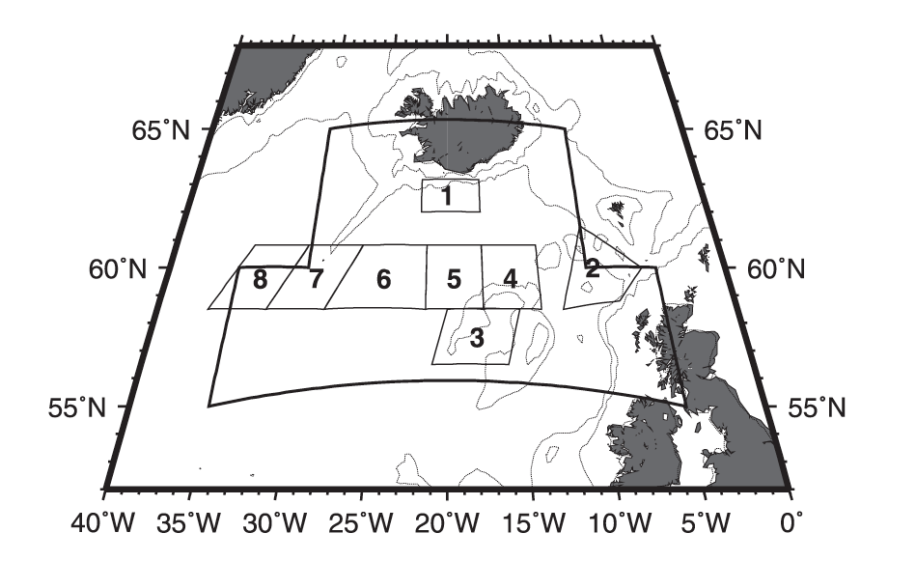
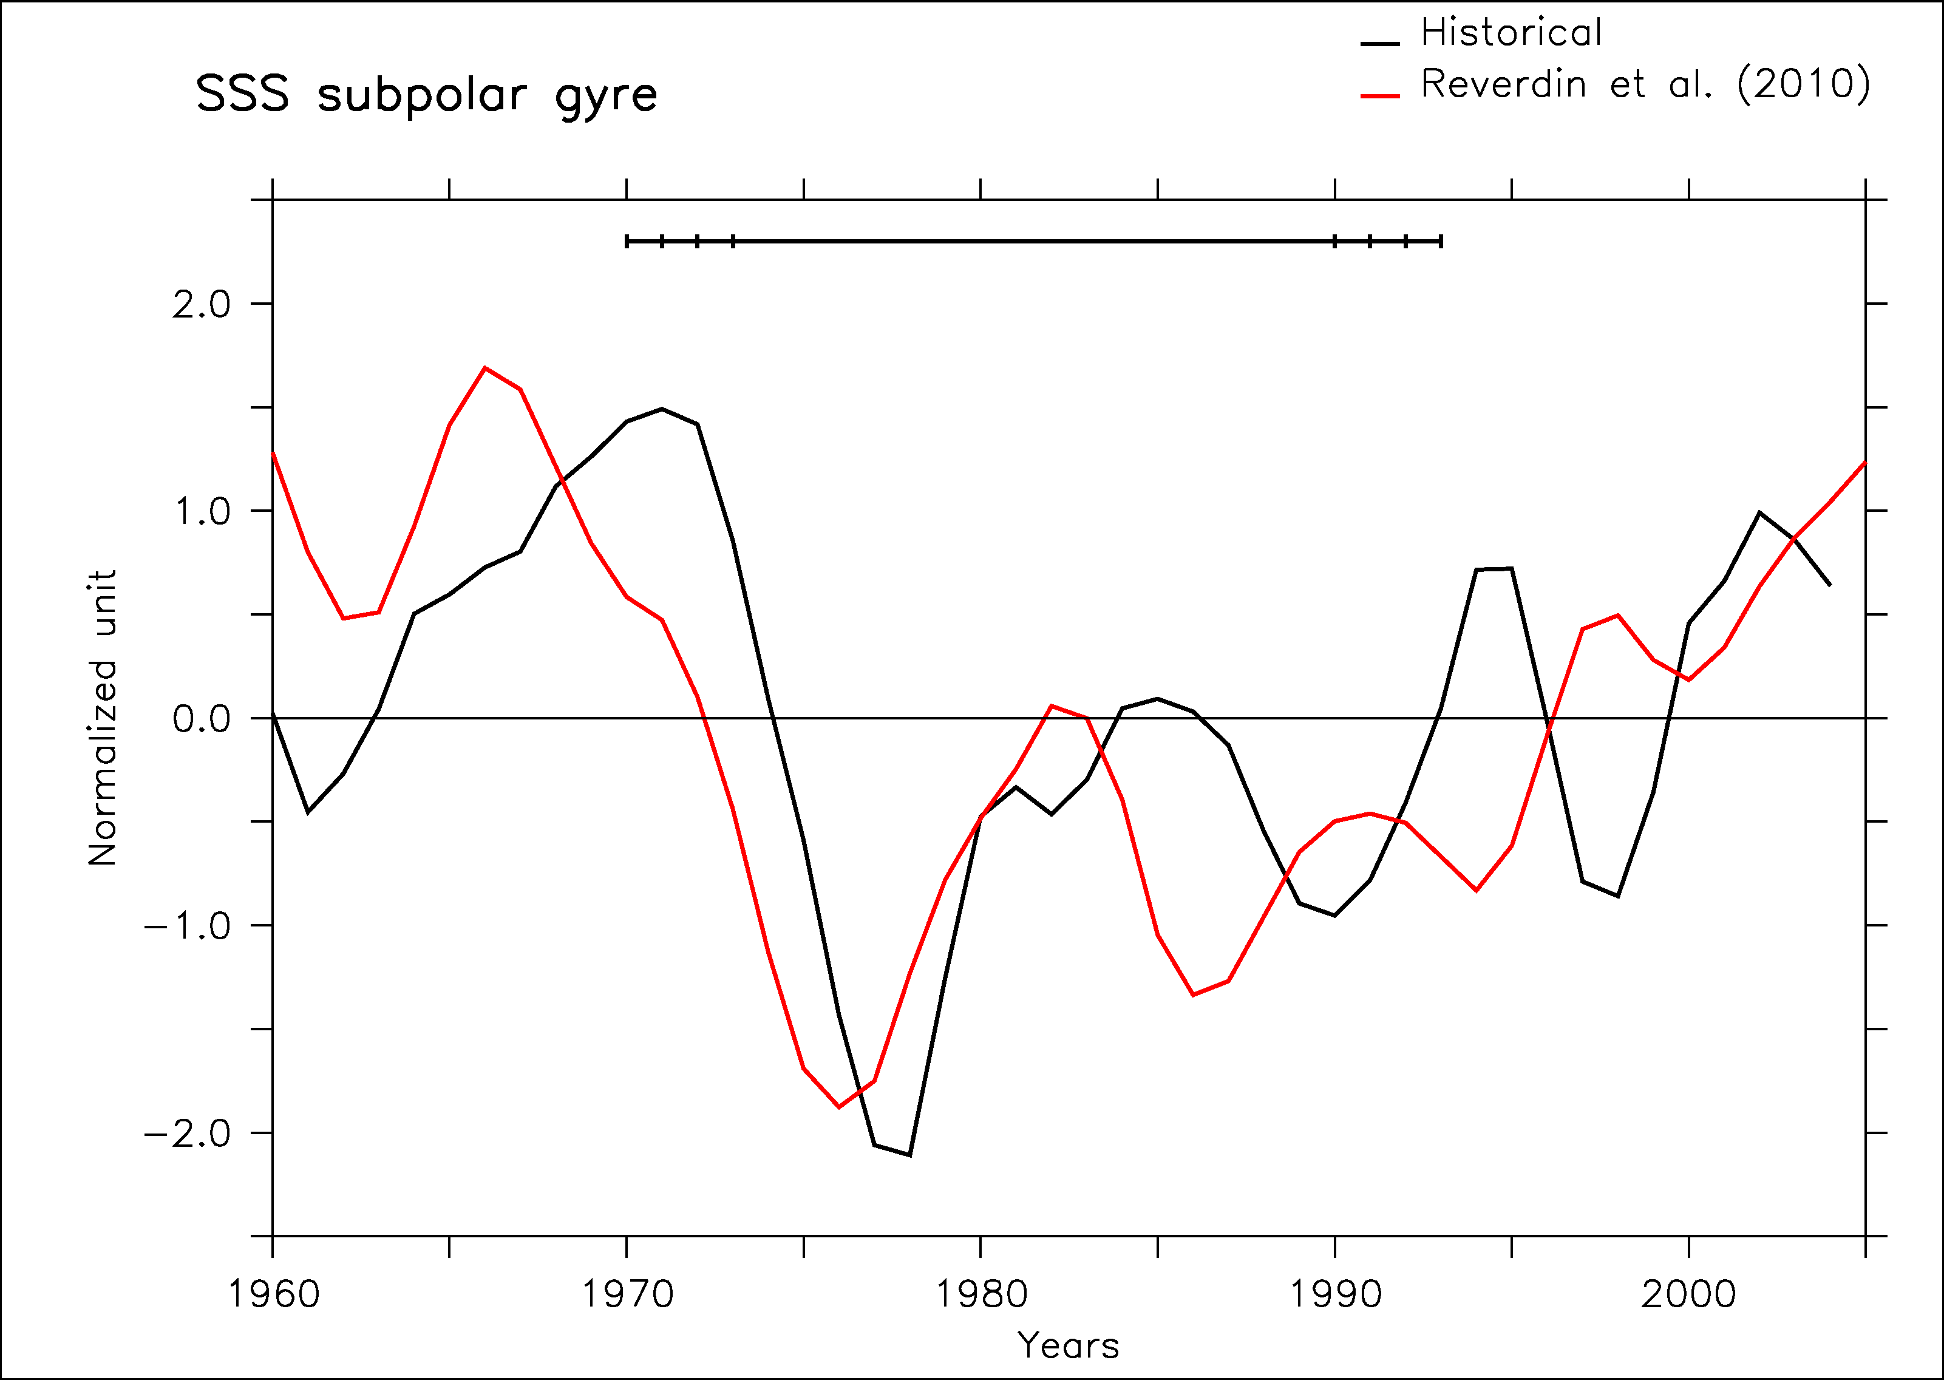
Comparison with in situ SSS in the subpolar gyre
Reverdin et al. (2010) reconstruction of SSS variability over the east subpolar gyre
Too strong variance in the model (2 times)
Agreement between historical and data from 1970 to 1994 (20-yr sliding window correlation, p<0.1)
Historical
Reverdin et al. (2010)

Slide 17
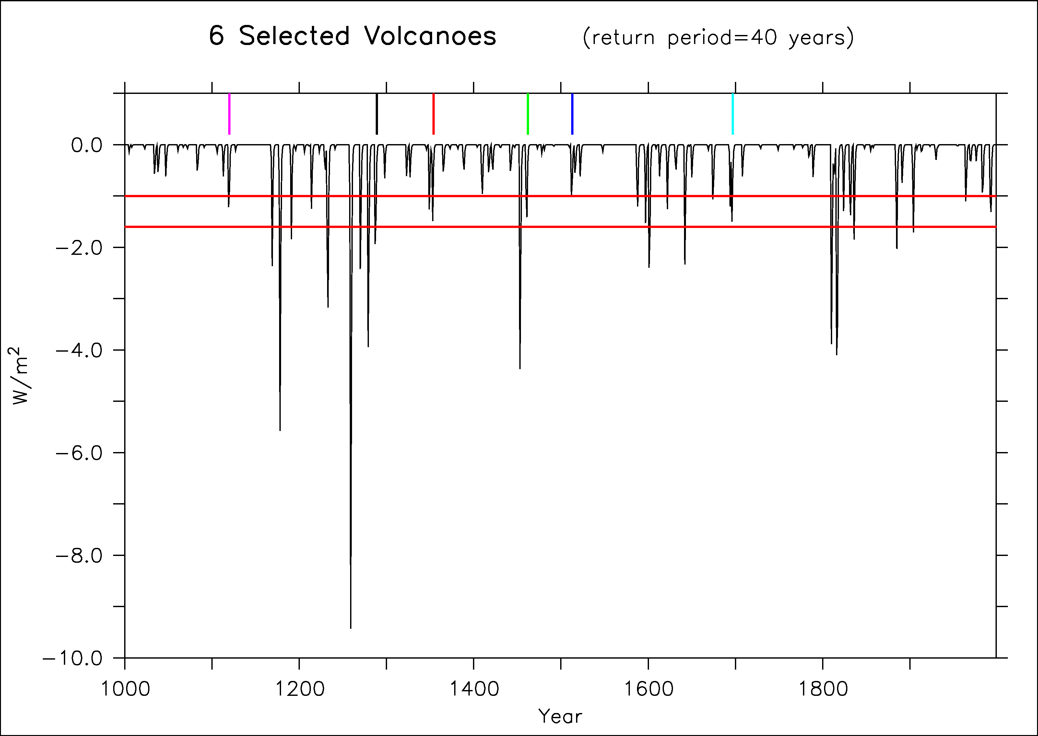
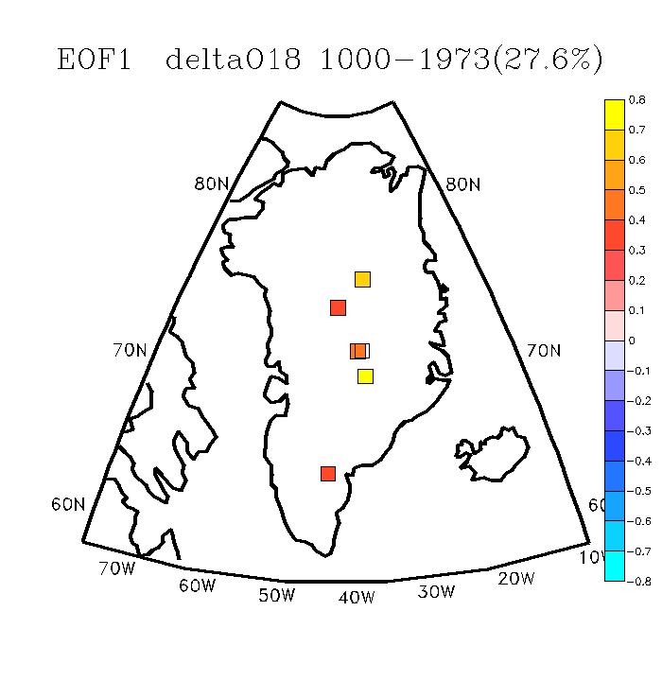
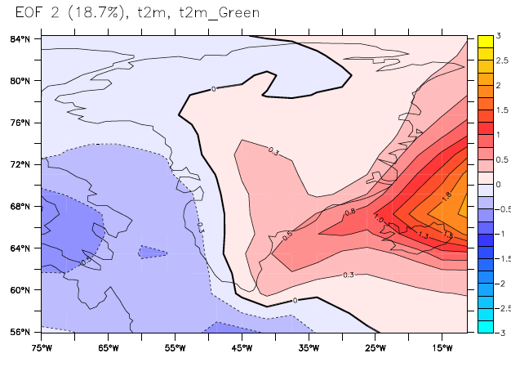
A paleo-perspective
Last millennium simulation from IPSLCM5A-LR (Khodri et al. in prep.)
We select all the volcanoes from preindustrial era that are larger than Agung but not too large
6-member ensemble
EOF1 of Compilation of 6 ice cores reconstructing Greenland O¹⁸ over the last millennium (Ortega et al. in prep.)
EOF1 δO¹⁸ ice cores
EOF2 t2m model

Slide 18
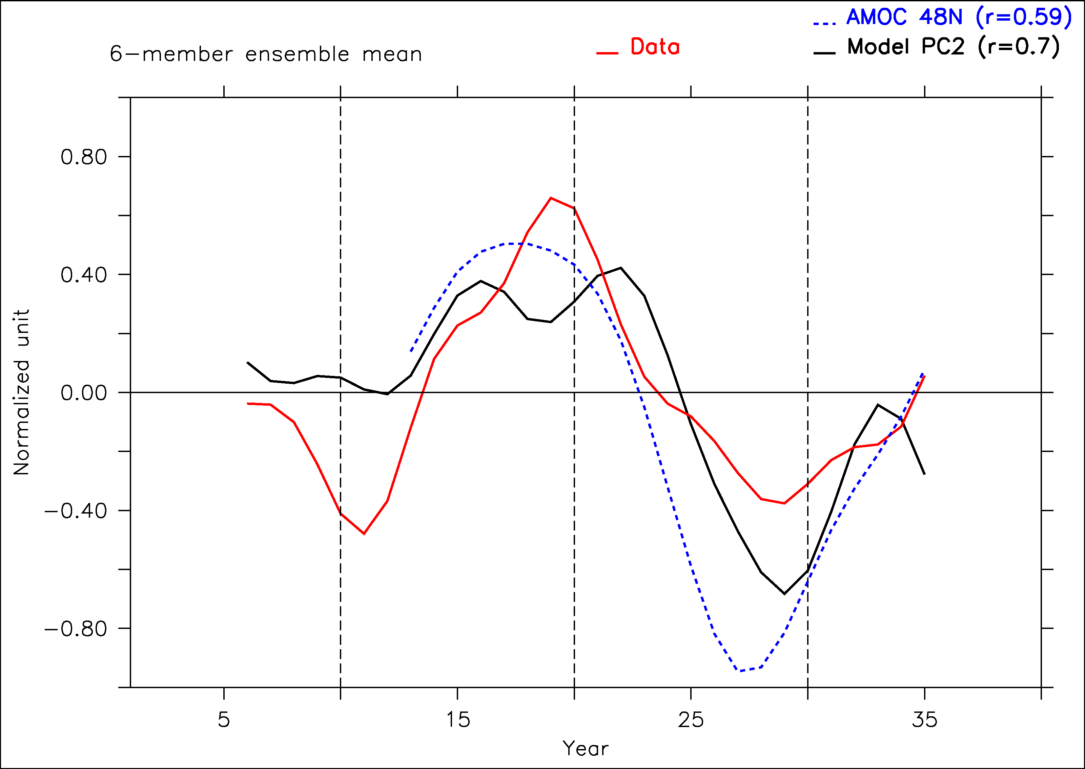
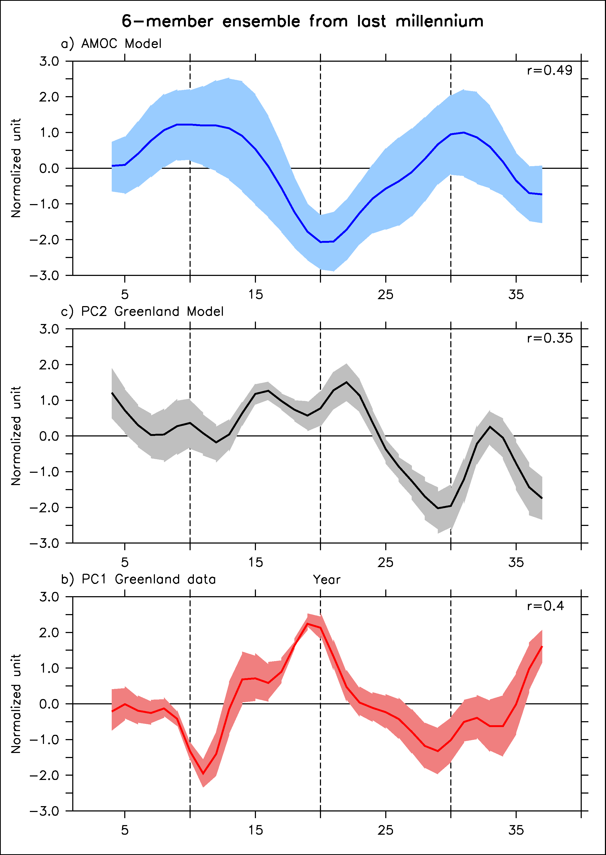
A paleo-perspective
We select the same timeseries following volcanoes in data and in PC2 of t2m of the model over Greenland
Significant correlation both in model and data, following AMOC variations by around 5 years
EOF2 t2m model
EOF1 δO¹⁸ ice cores
Notes:
Explain better the link AMOC temperature: bring warm water in Nordic Seas after a delay of 5-7 years
Faire PC1-HadISST in supplementary

Slide 19
Conclusions
Volcanic eruption precedes an AMOC maximum by around 10-15 years
Effect of Pinatubo: destructive interference!
NAO still explains large amount of variance as compared to this mechanism of 20-yr cycle excitation by volcanoes
Impact of volcanoes also very clear in a 5-member CMIP5 ensemble
Consistent with in situ SSS in the subpolar gyre
And data of Greenland over the last millennium
large body of evidences confirming potential reality of these processes in response to volcanic eruptions

Slide 20
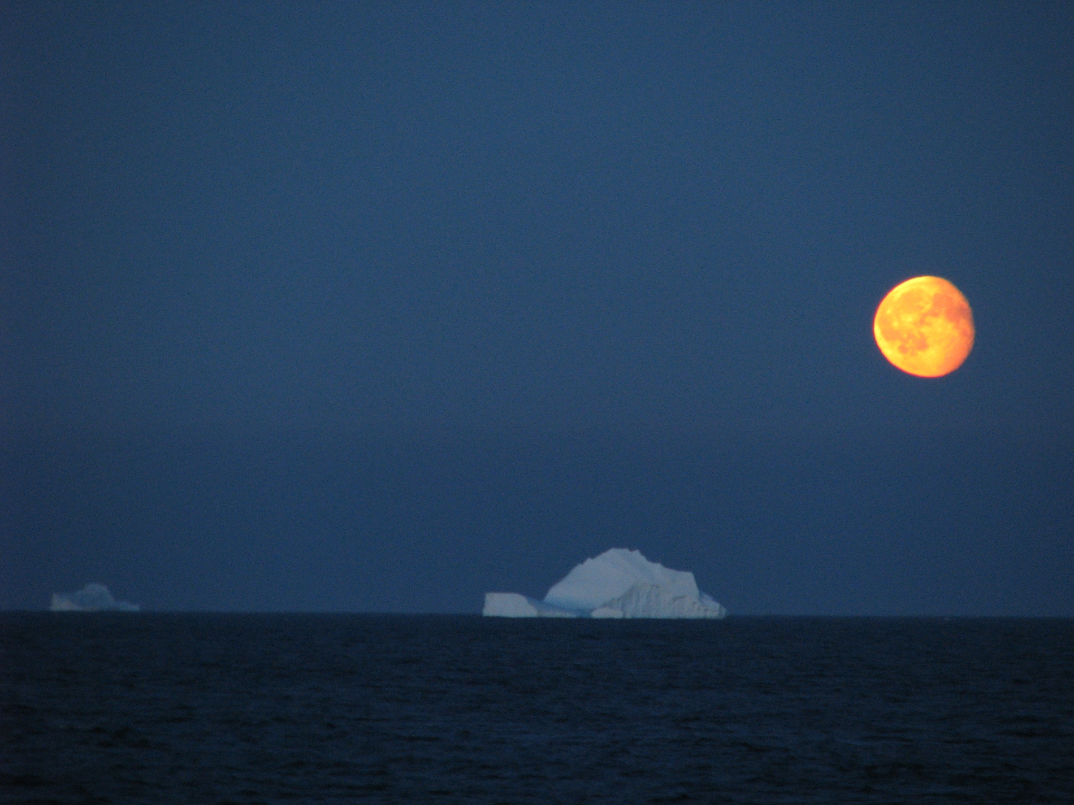
Thank you
Didier.Swingedouw@lsce.ipsl.fr
Courtesy of Bruno Ferron, OVIDE 2010

Slide 21
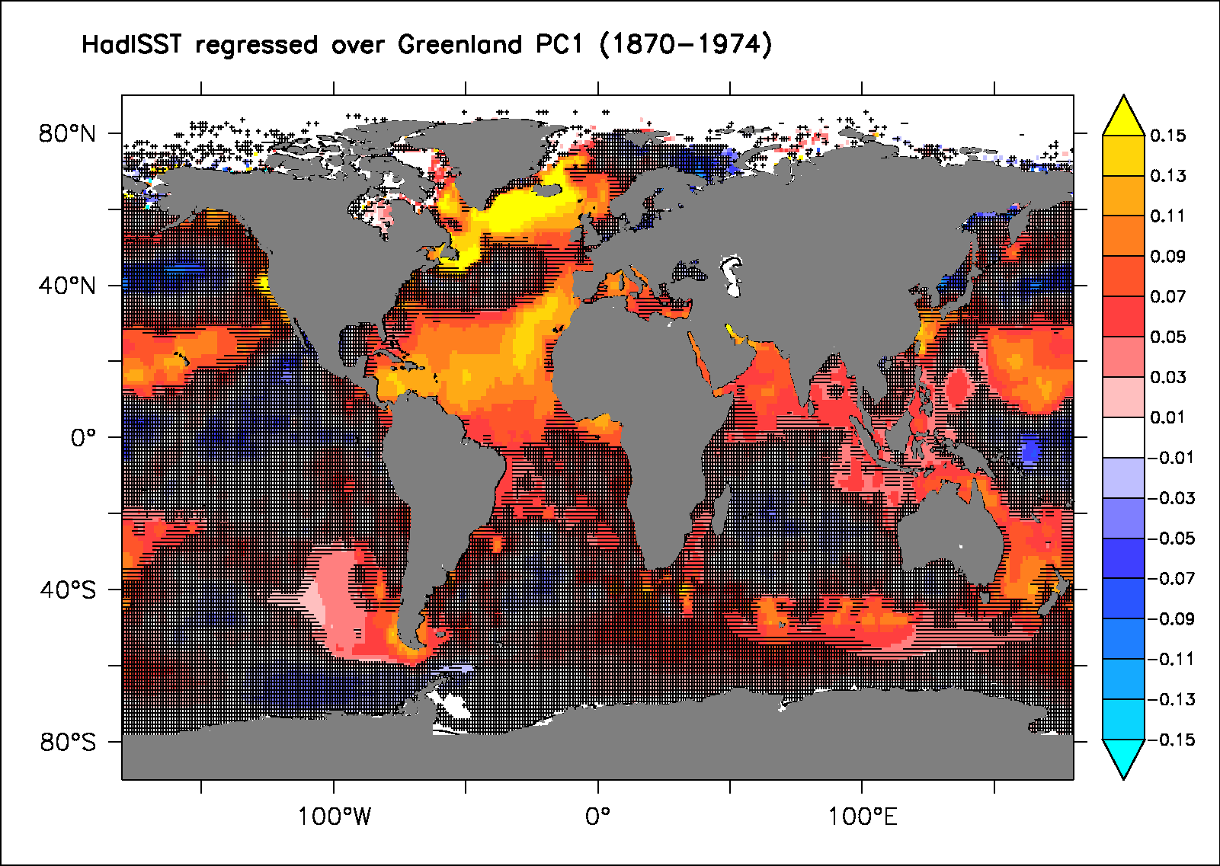
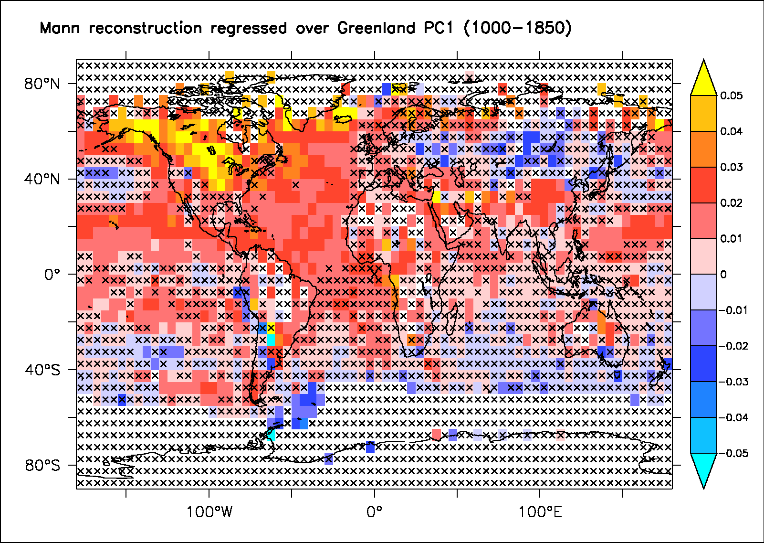
Link between PC1 over Greenland and the AMO

Slide 22
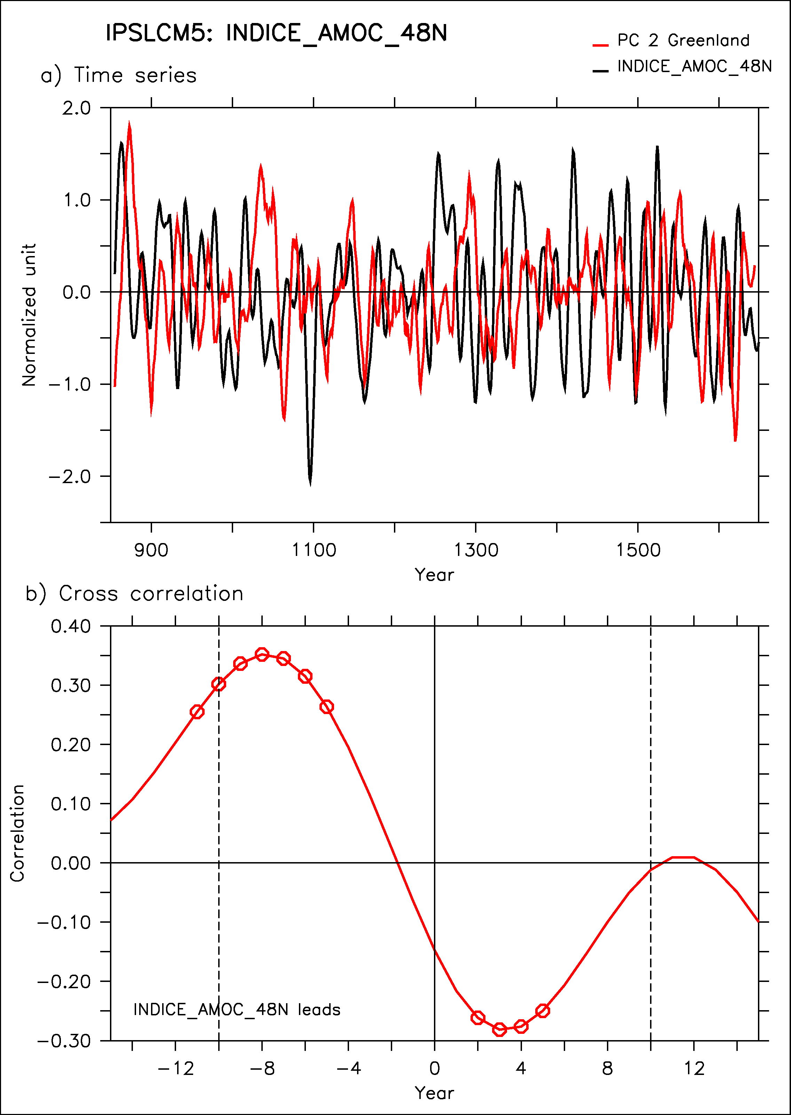
A paleo-perspective
In the model, the AMOC indeed leads by 7 years the PC2 of Greenland t2m for the whole simulation
Notes:
Explain better the link AMOC temperature: bring warm water in Nordic Seas after a delay of 5-7 years
Faire PC1-HadISST in supplementary

Slide 23
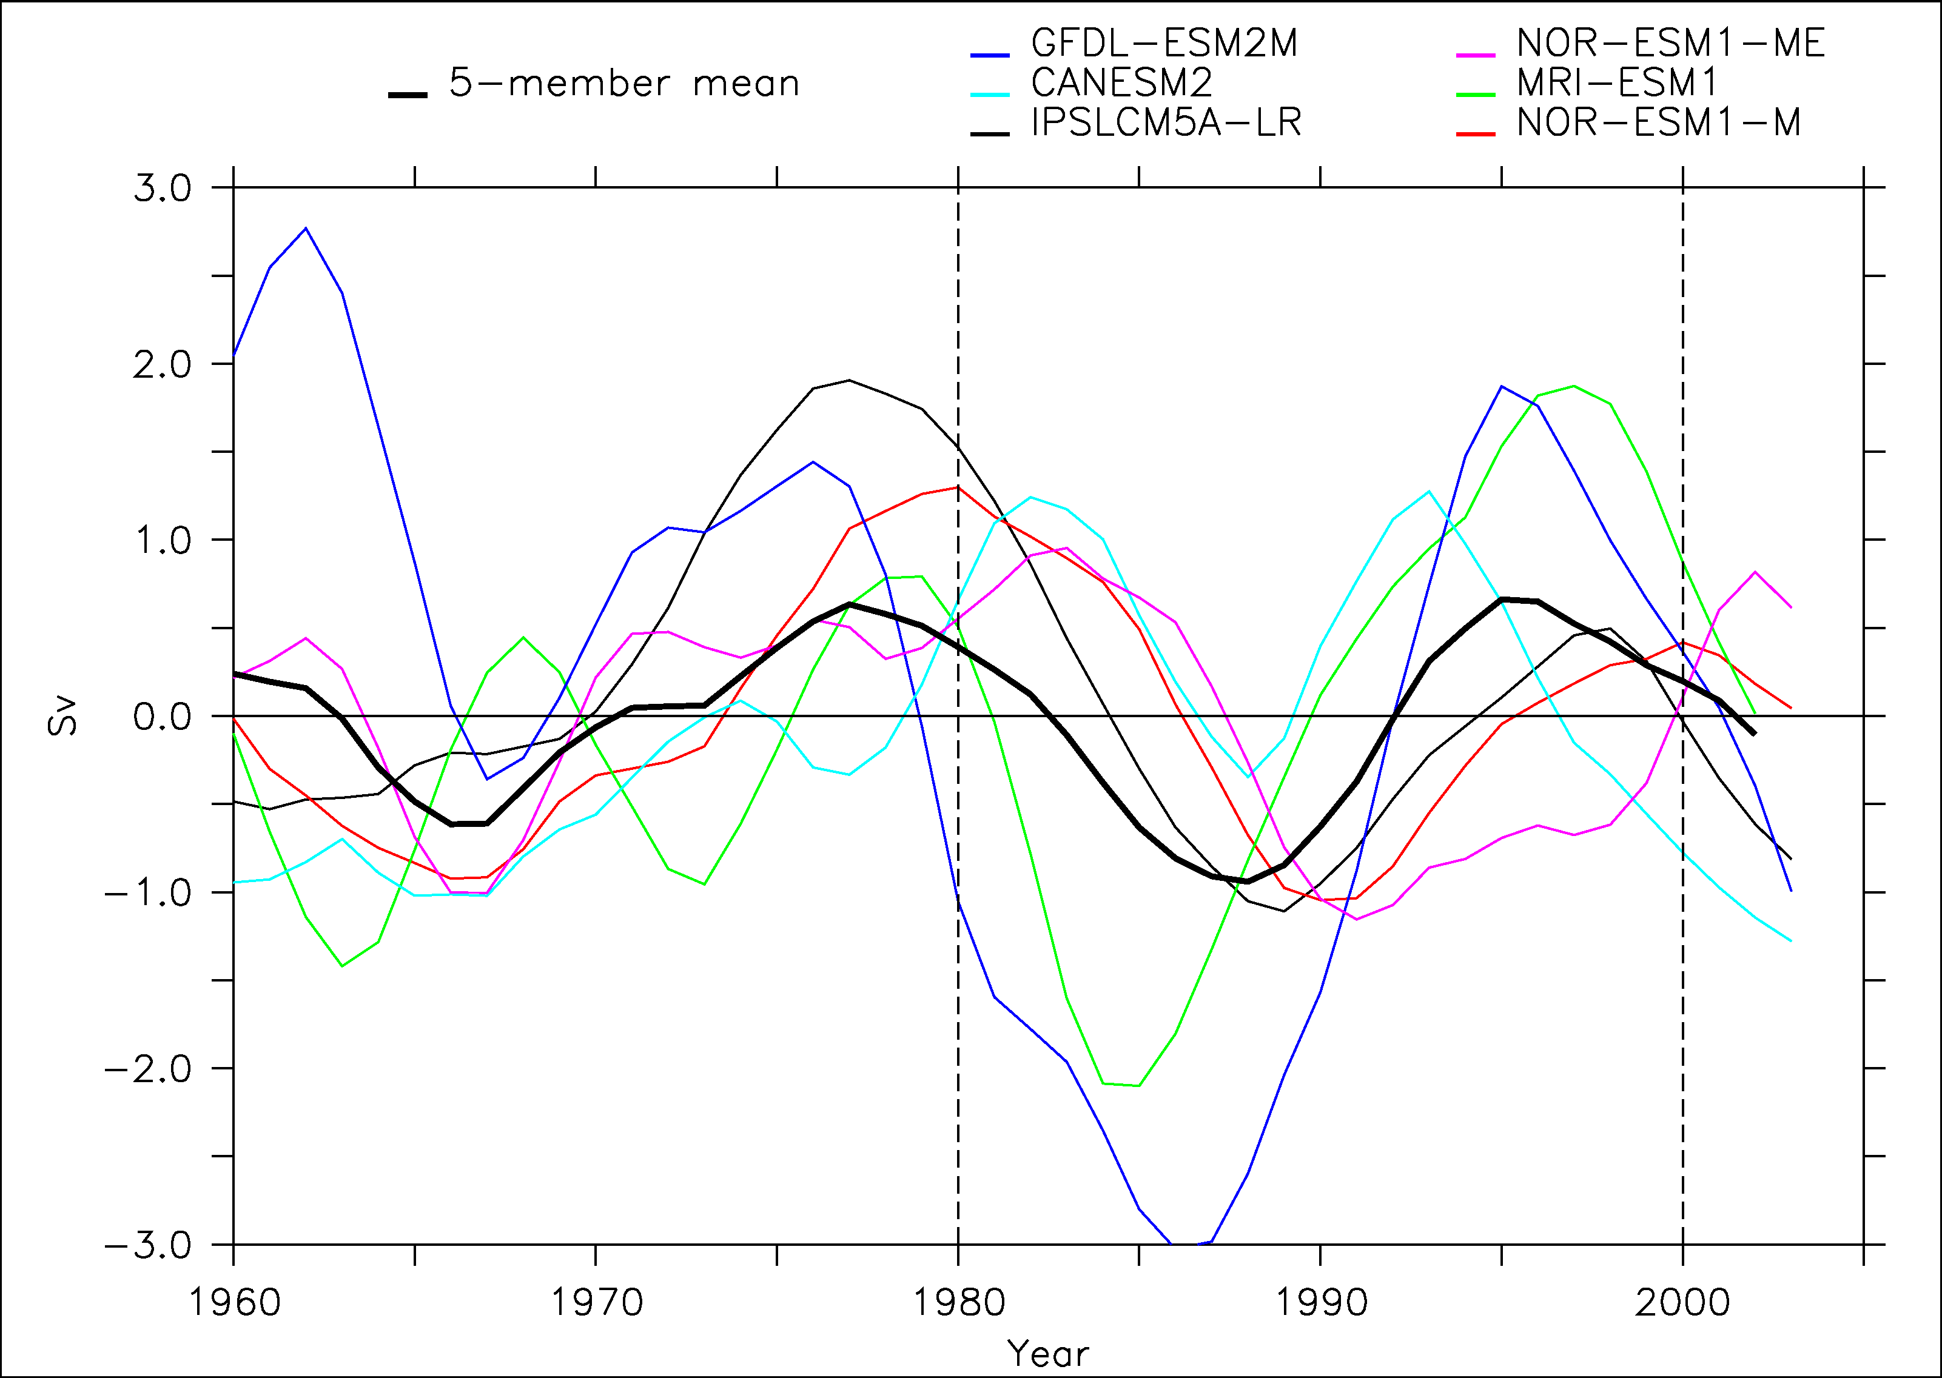
A multi-model confirmation?
11 individual models (not different versions) from CMIP5 WITHOUT IPSLCM5A-LR
The ensemble mean shows a maximum in AMOC just before 1980 as in IPSLCM5A-LR
Large spread
5 models show a maximum of energy in the 12-30 yrs spectral band. Strong similarity of the response in these five models

Slide 24
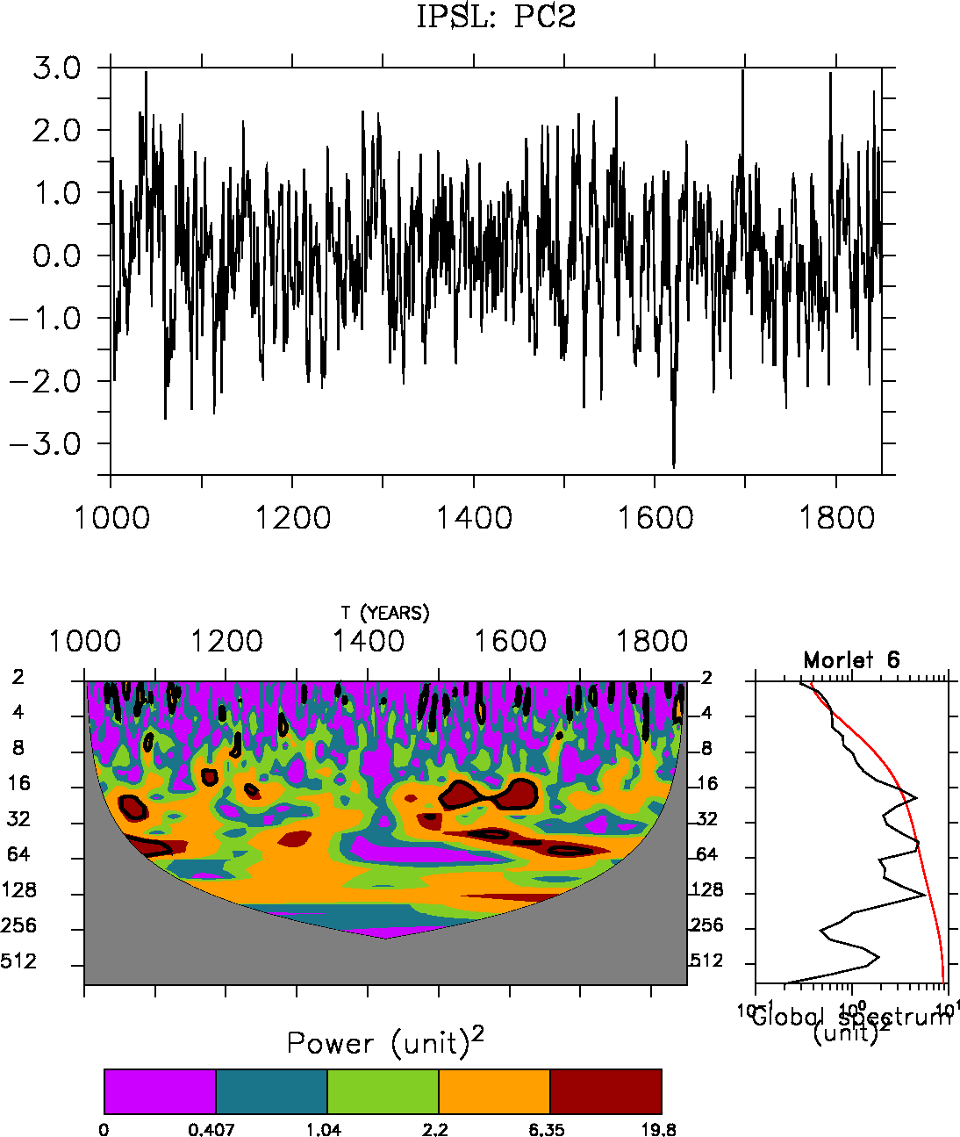
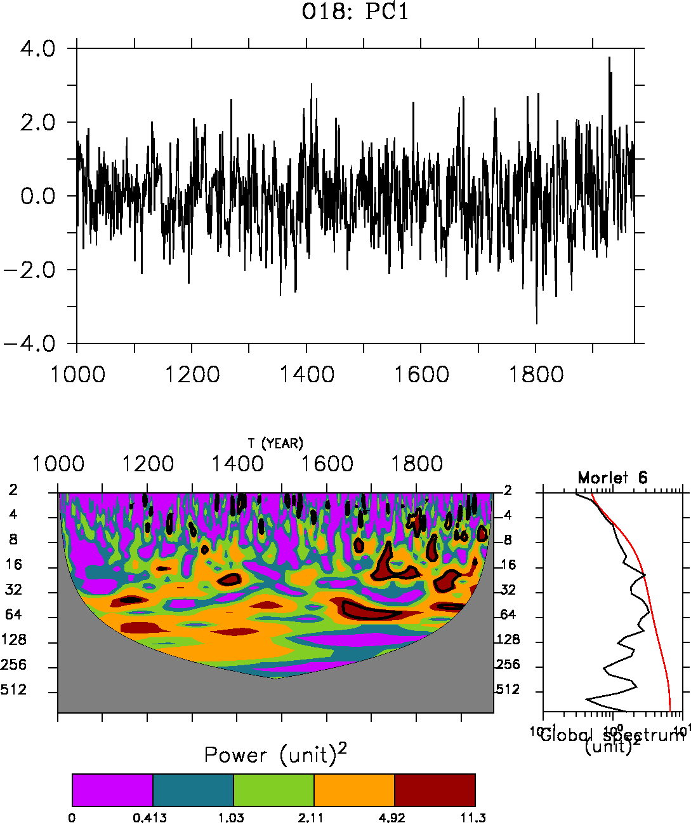
A paleo-perspective
EOF1 δO¹⁸ ice cores
Notes:
Explain better the link AMOC temperature: bring warm water in Nordic Seas after a delay of 5-7 years
Faire PC1-HadISST in supplementary

Slide 25
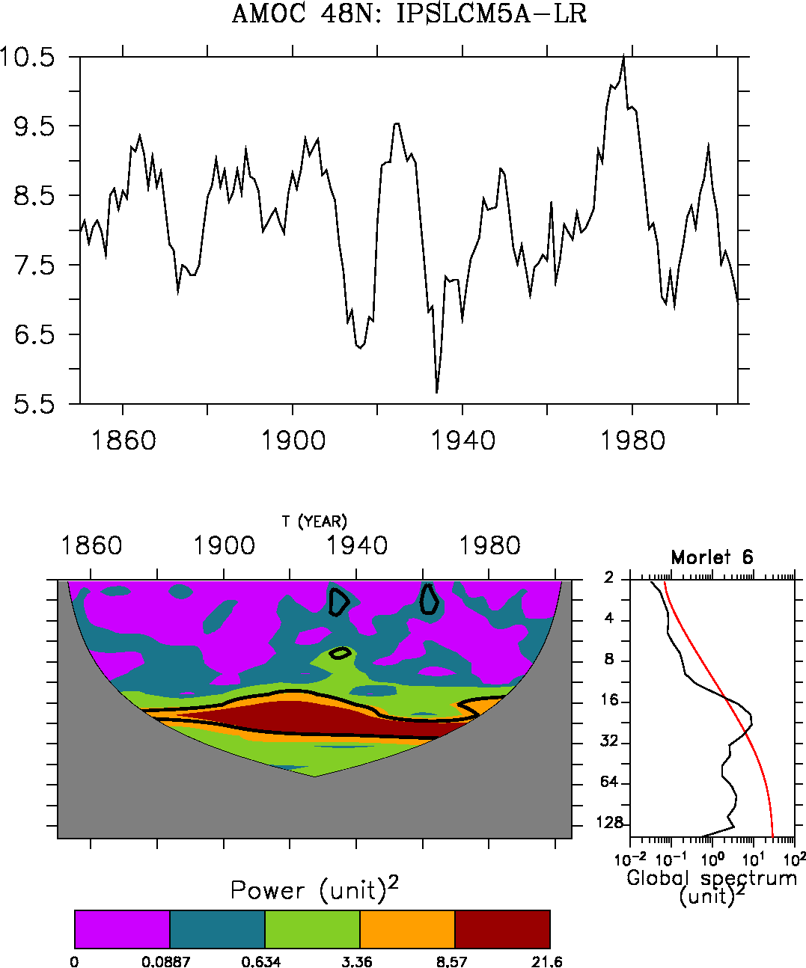
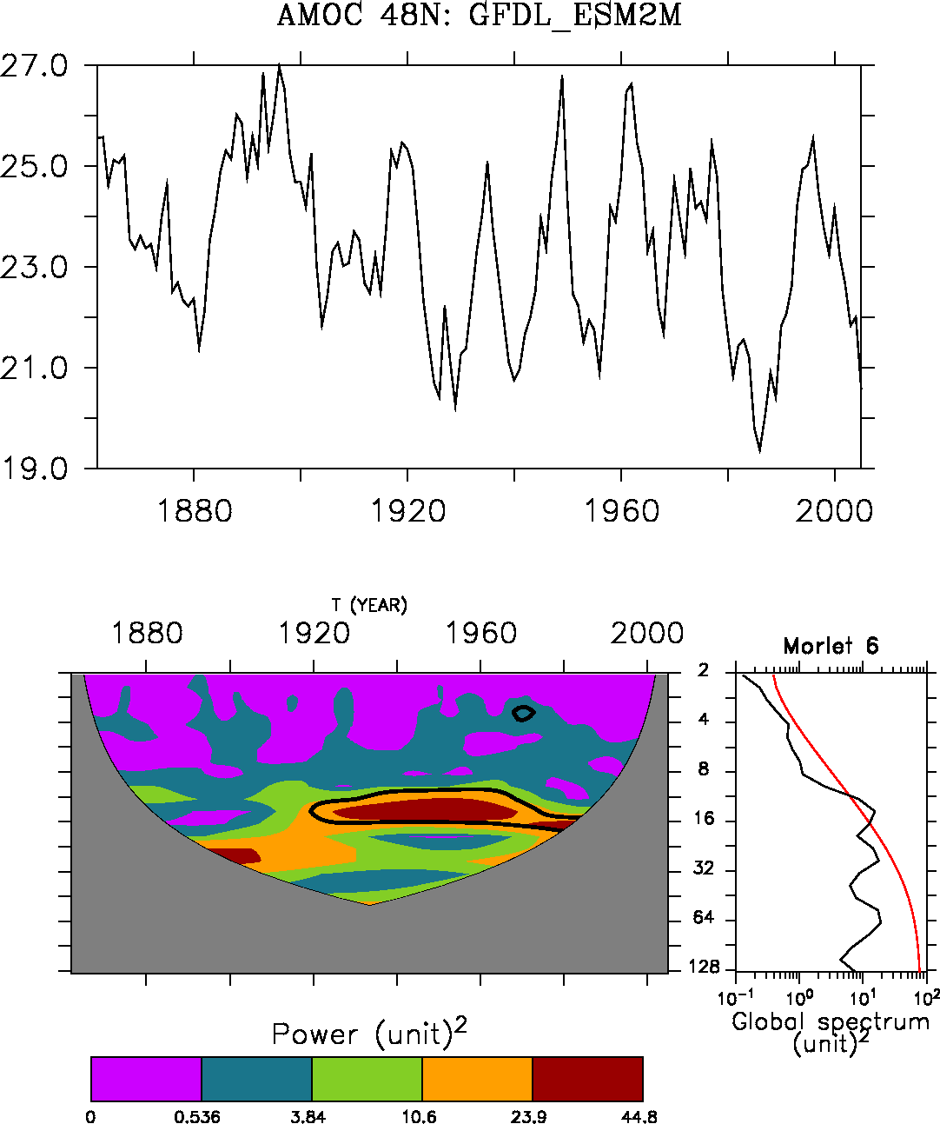
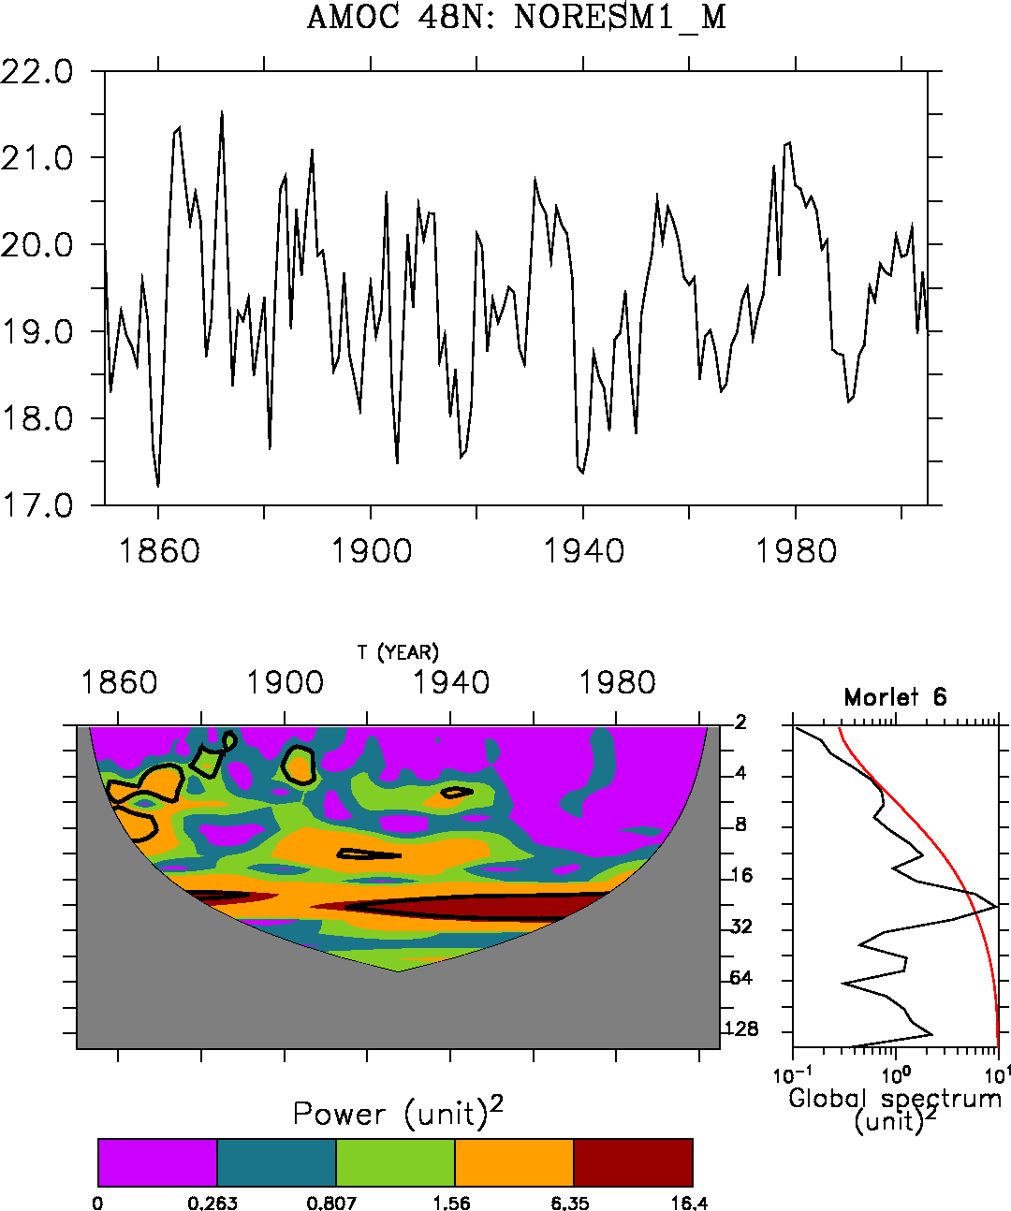
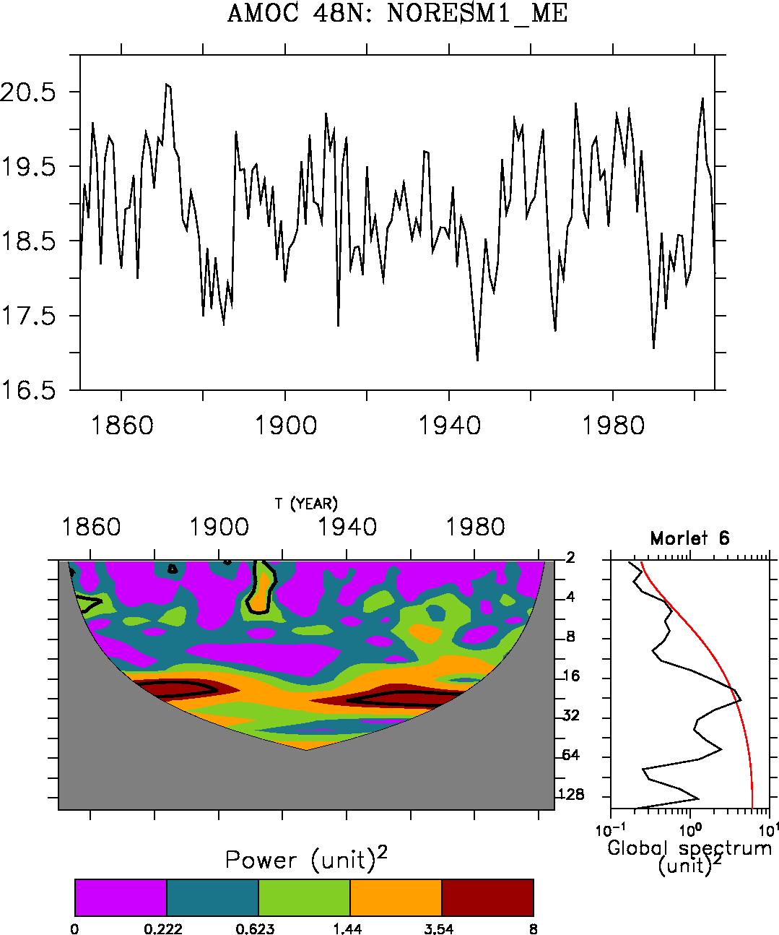
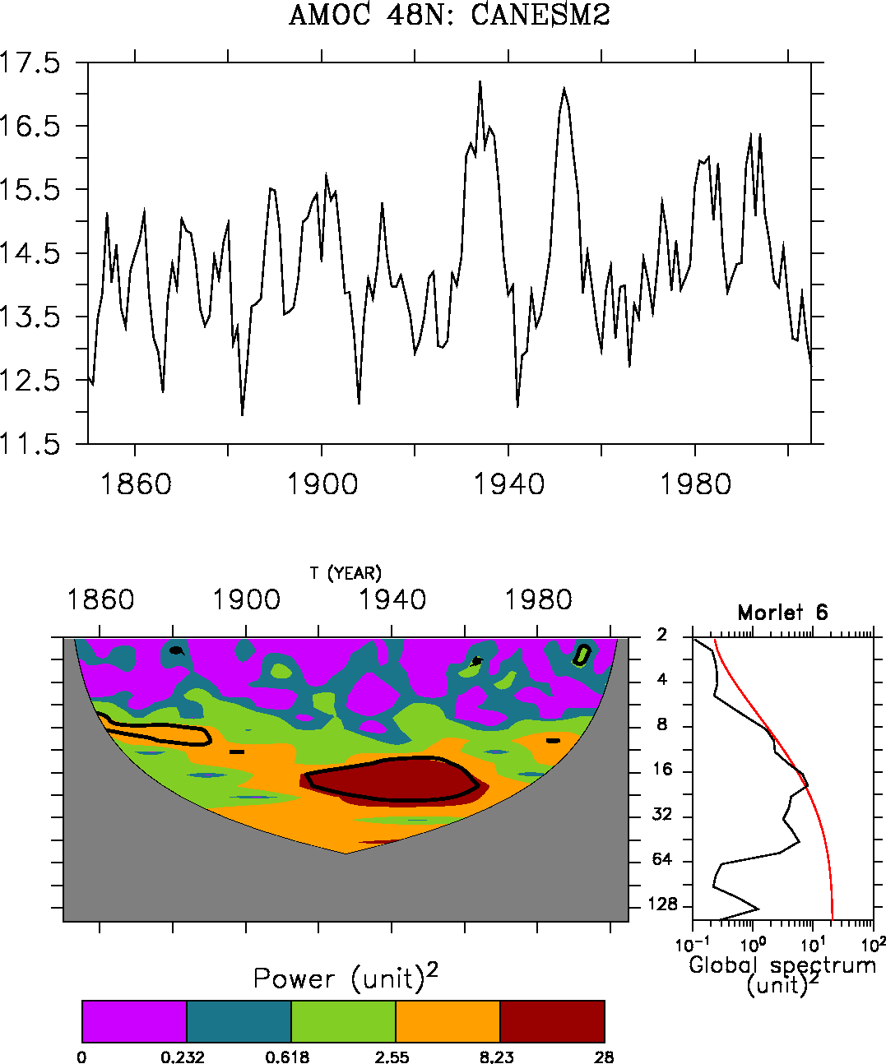
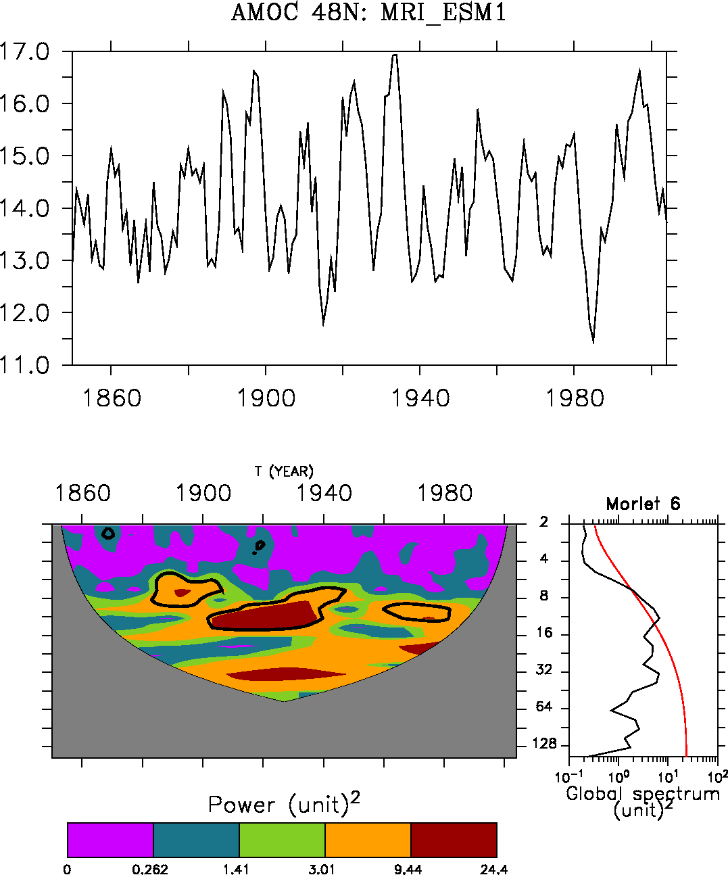

Slide 26
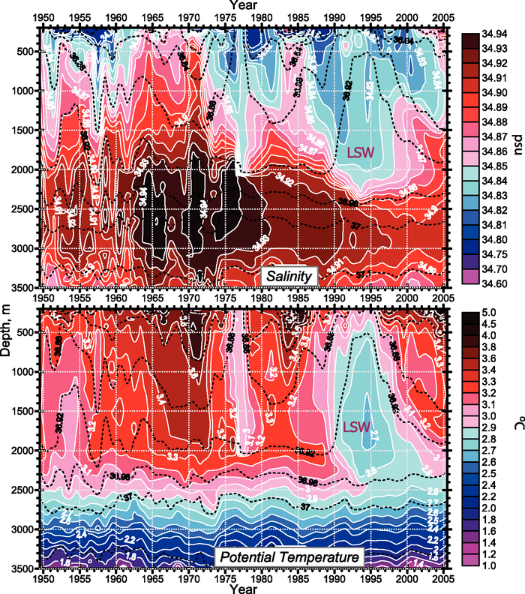
In situ Labrador Sea variation
GSA
GSA
GSA
The 1985 GSA is clearly different from 1972 and 1993 in the sense that there is a subsurface positive anomaly
Belkin et al. (1998): two modes of GSA, one remote (Artic) and one more local (1980s)
Central Labrador Sea from 1949 to 2005 (updated from Yashayaev et al., 2003)
Source IPCC 2007

Slide 27
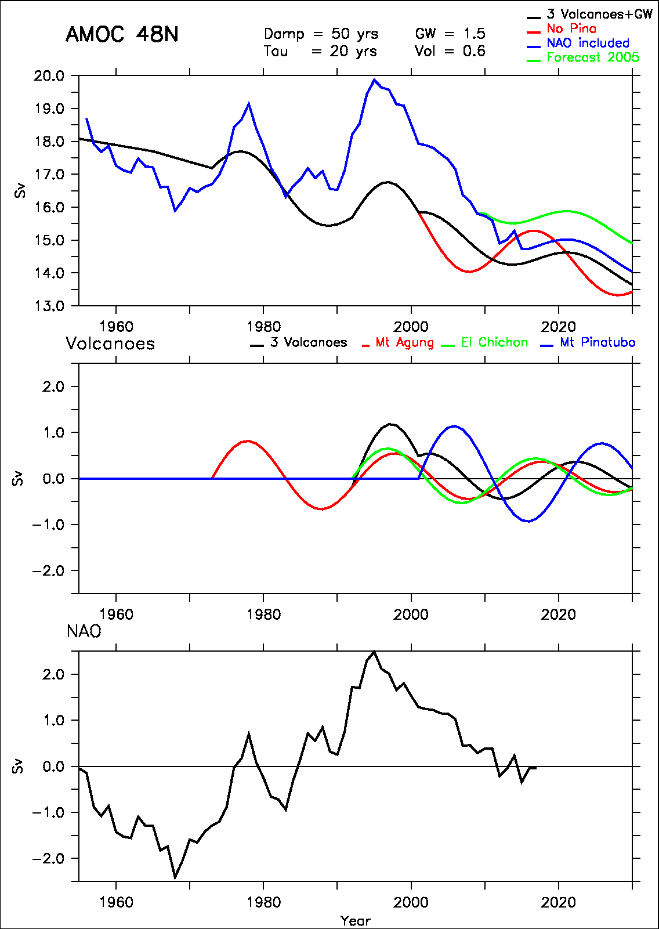
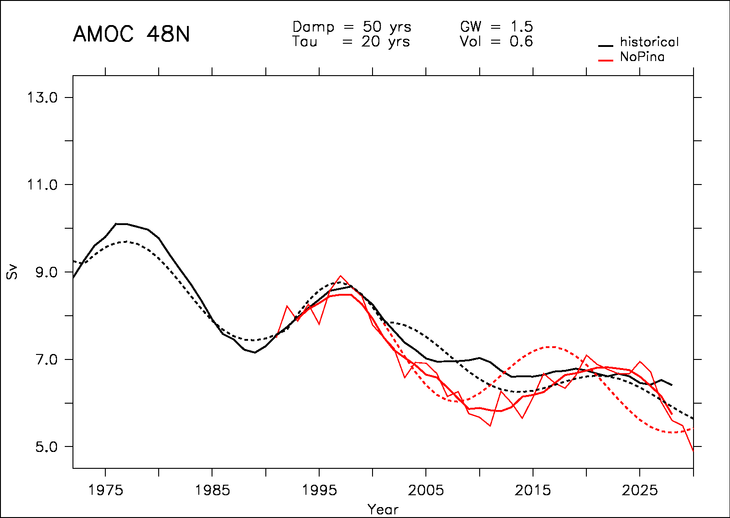
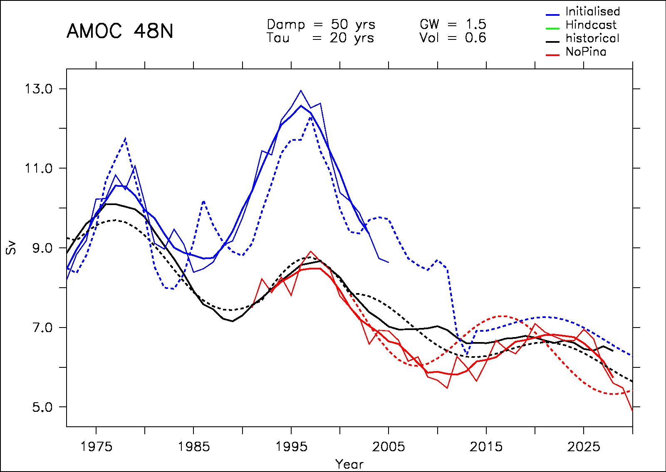
Comparison of the AMOC forcings
NAO forcing is larger than that from volcanoes
Over the period 1973-2018:
  Std volcanoes =0.54 Sv
  Std NAO = 0.93 Sv

Slide 28
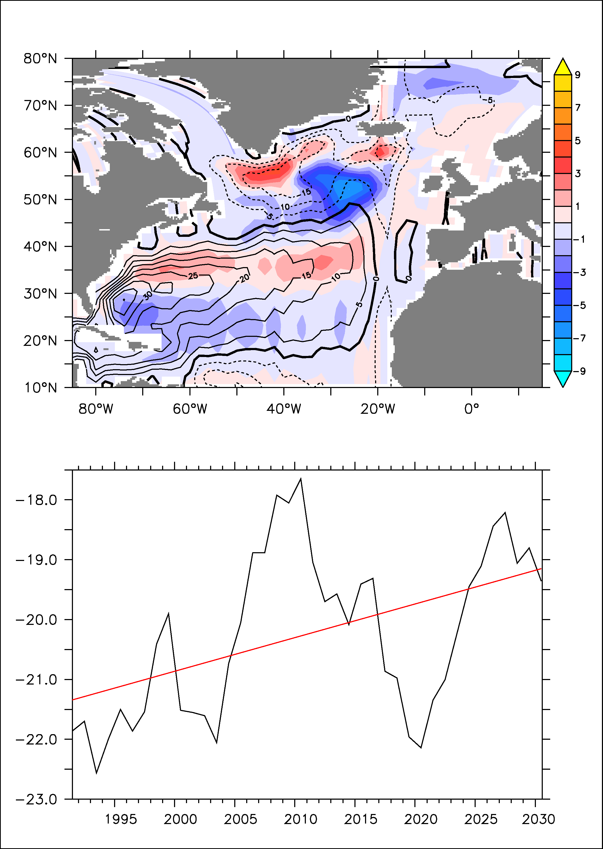
Slow down of the subpolar gyre
Gyre changes (2010-2030 vs 1850-1950
The 20-yr cycle in the model is dependant on the subpolar gyre strength (anomalies propagation)
The subpolar gyre is slowing down in the model (10% in 40 years)
To improve the model we can take into account this slowing down
Subpolar gyre index in NoPina

Slide 29

Accounting for the slow down of the subpolar gyre
To improve the model we take into account the slowing down of the subpolar gyre (10% in 40 years)

Slide 30
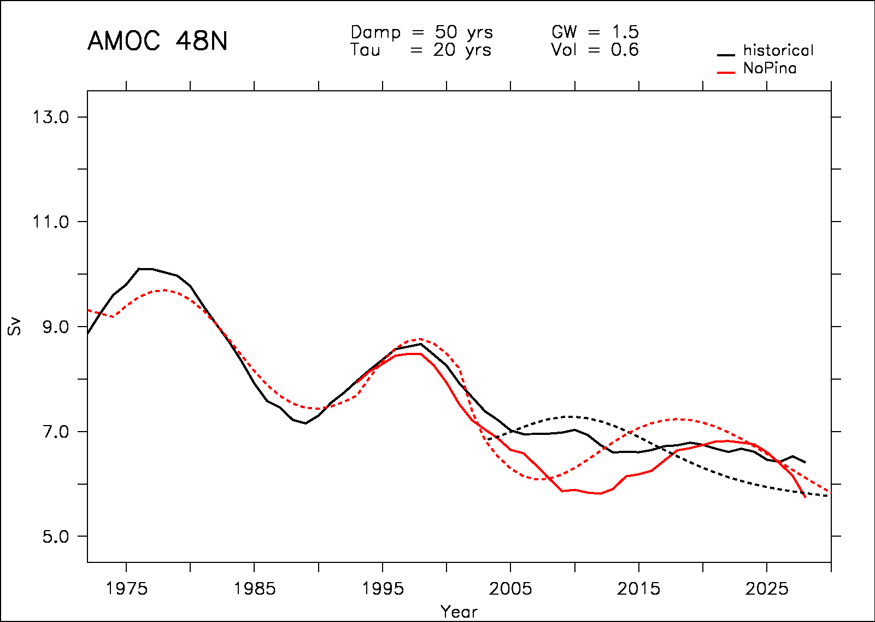
Accounting for the slow down of the subpolar gyre
To improve the model we take into account the slowing down of the subpolar gyre (20% in 20 years from 1990 to 2010)

Slide 31
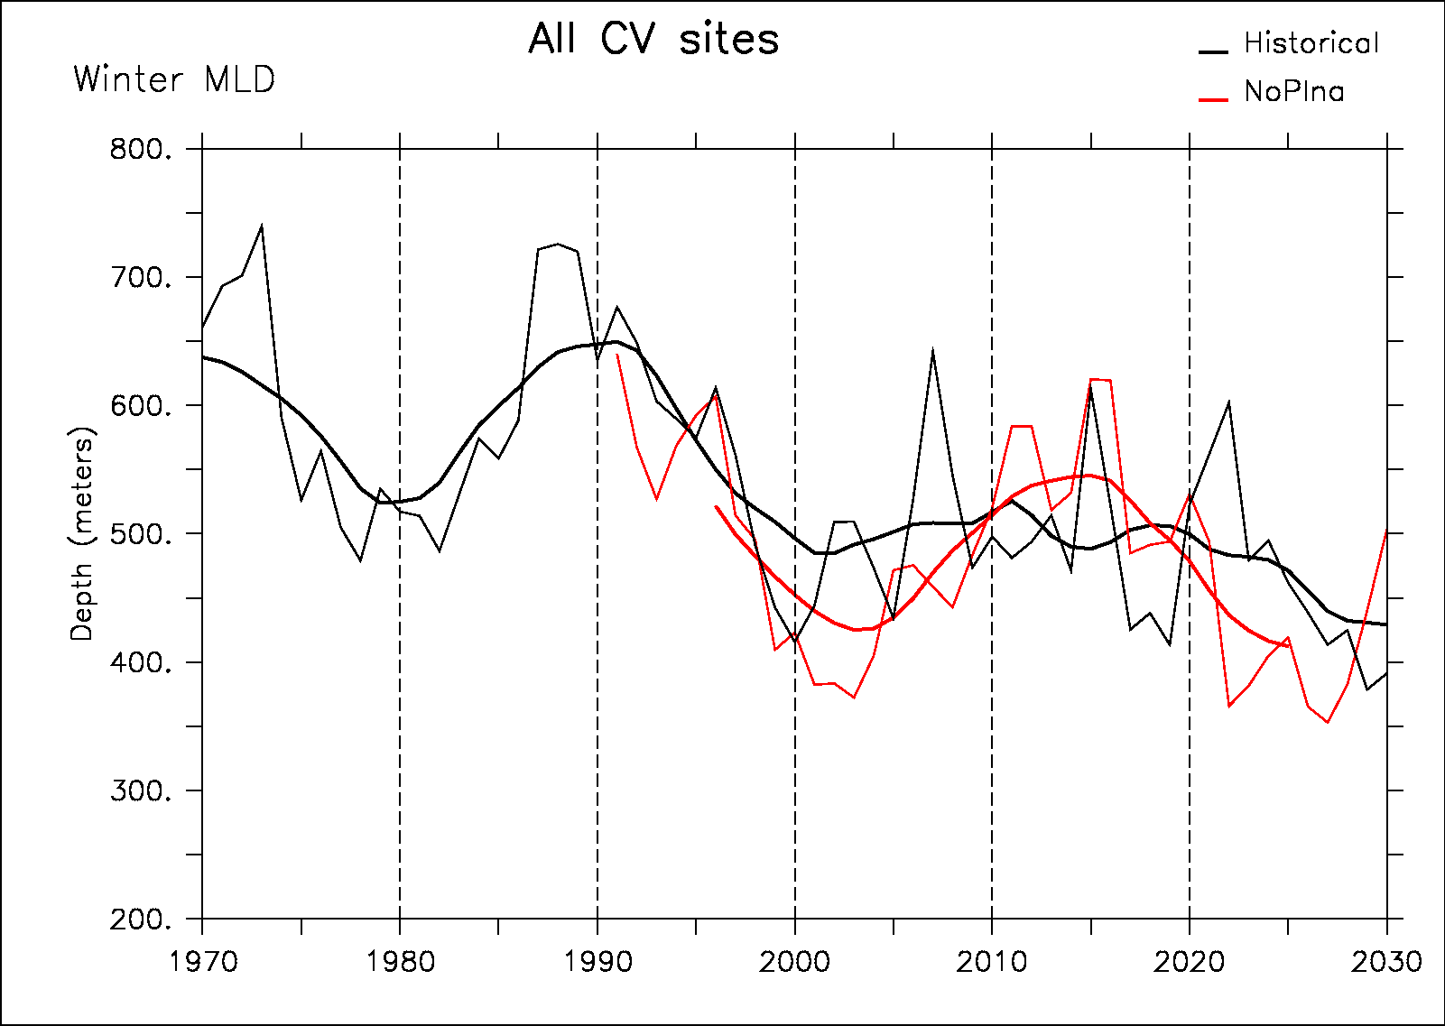
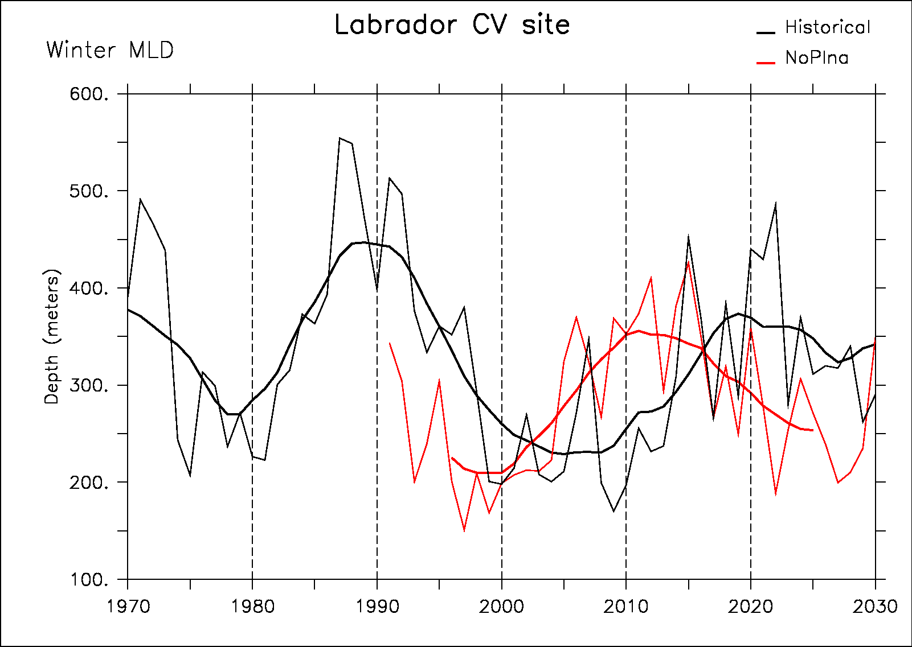
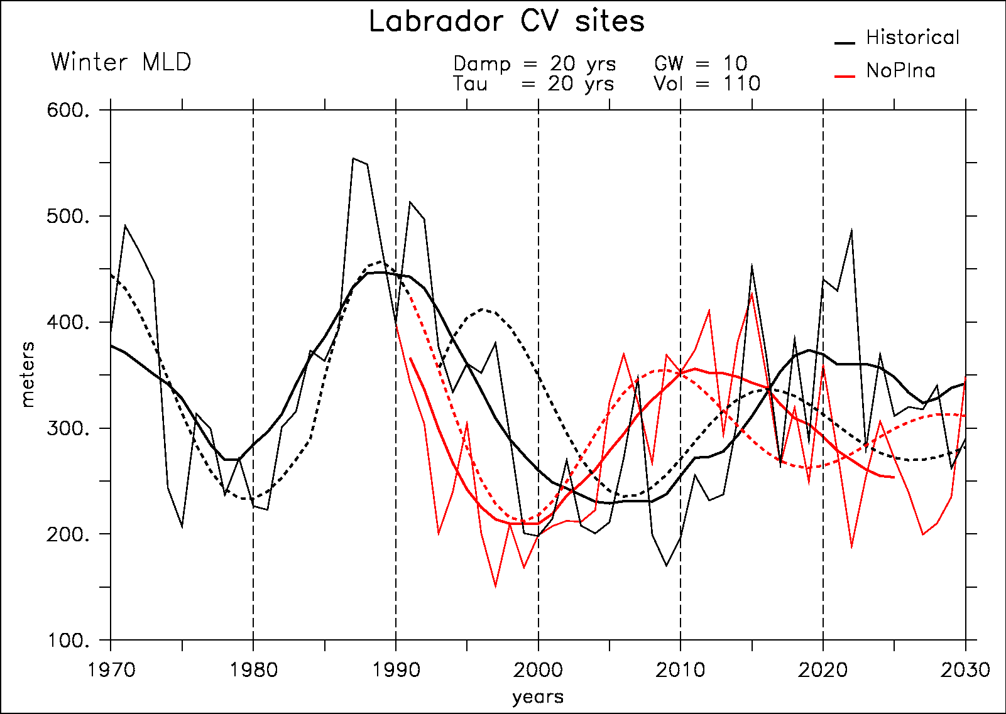
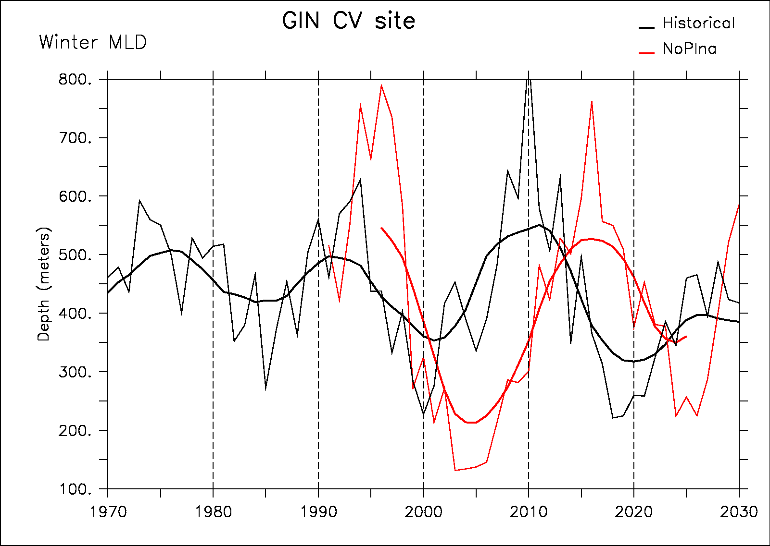
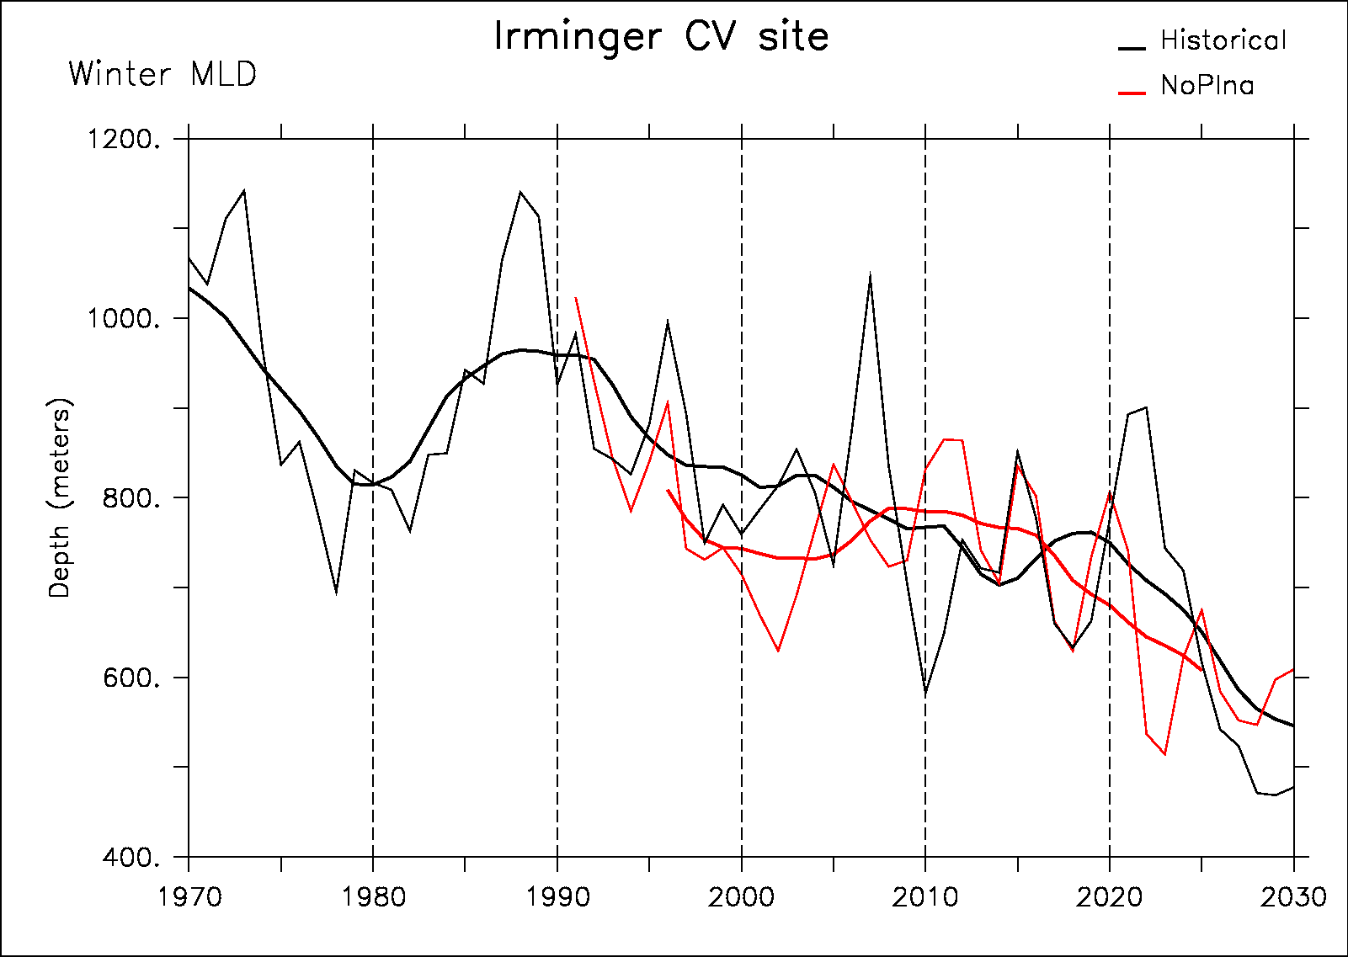
Convection sites response

Slide 32
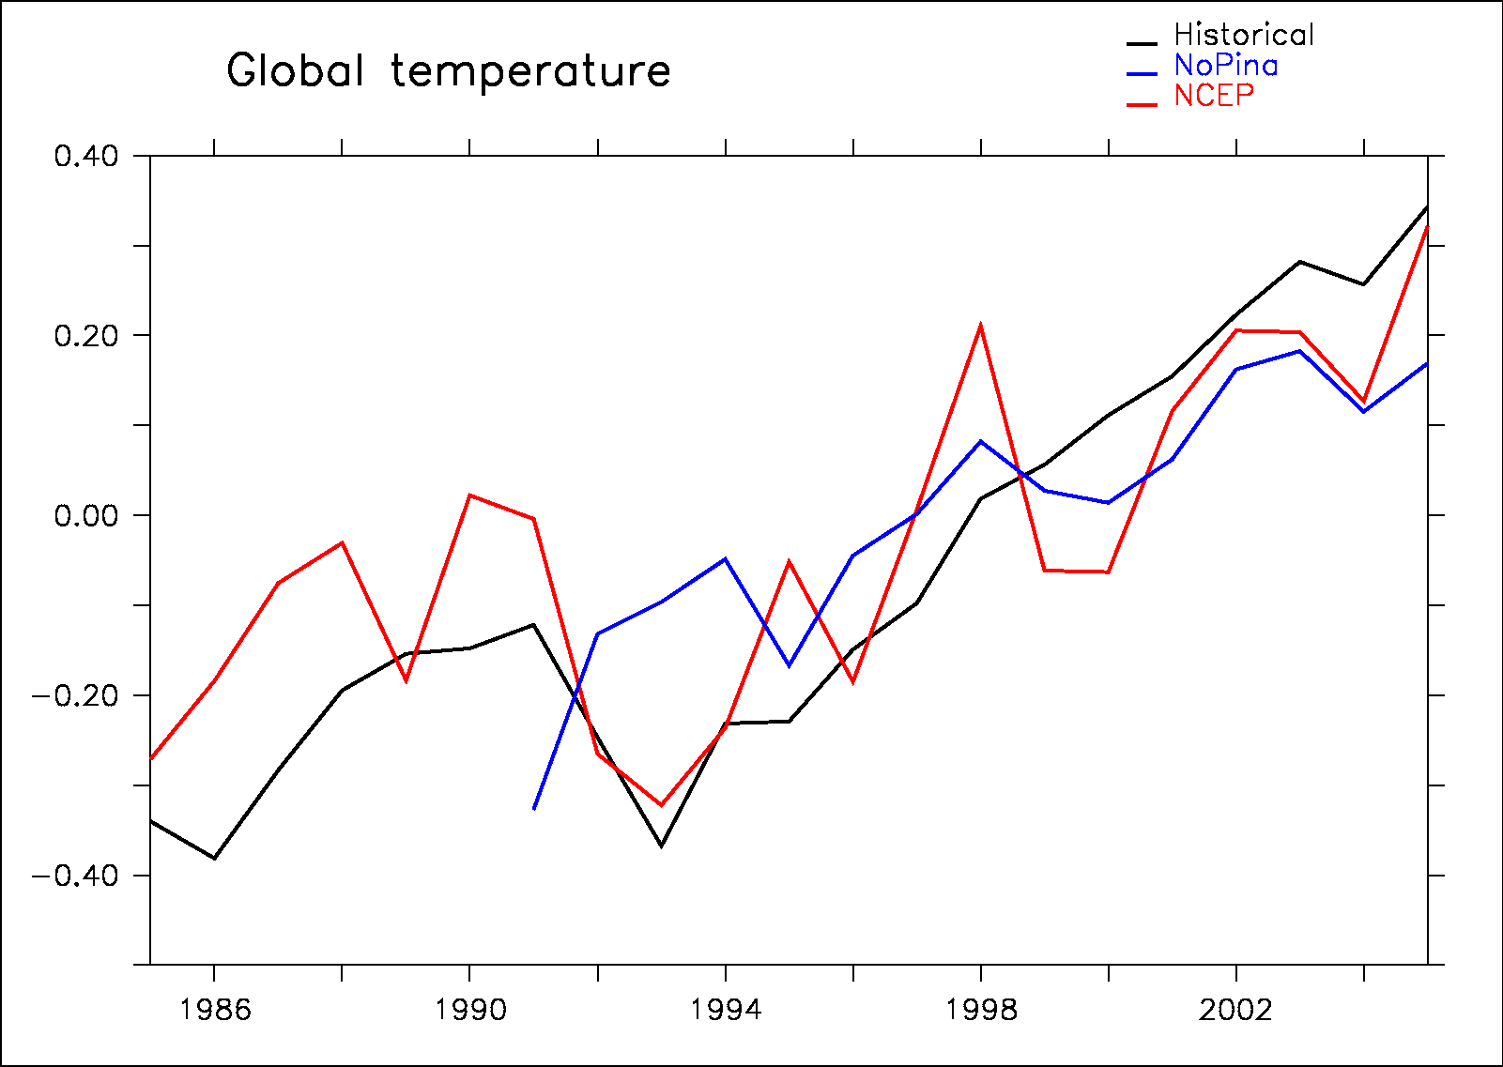
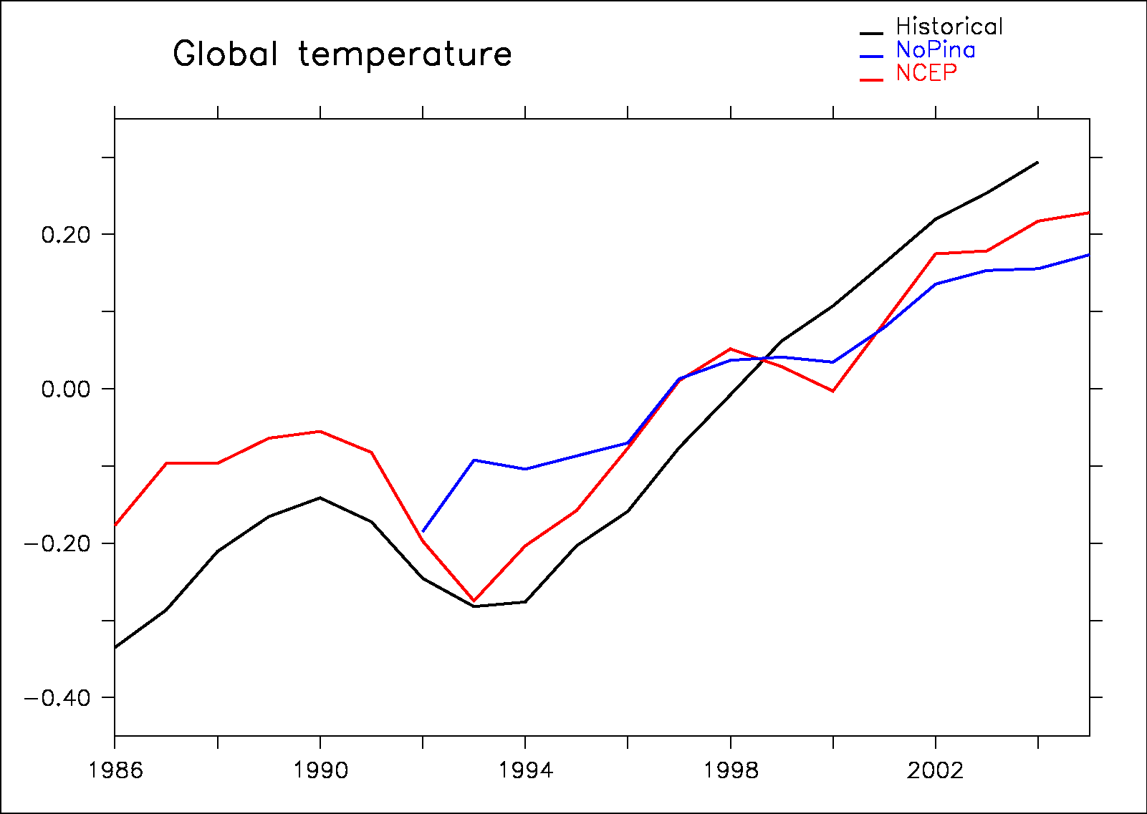
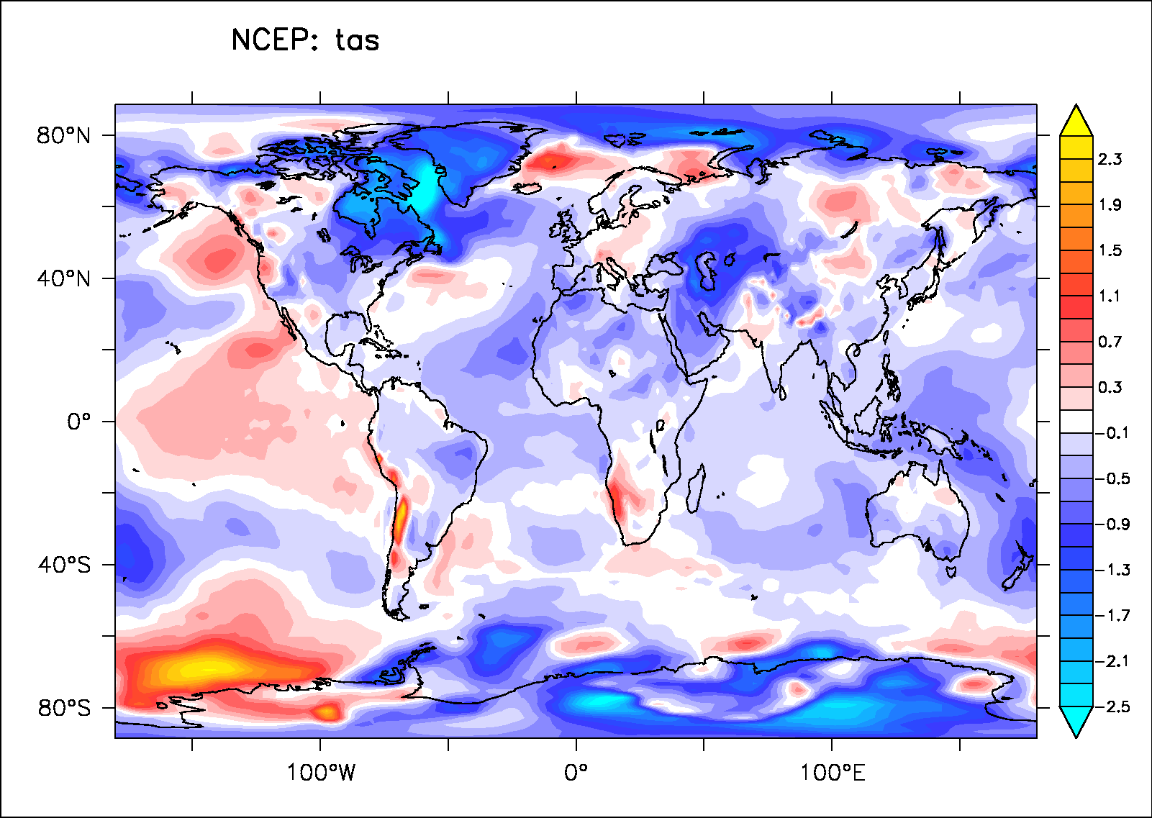
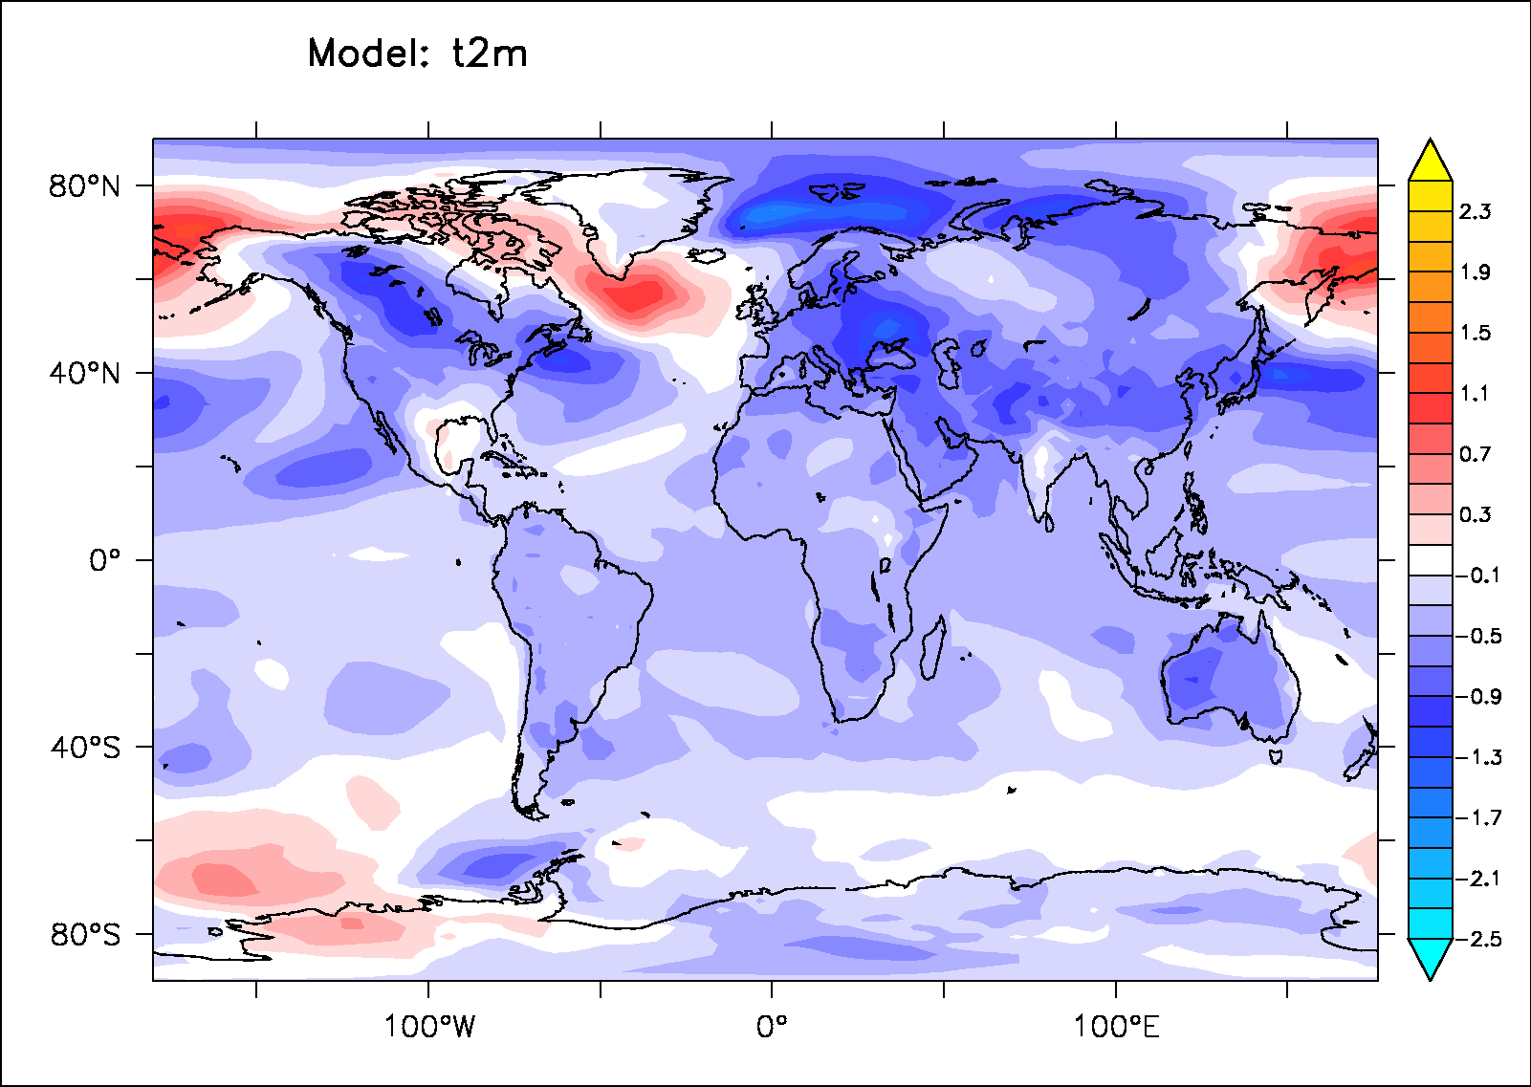
Pinatubo direct impact

Slide 33
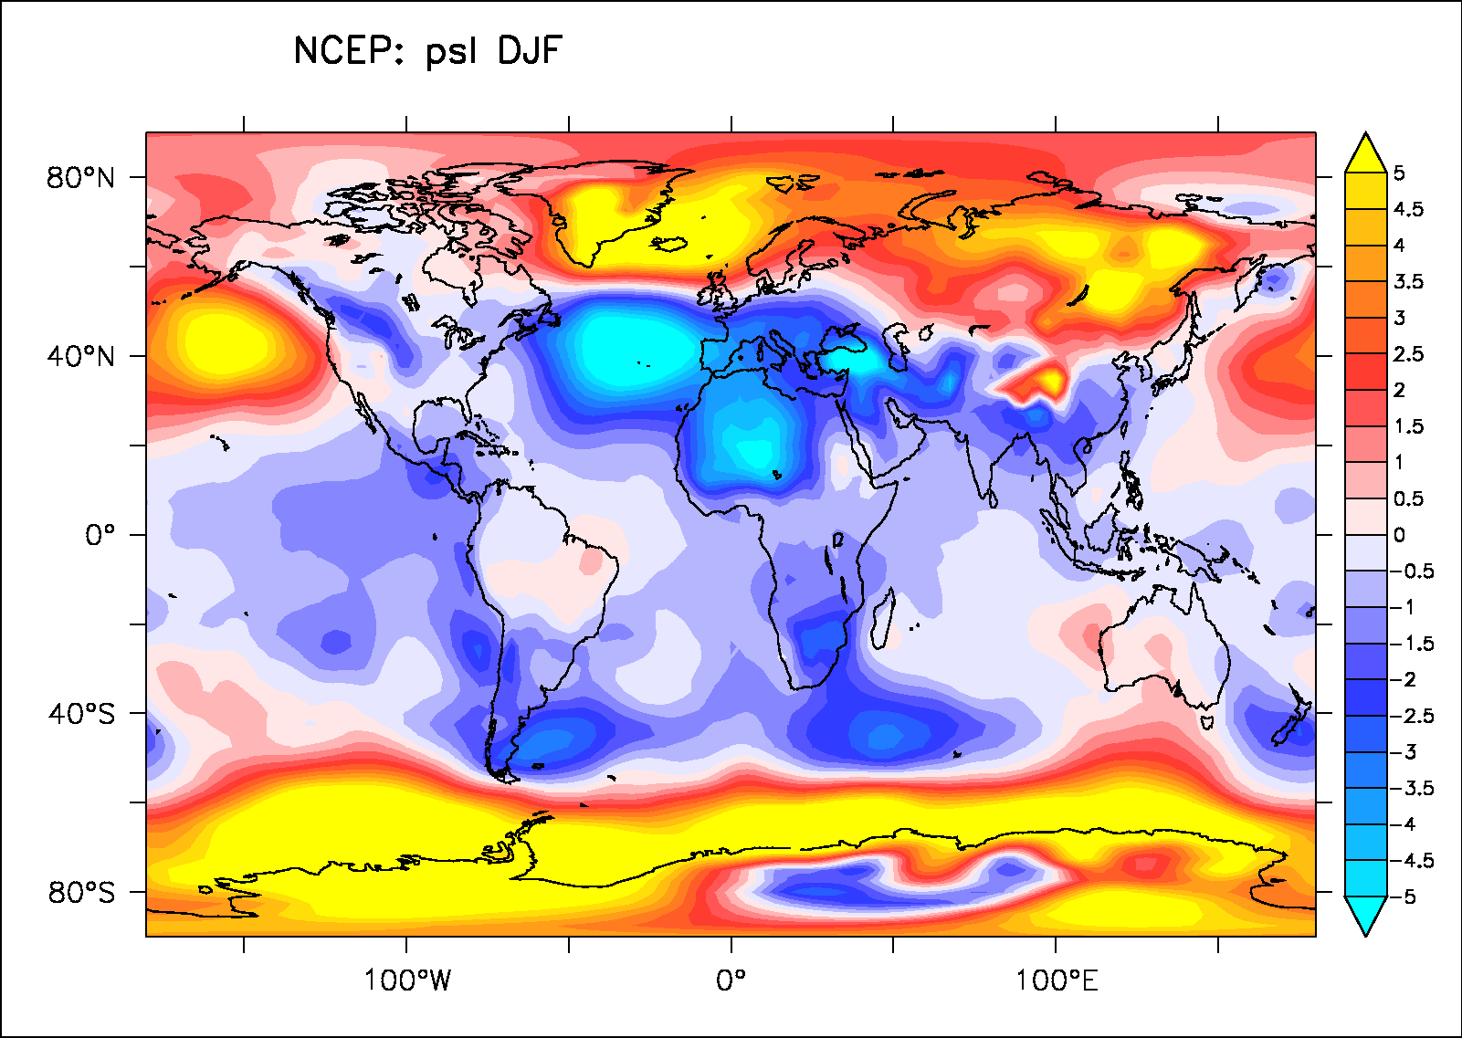
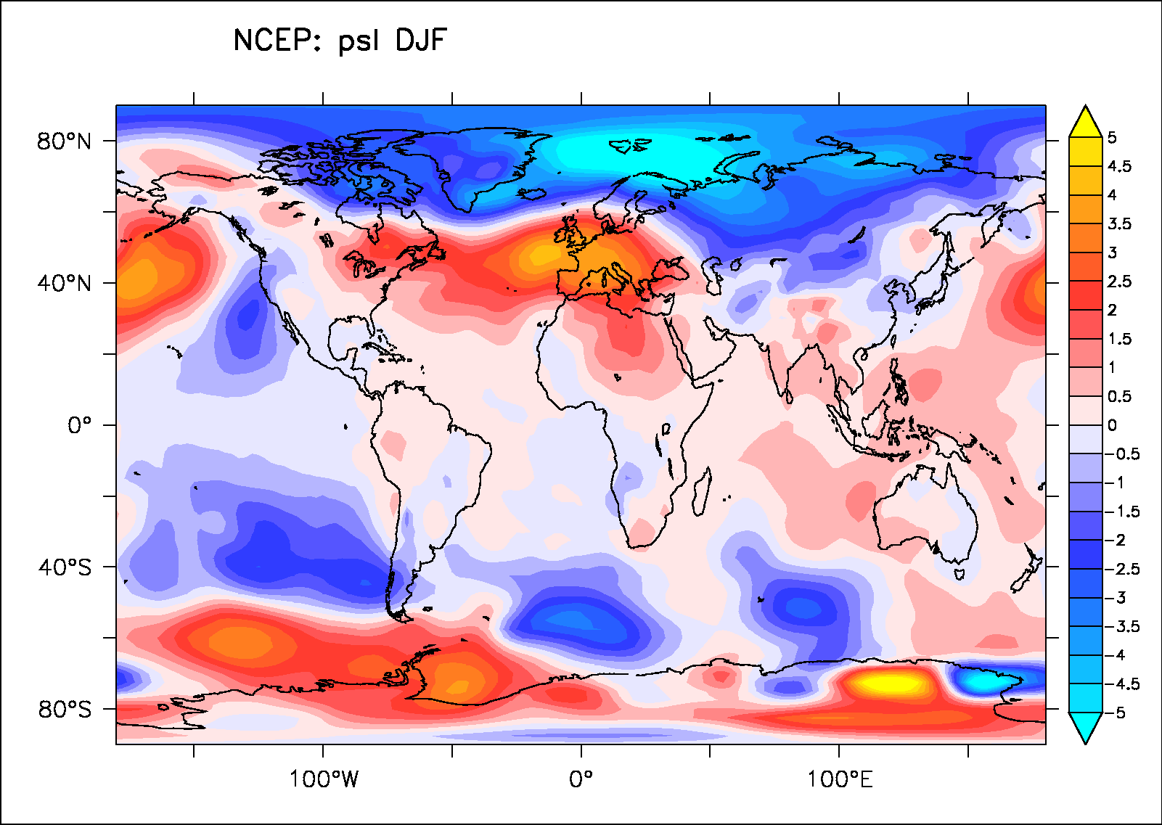

Is volcanic impact on the NAO so clear in data?
Agung: 1963-1965
Pinatubo: 1991-1993
El Chichon: 1982-1984

