Slide 1

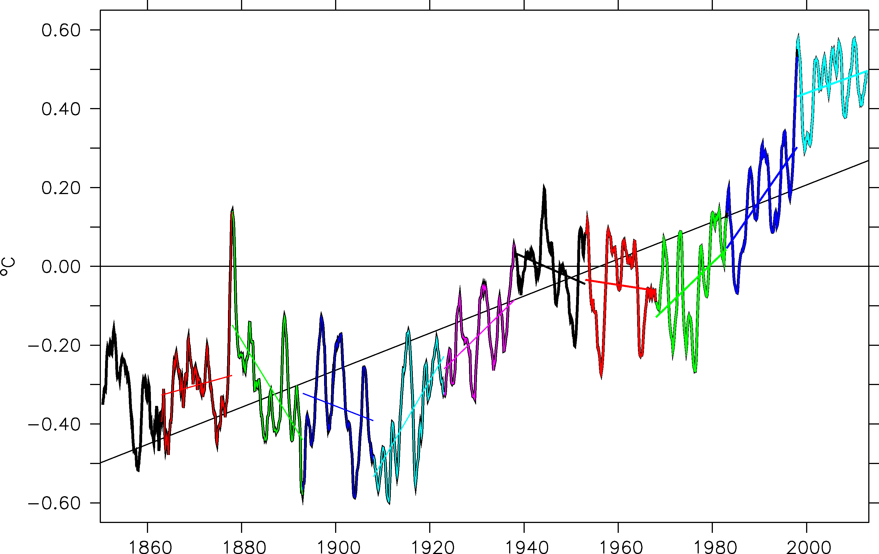


Tentative reconstruction of the recent Hiatus using IPSL-CM5A-LR
Didier Swingedouw, Juliette Mignot, Eric Guilyardi, Sébastien Nguyen, Lola Ormières

Slide 2
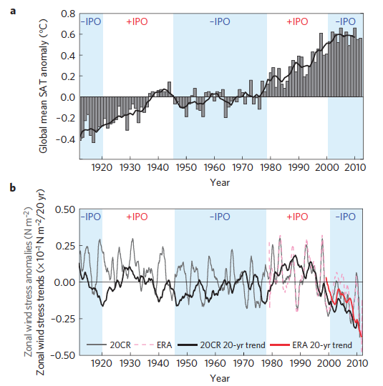
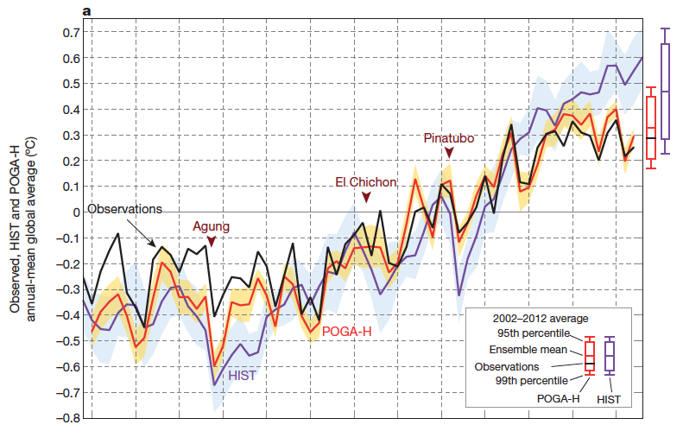
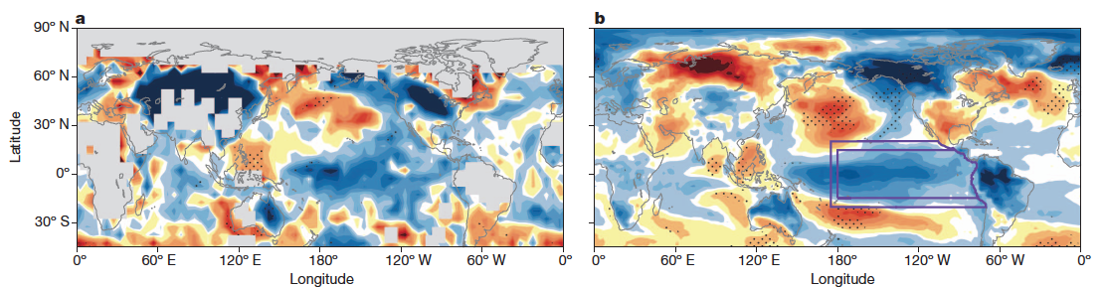
Hiatus and partial nudged simulations
Understanding dynamics explaining hiatus signal
Testing similar experimental design as Kosaka and Xie (2013) to evaluate consistency within IPSL model + home-made simulations
Trend T2M pattern in boreal winter 2002-2012
HadCRUT
POGA
England et al. 2014

Slide 3
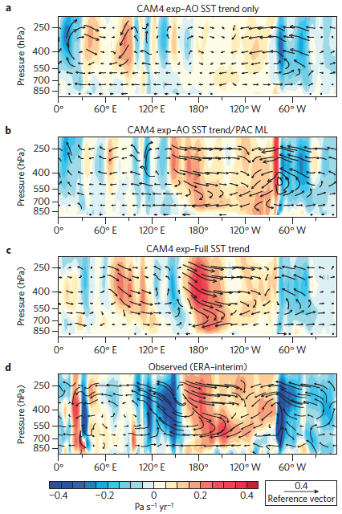
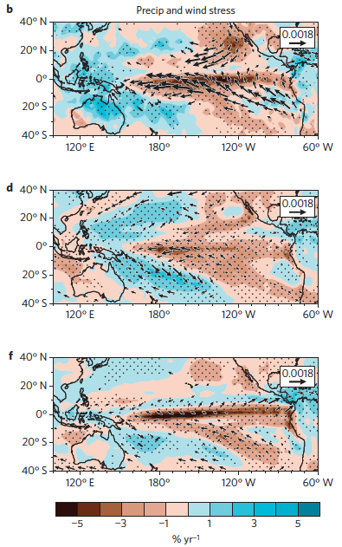

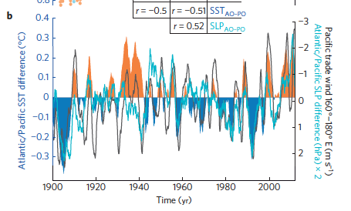
Atlantic-Pacific connection?
1992-2011 trend obs.
Mc Gregor et al. (2014):
AGCM (CAM4) or AGCM + ML ocean
Only five members
1992-2011 SST global
1992-2011 SST Atl. Pac ML
West Pac.
Atlantic

Slide 4
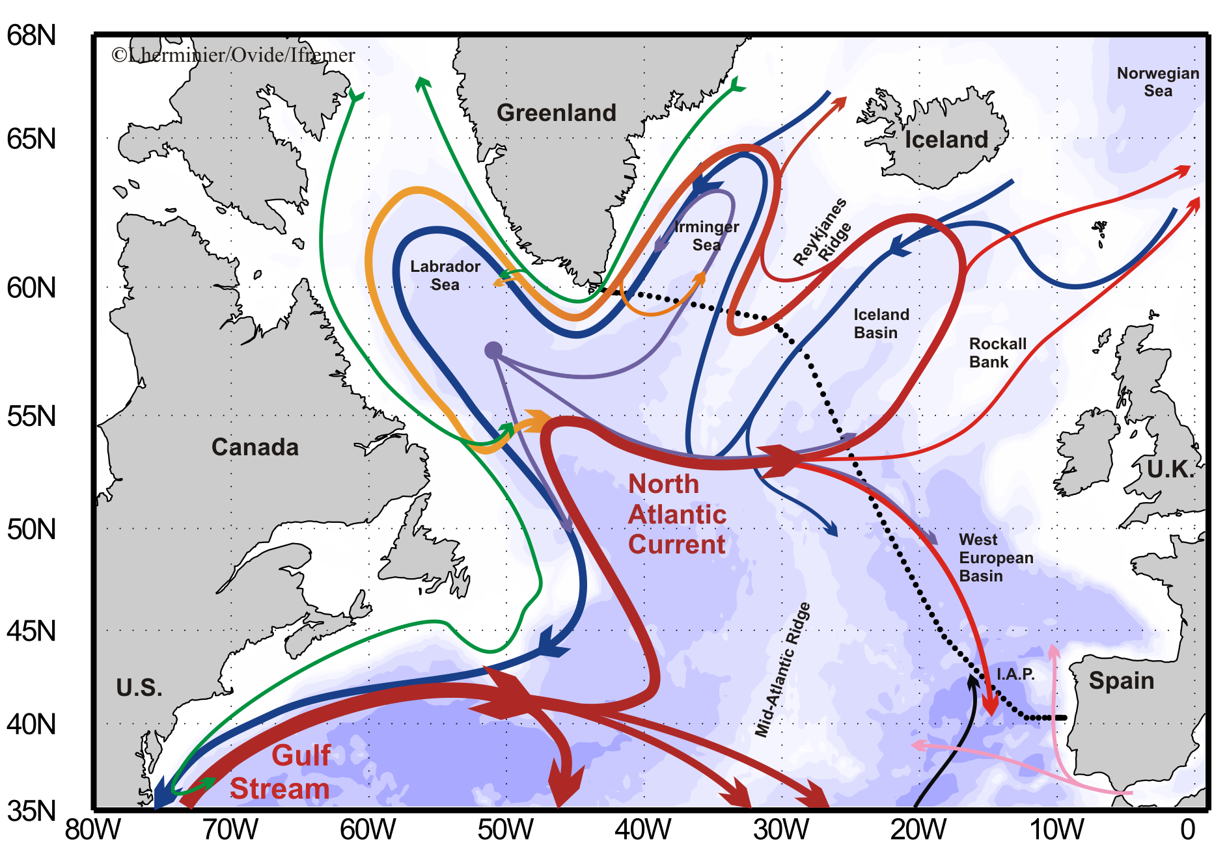
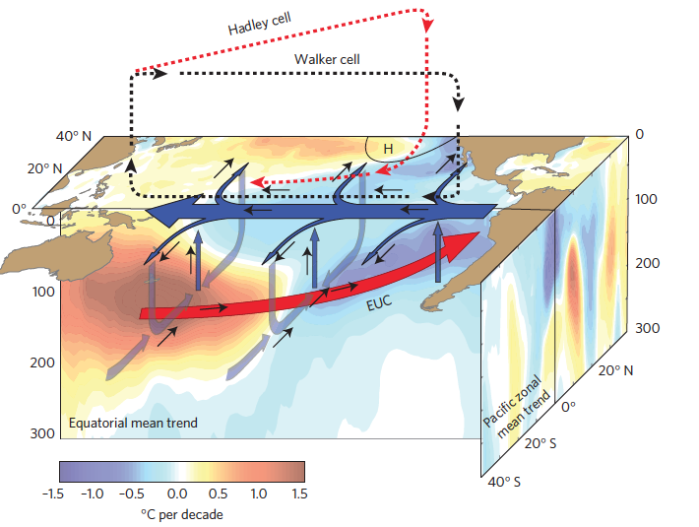
Hiatus explanation?
Adapted from England et al. (2014)

Slide 5
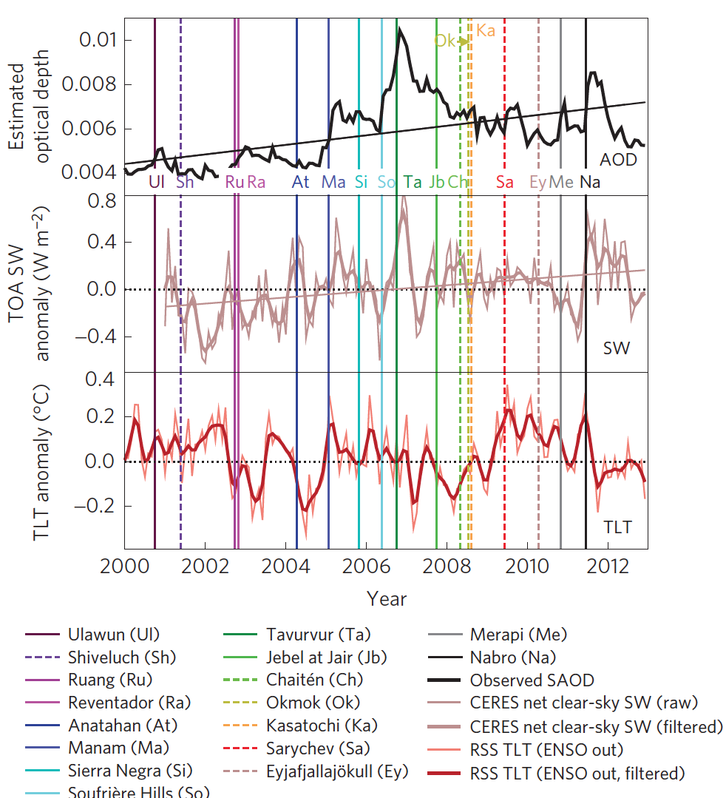
A role for small volcanoes?
Santer et al. (2014): small tropospheric eruptions from 1998 may also played a role for the Hiatus
Knutti et al. (2014),, Marotzke et al. (2015): forcing and internal variability may both played their role
Meehl et al. (2011), : if you select the models in the good IPO phase, you can reproduce hiatus within historical simulations

Slide 6
Positive phase of the AMO
Intensification of the Pacific trade winds
Negative phase of the IPO
McGregor et al.(2014)
England et al. (2014)
Kosaka et Xie (2013)
HIATUS
Santer et al. ( 2014)
Radiative forcing from small volcanoes

Slide 7
Can we reproduce this Hiatus using classical nudging techniques of SST anomalies using IPSL-CM5A-LR model? (i.e. robustness of former proposed mechanisms?)

Slide 8
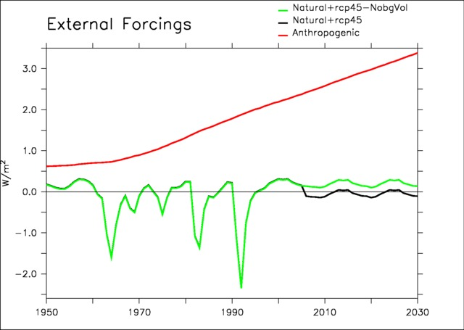
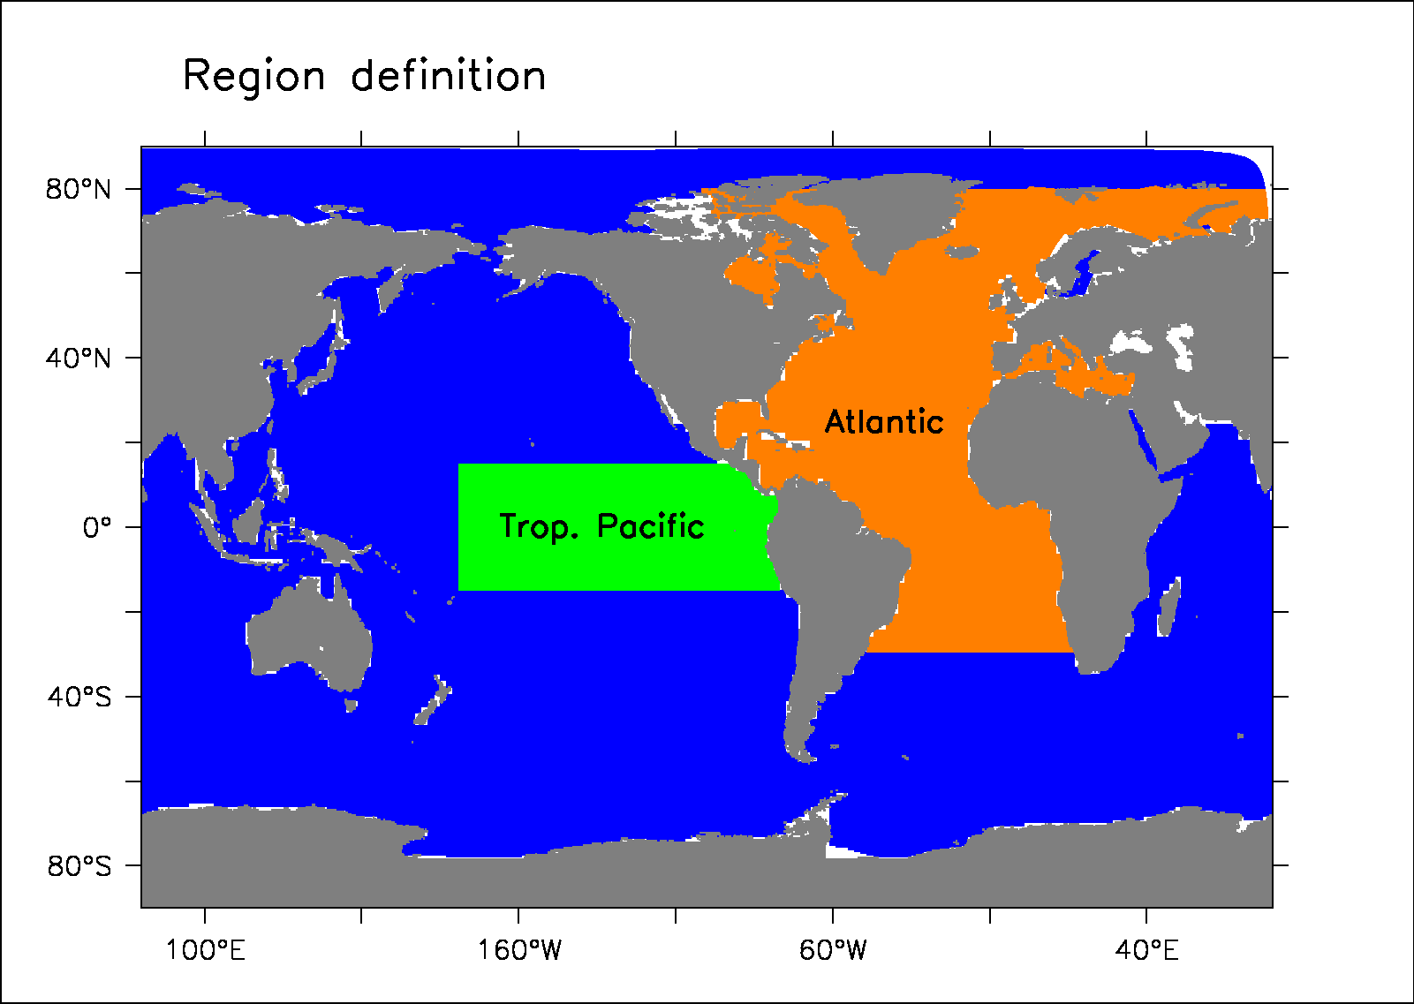
Experimental design
Restoring of 40 W/m2/s, 6 times lower than Kosaka and Xie: this could be important for dynamics! (cf. Cassou)
Restoring towards 3D wind every 6 hours with coef equal to 1/0.25 s⁻¹
Background volcanoes from 2006 in CMIP6 projections! not included here in nudged simulations
External forcing
Simulations | # members | Restoring
Historical | 6
Nudged Glob. | 1 (+4 to come) | Global SST Reynolds et al. (2007)
Nudged Pac. | 7 | Tropical East Pacific SST Reynolds et al. (2007)
Nudged Atl. | 7 | Whole Atlantic SST Reynolds et al. (2007)
Nudged Wind | 1 | 10-m wind from Era-Interim
Partial nudging region

Slide 9
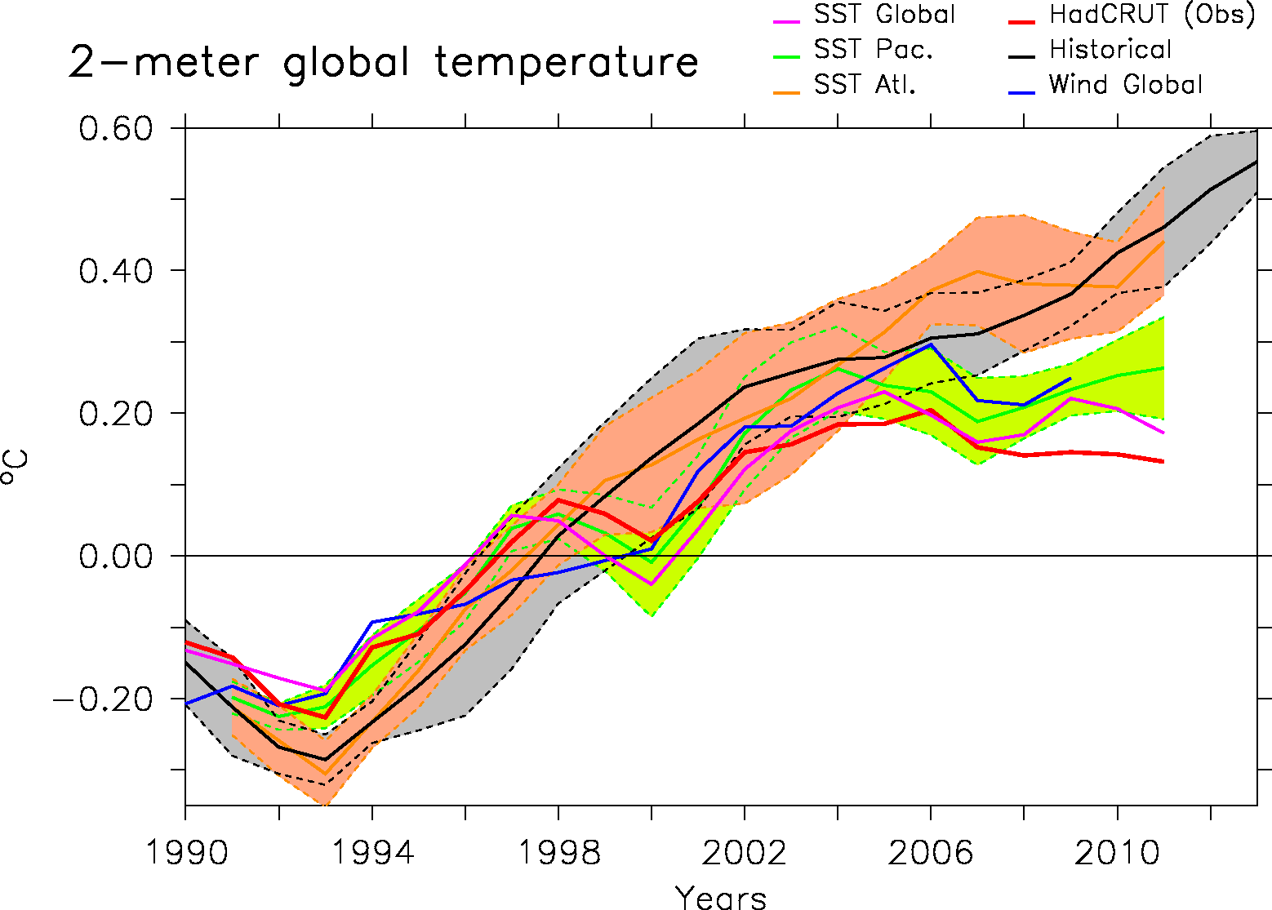
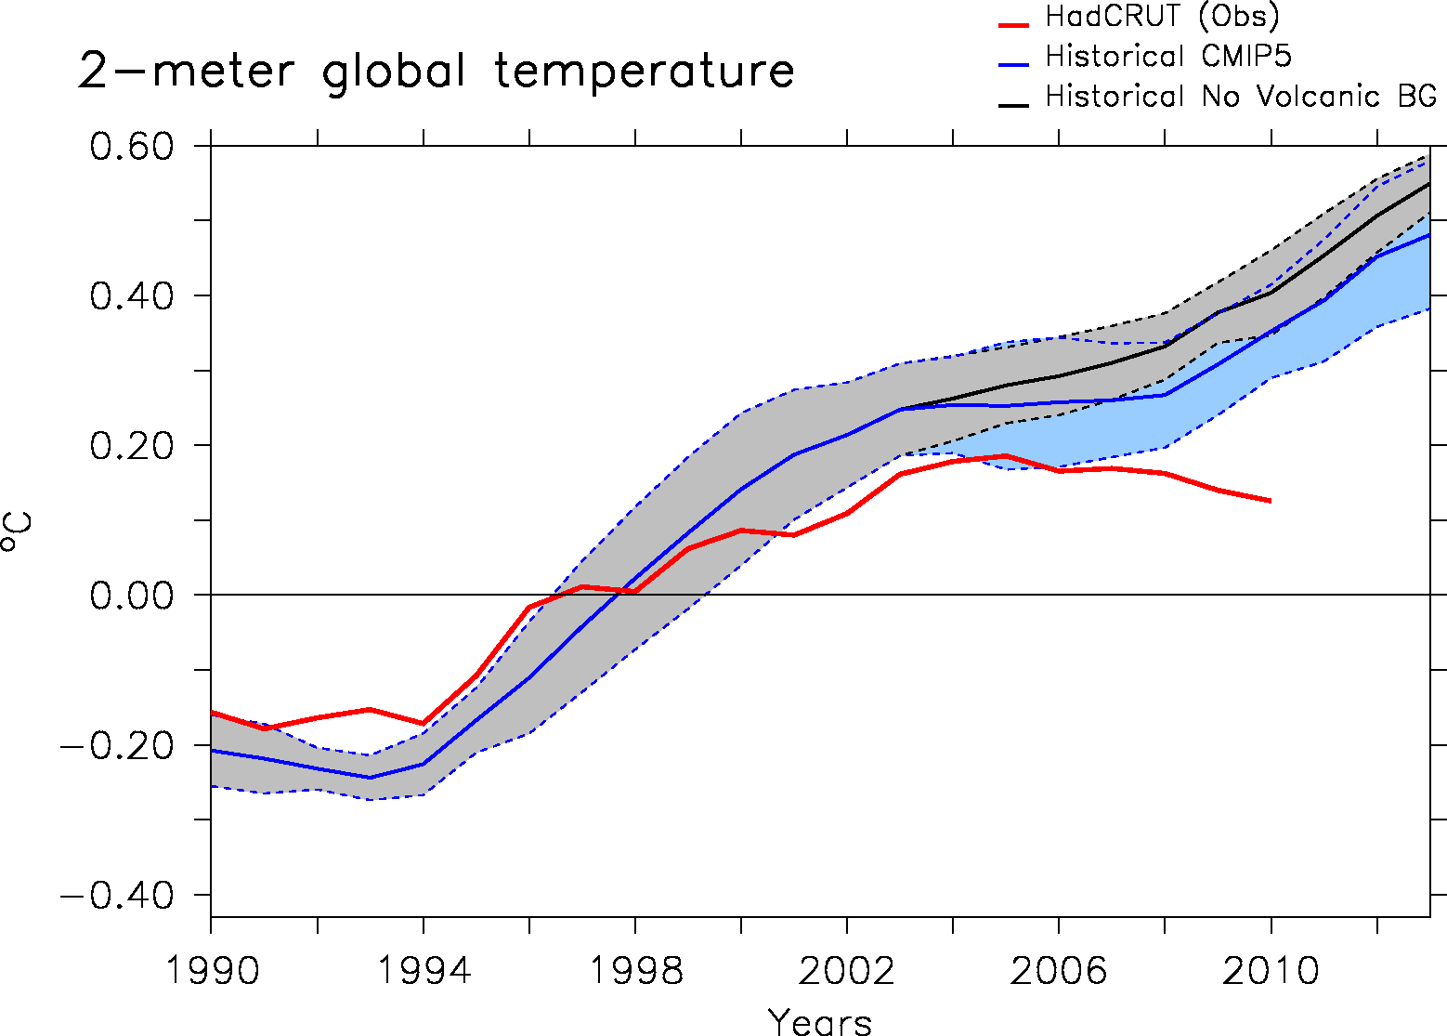
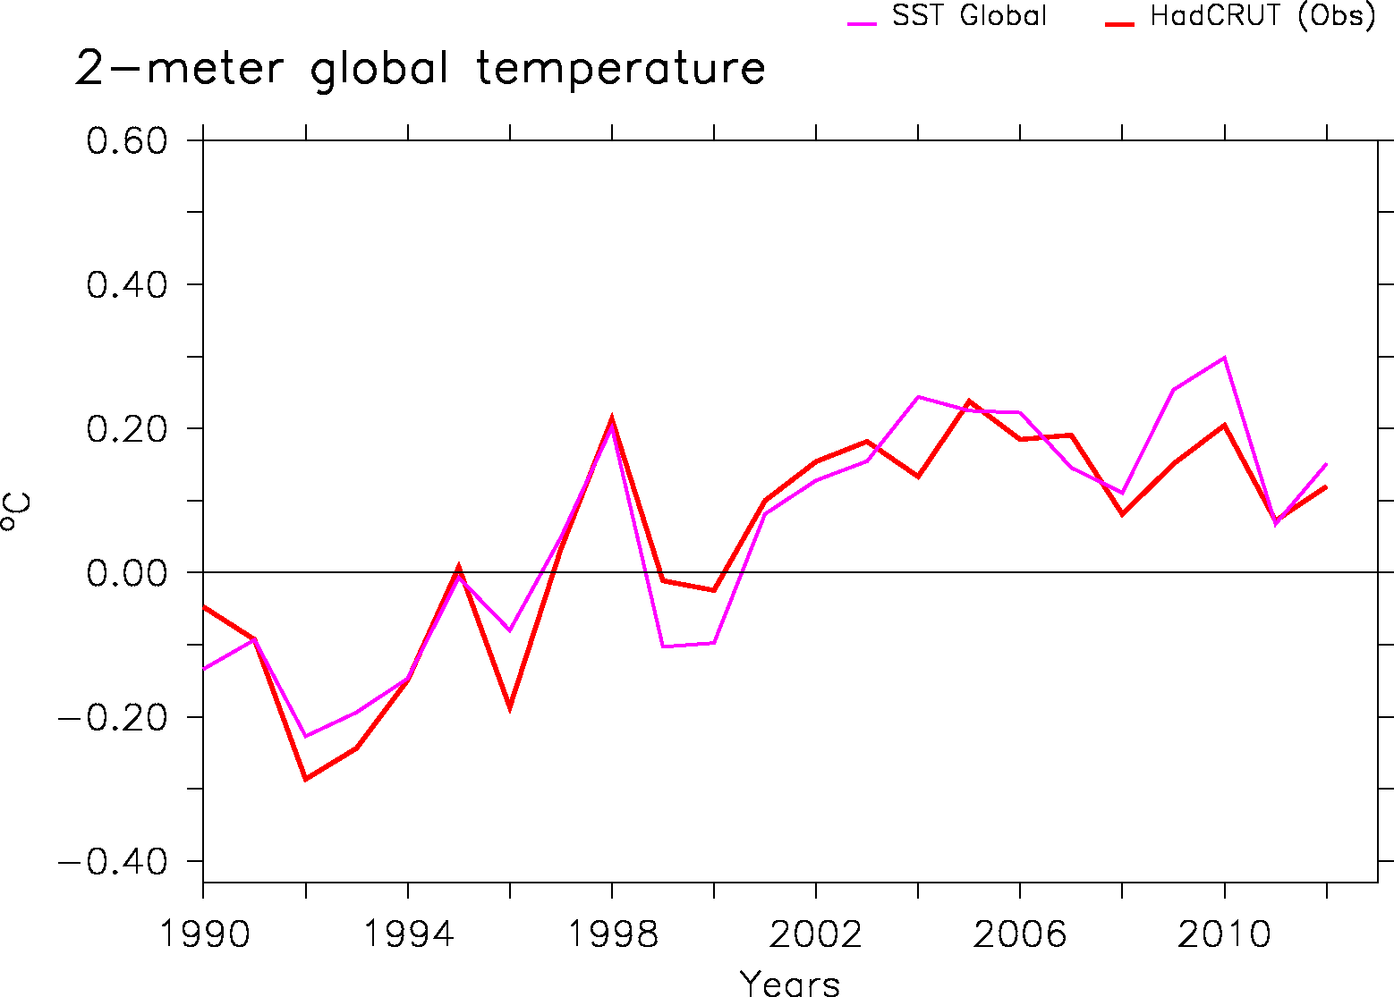
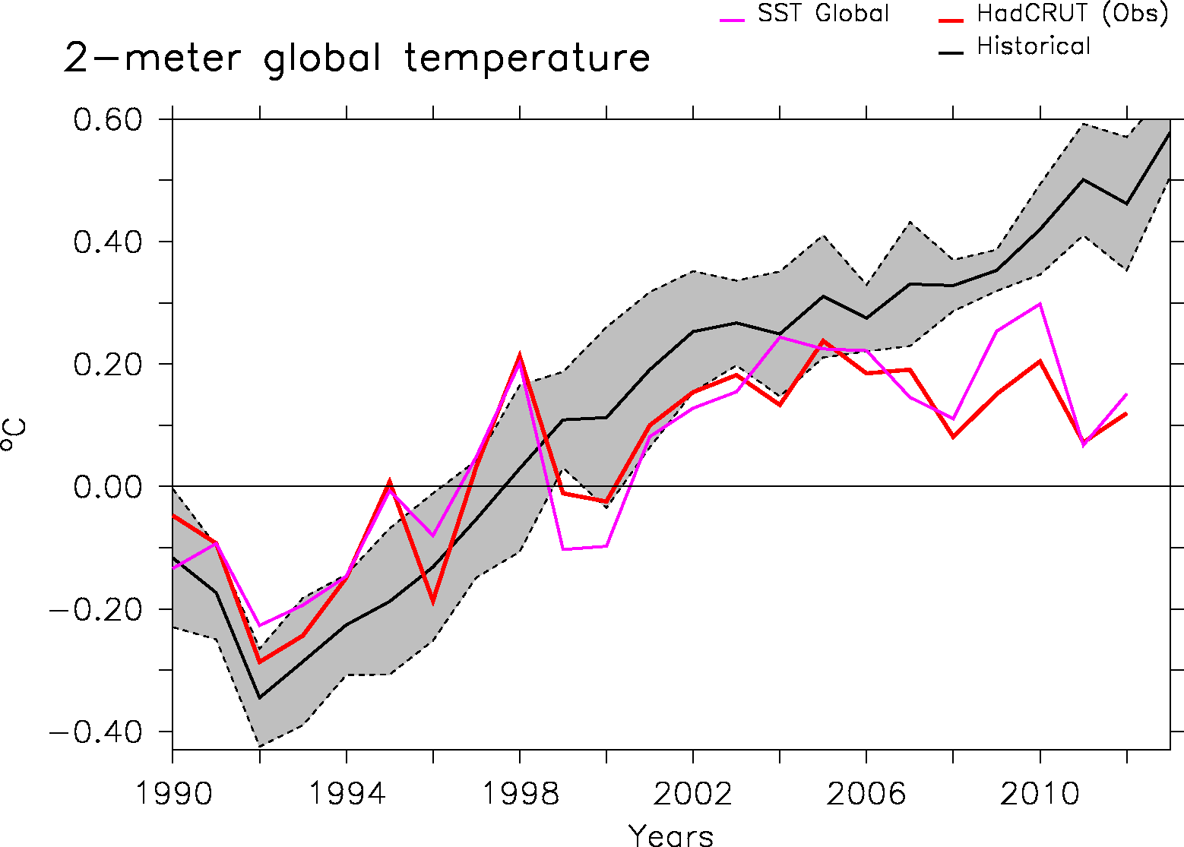
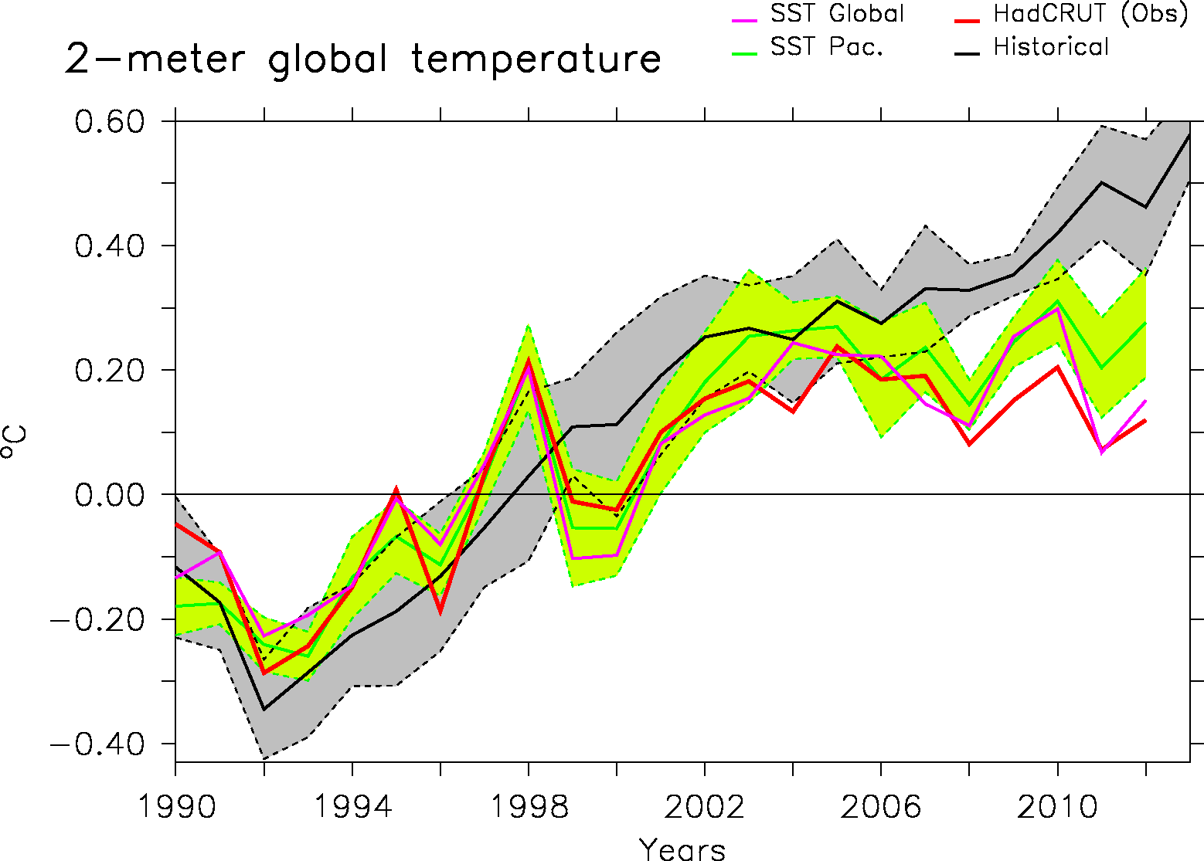

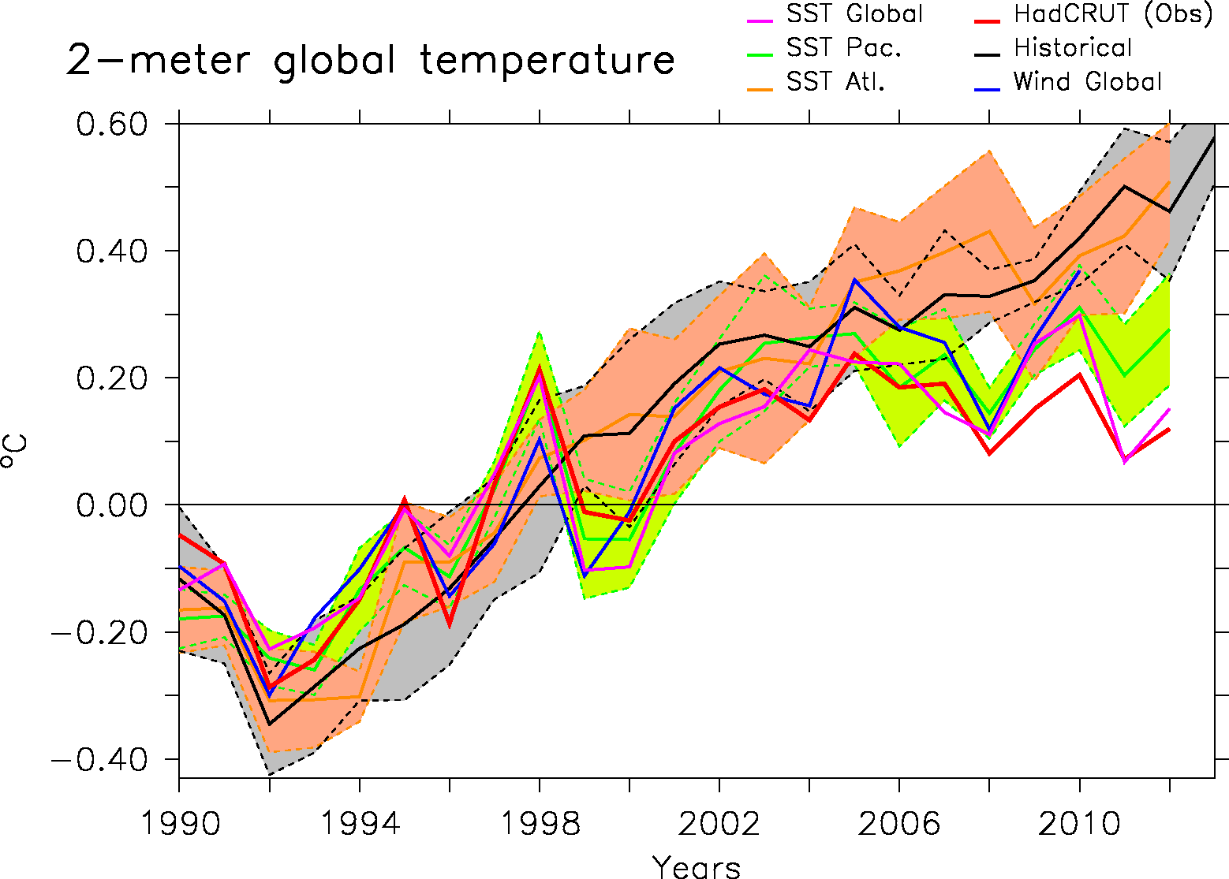
Global temperature response

Slide 10
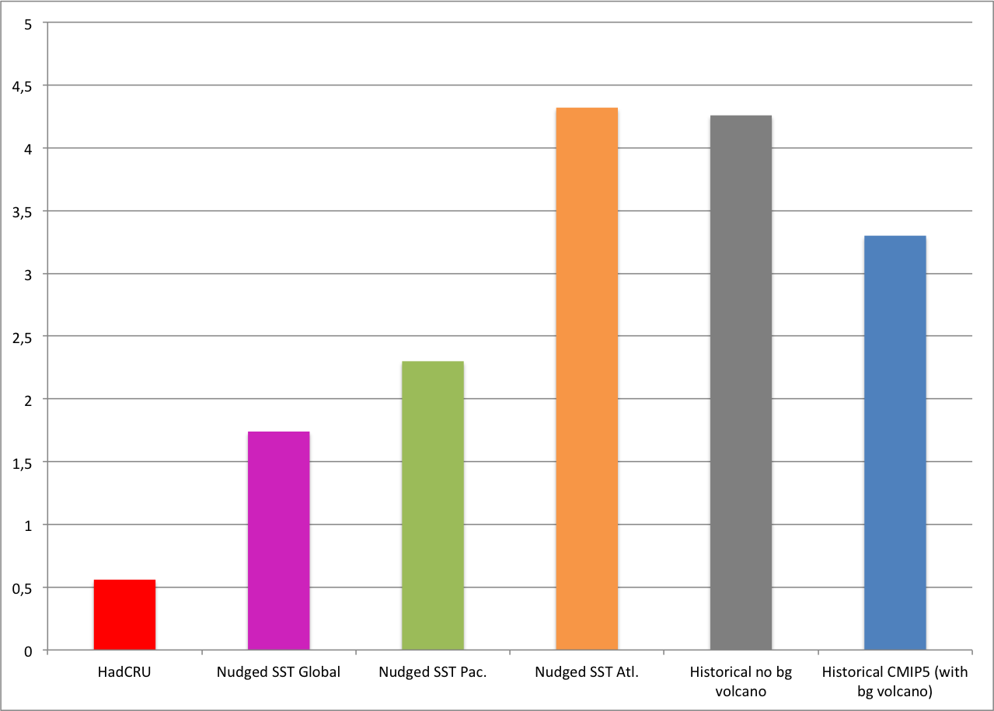
Linear trend 1998-2012
No simulation totally captures the observed trend from HadCRU
0.1°C/15 yrs is missing in nudged to global SST run compared to HadCRUT
Equivalent to the impact of background volcanoes!
Error bars to come!
Role of observation mask should be evaluated as well (cf. Hawkins et al.)
0.1°C/15yrs

Slide 11
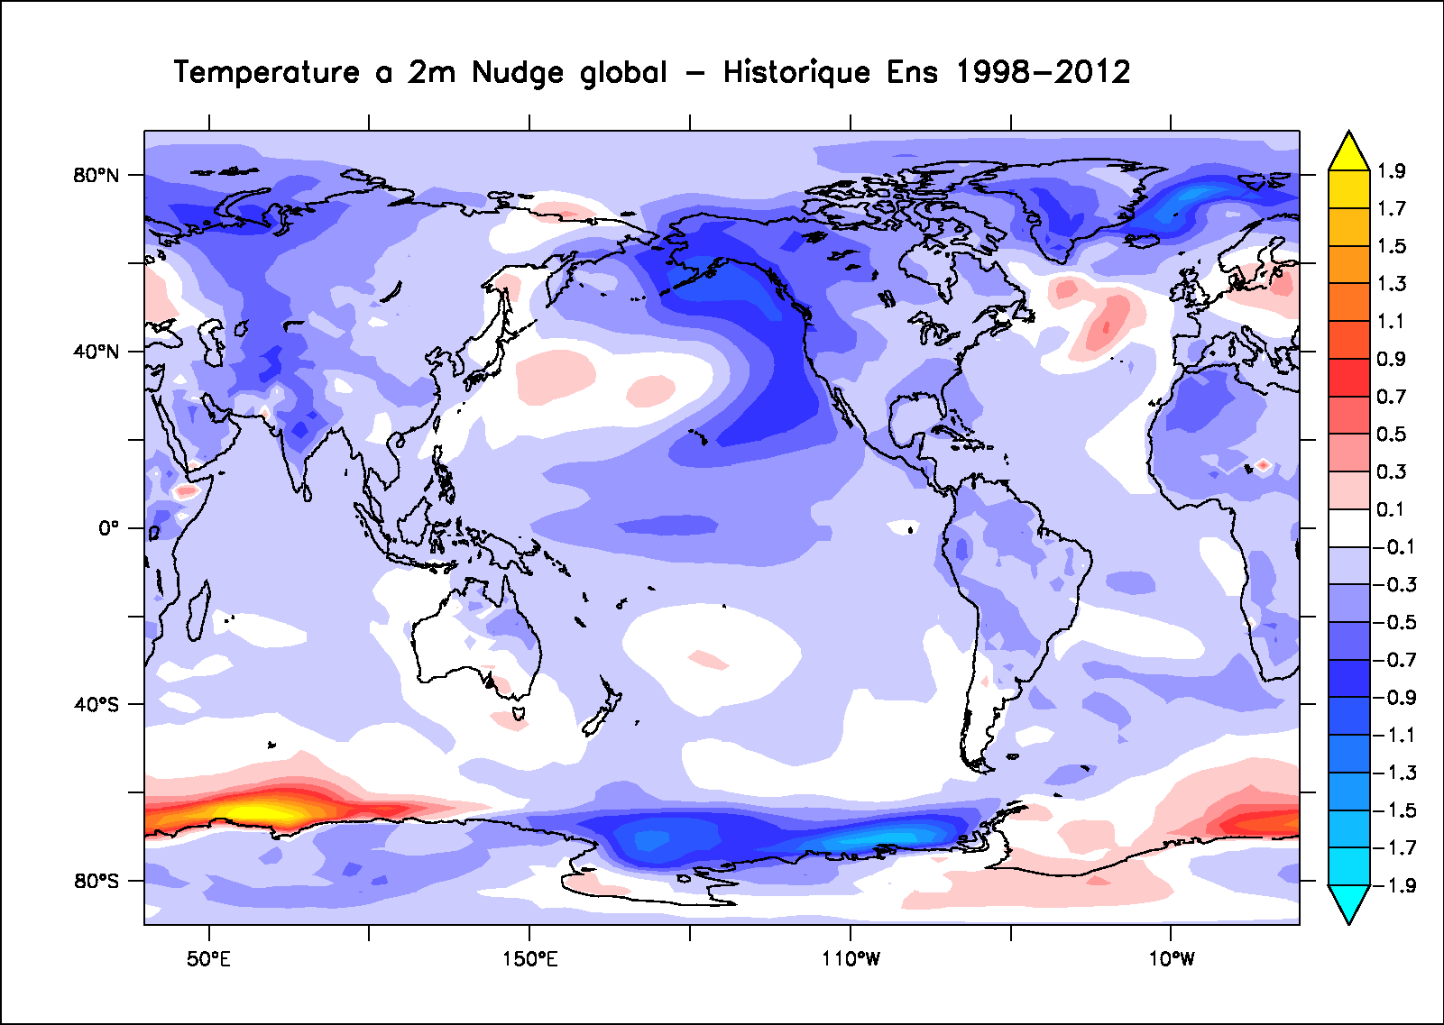
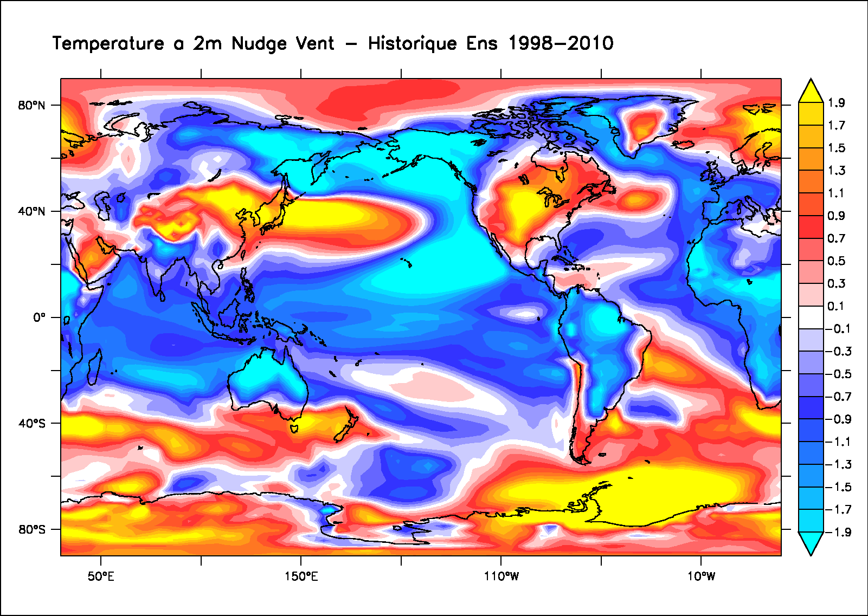
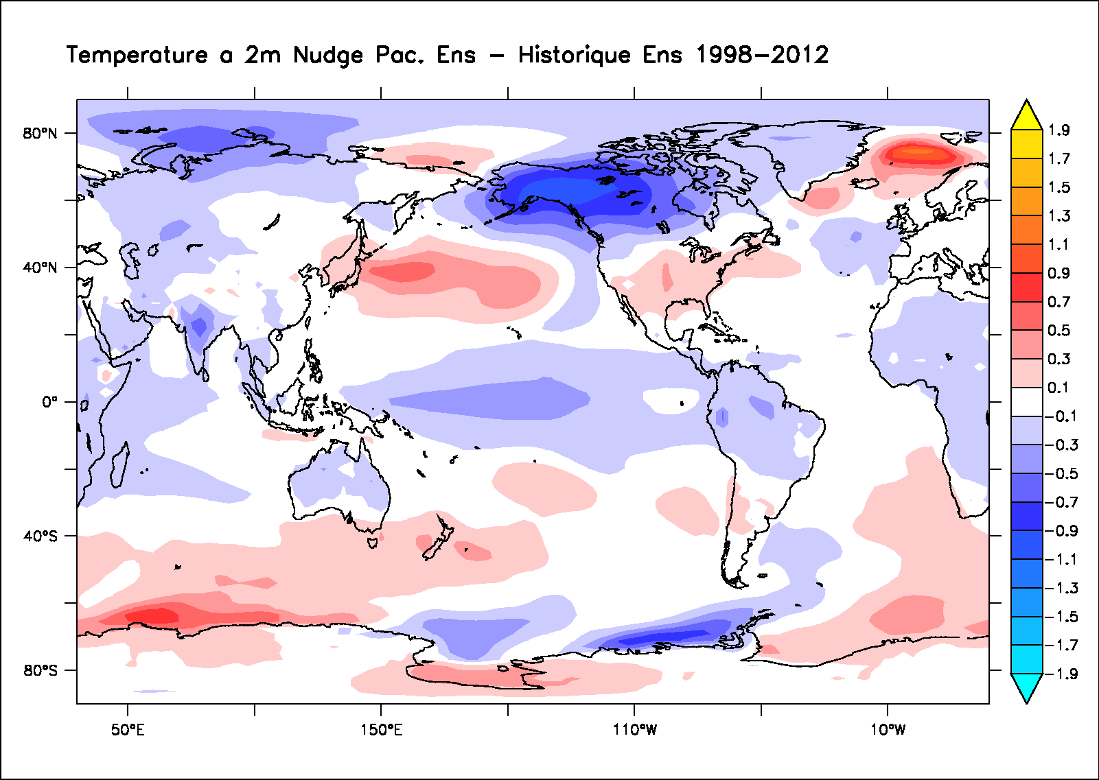
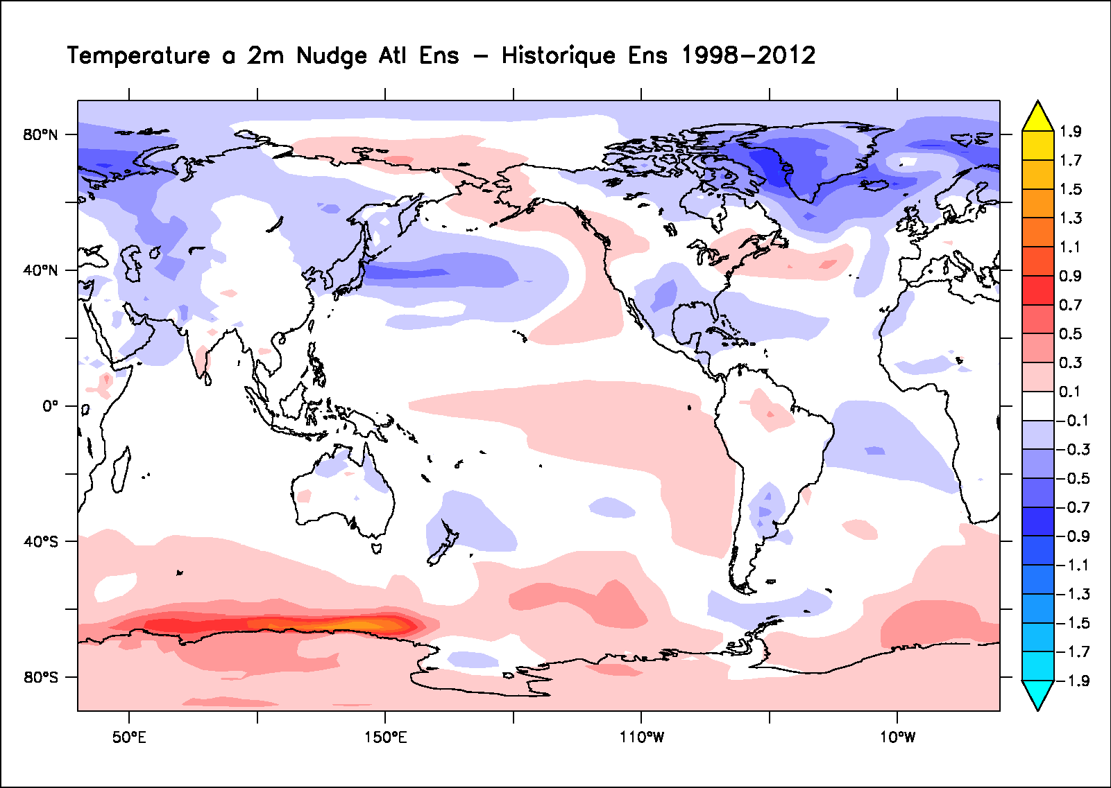
T2M Pattern anomalies
Global SST nudging- historical (1998-2010)
Global wind nudging- historical (1998-2010)
Pacific SST nudging- historical (1998-2010)
Atlantic SST nudging- historical (1998-2010)

Slide 12
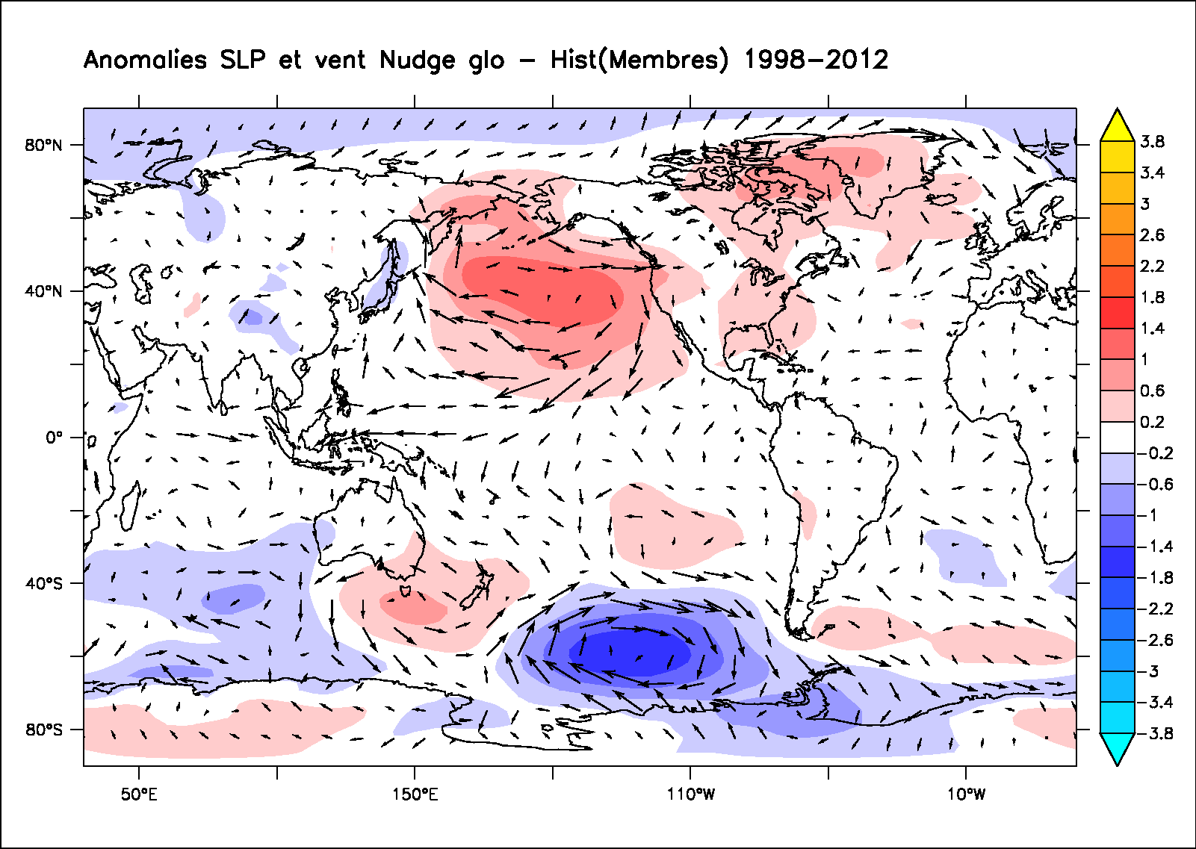
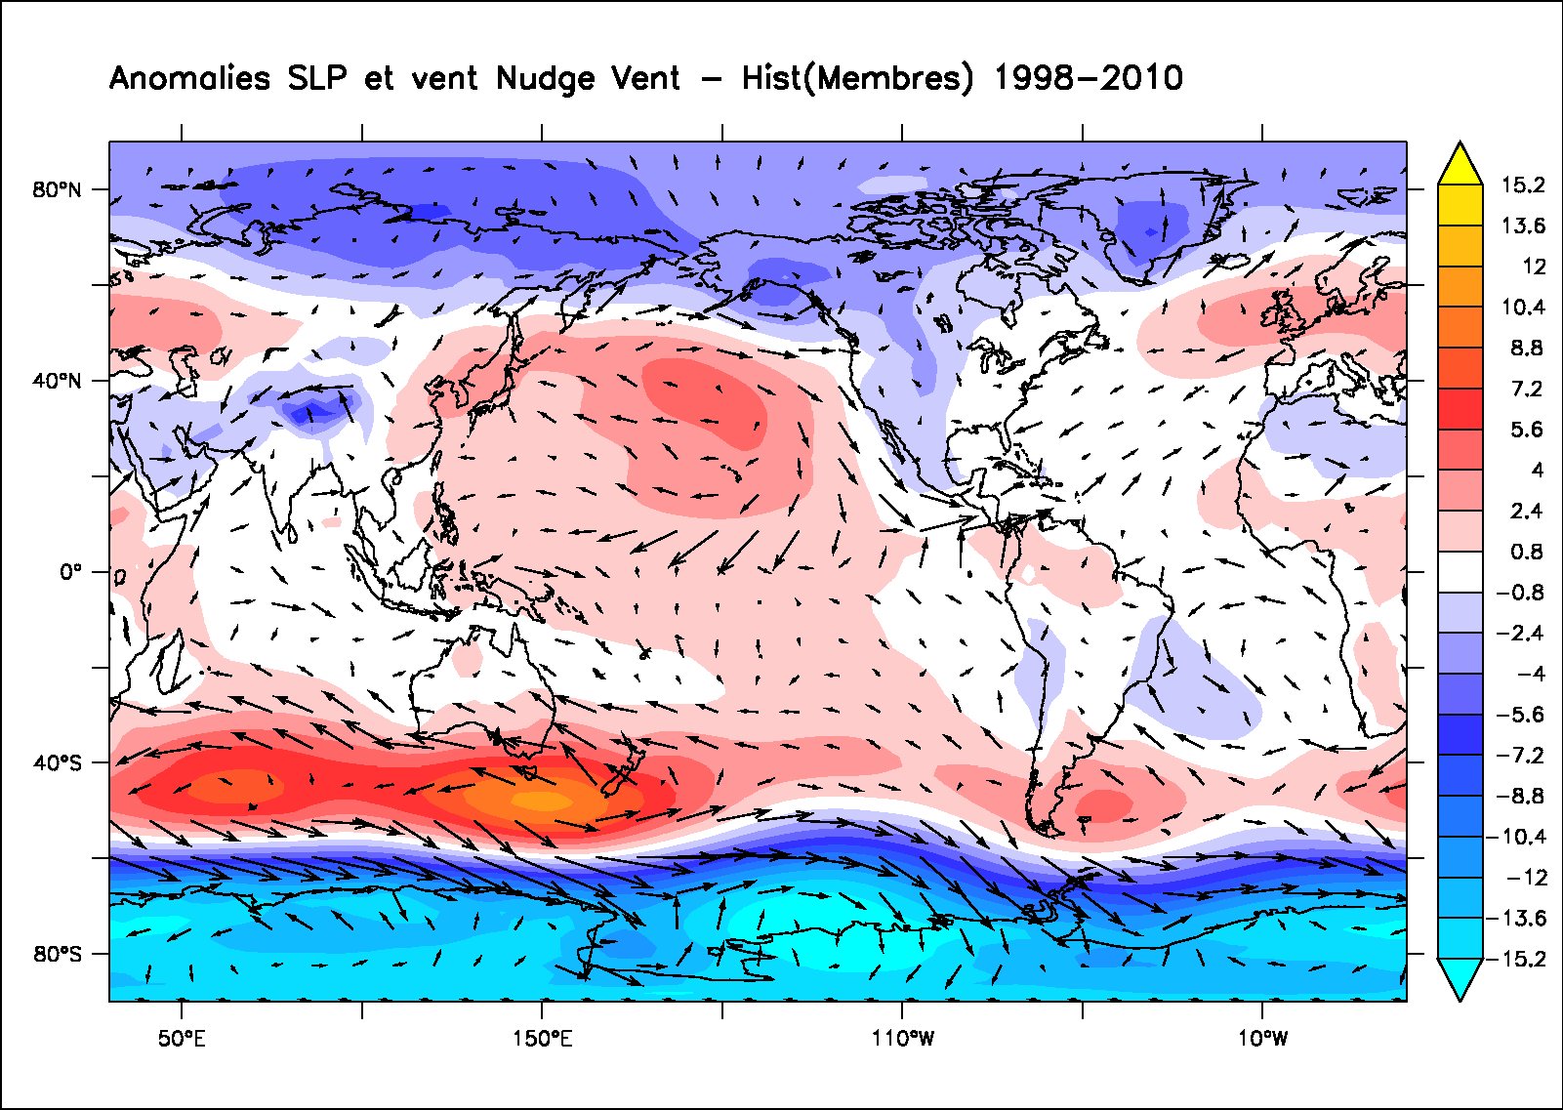
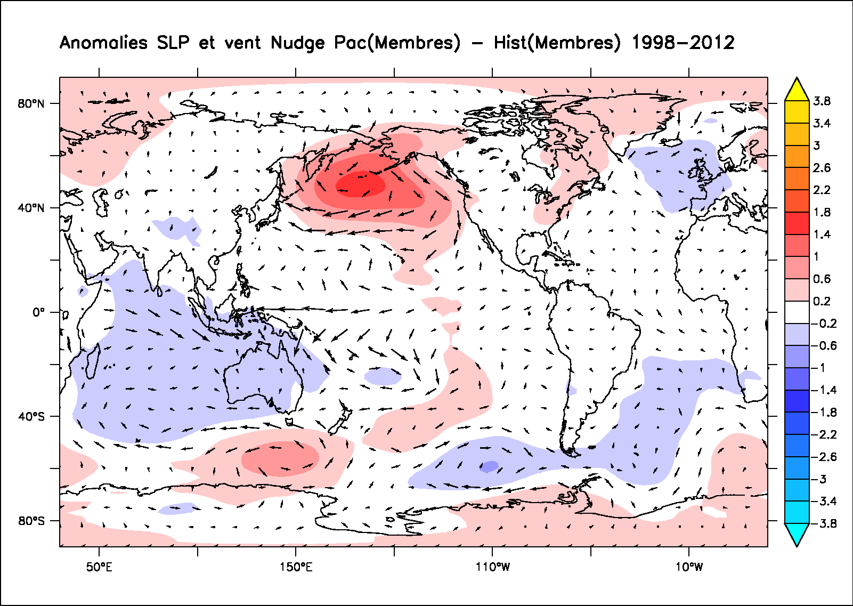
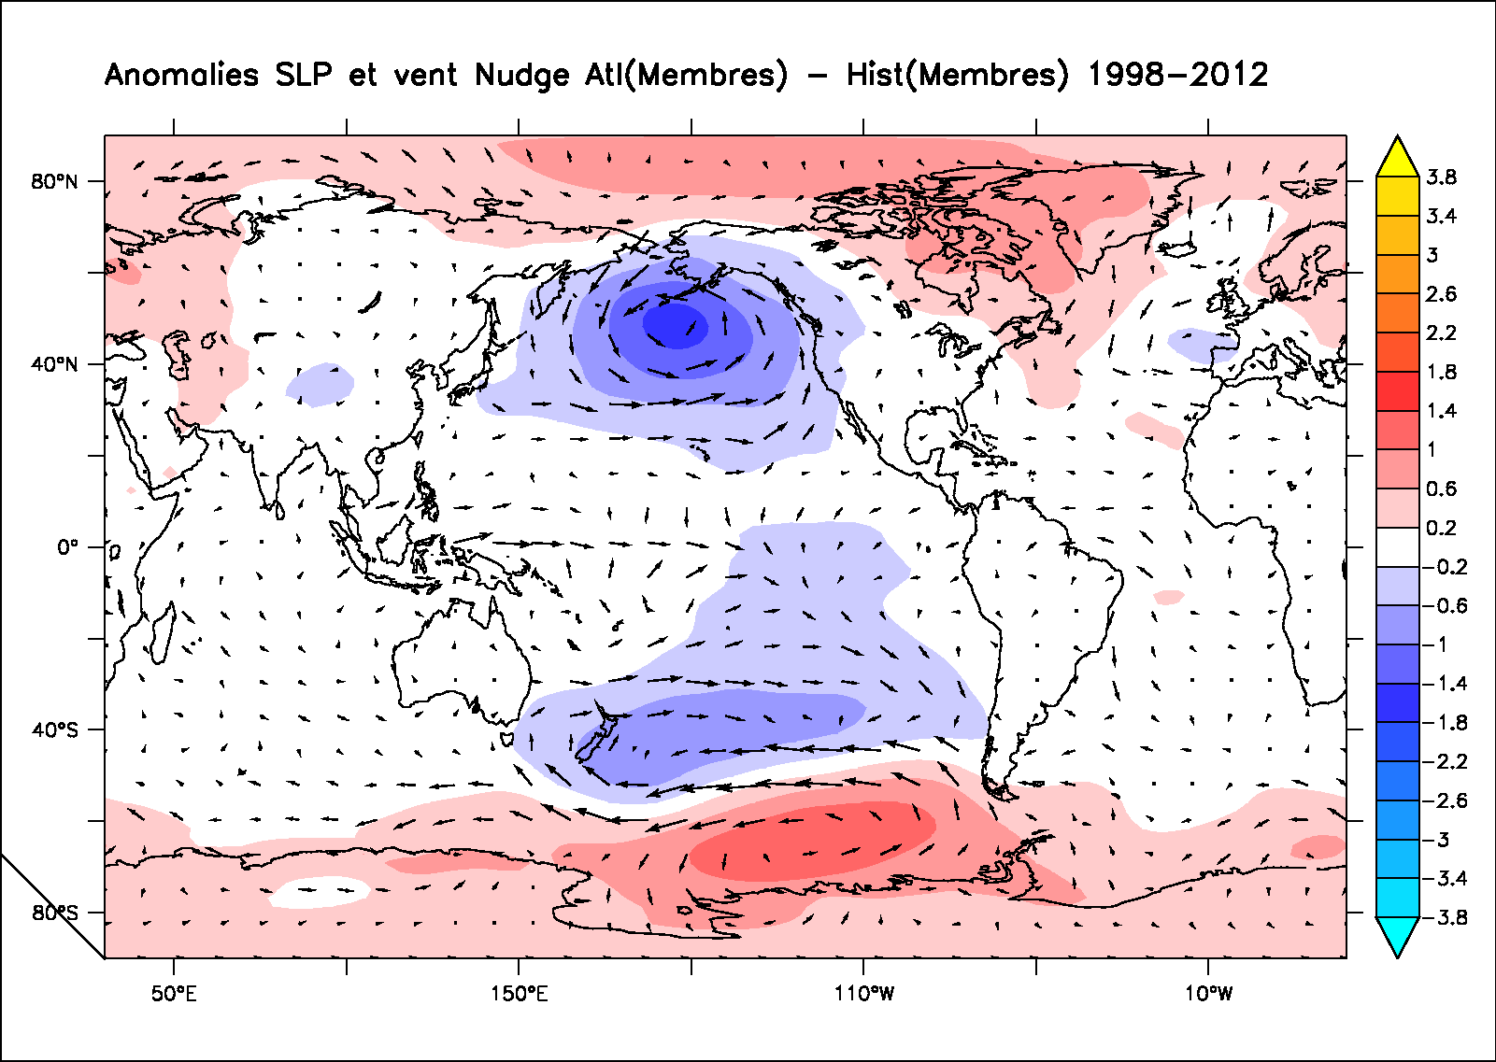
Wind and SLP anomalies
Global SST nudging- historical (1998-2010)
Global wind nudging- historical (1998-2010)
Pacific SST nudging- historical (1998-2010)
Atlantic SST nudging- historical (1998-2010)

Slide 13
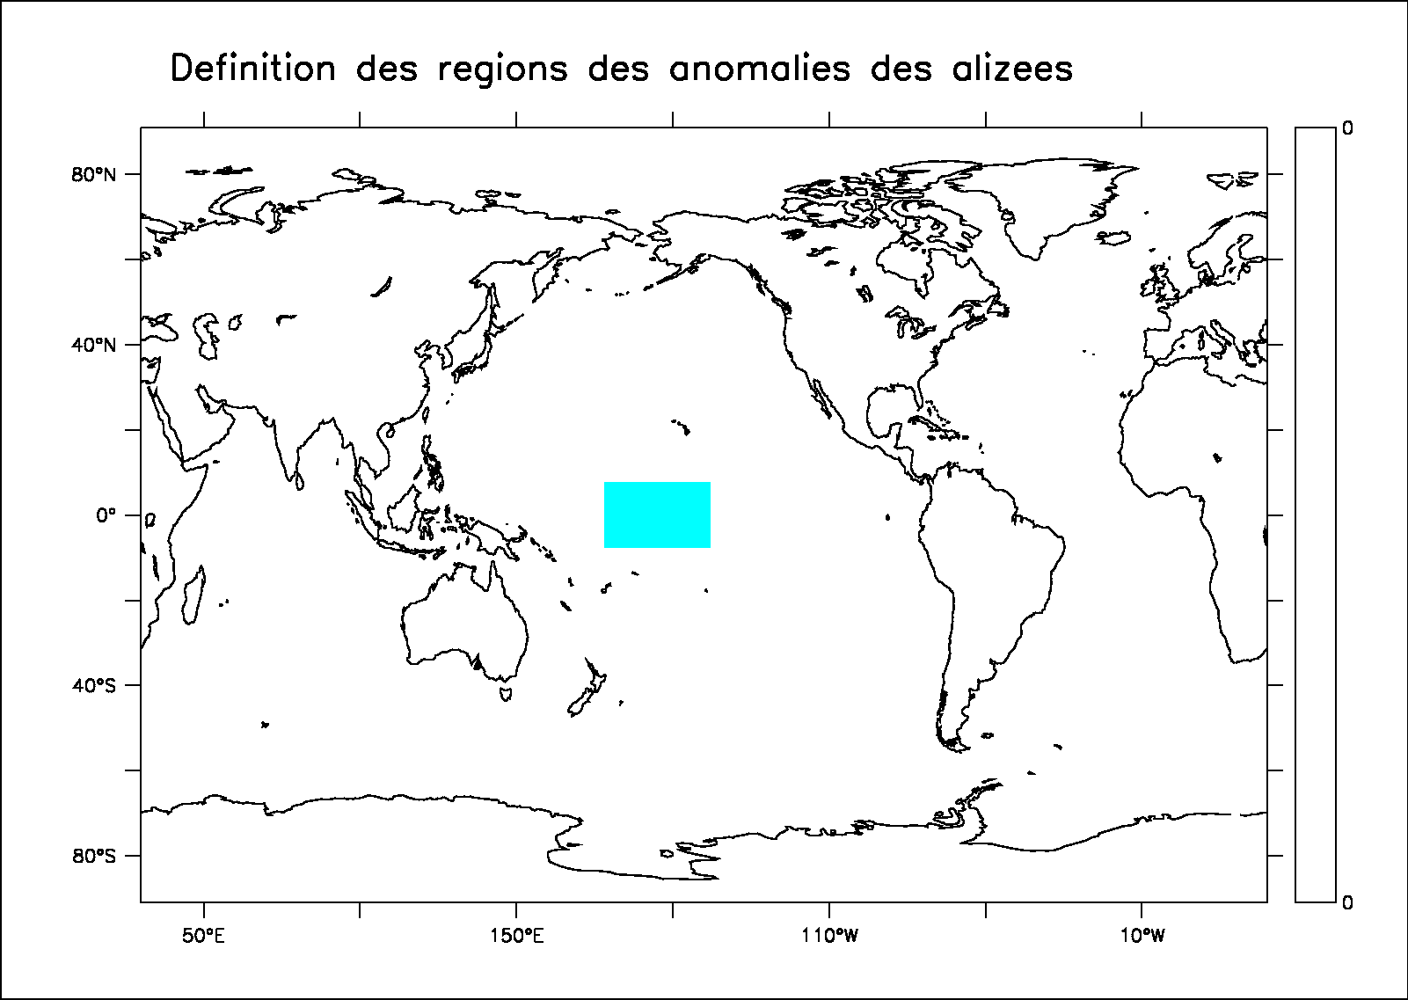
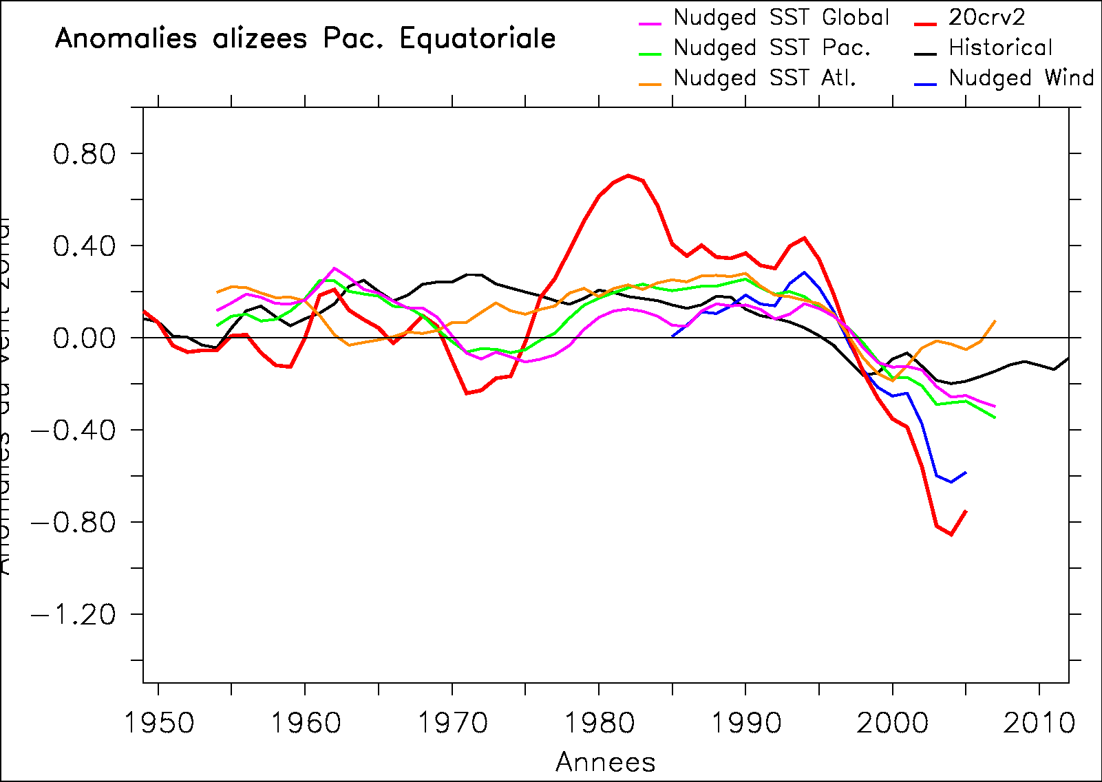
Zonal wind in the Tropical Pacific
NB: 5-yr running mean applied
Zonal wind stress anomalies
Cf. England et al. 2014

Slide 14
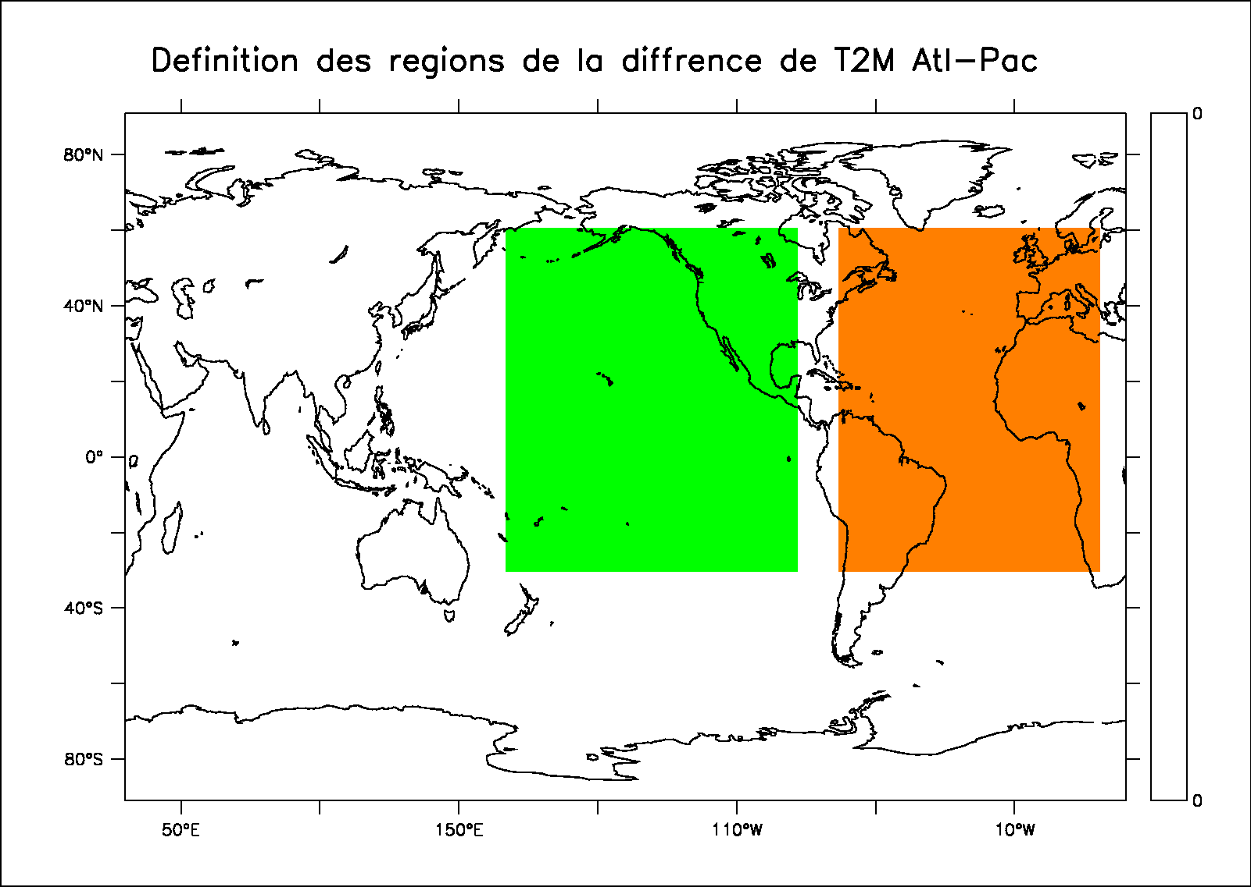
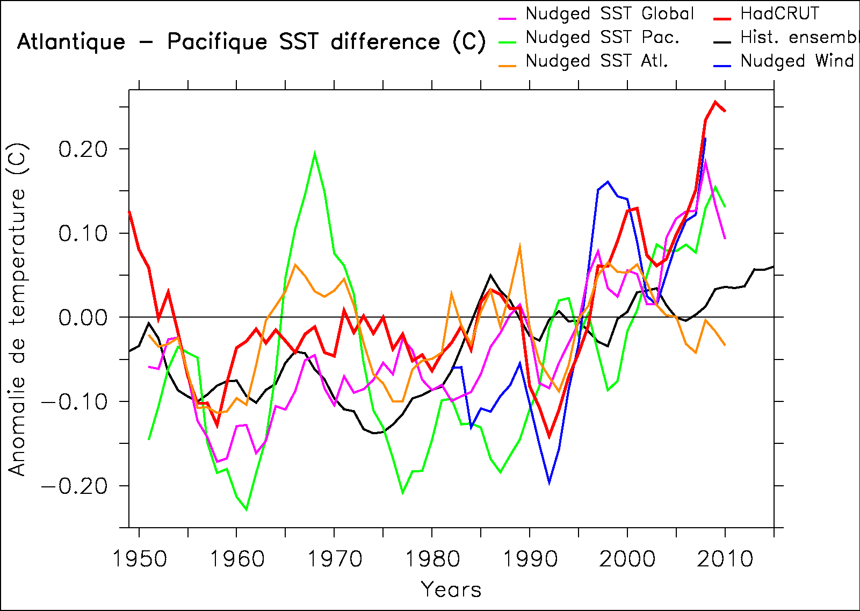
Atlantic-Pacific T2M differences
Cf. Mc Gregor et al. 2014

Slide 15
PDO-AMO relationship
IPSL-CM5A-LR
Marini and Frankignoul 2033
On the opposite, we do find a weak positive correlation at lag 0 year in the IPSL-CM5A-LR control simulation

Slide 16
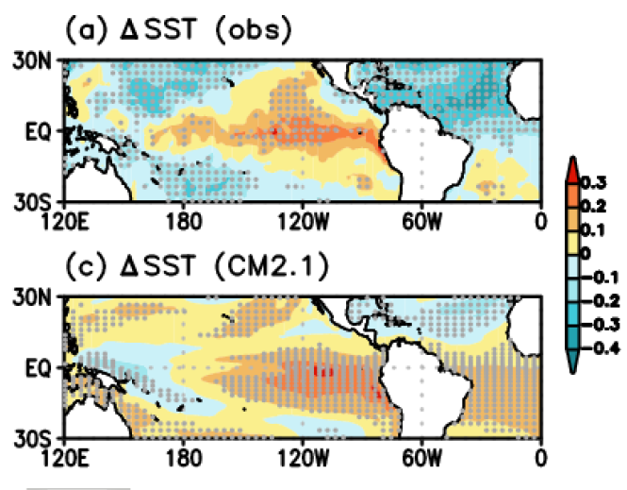
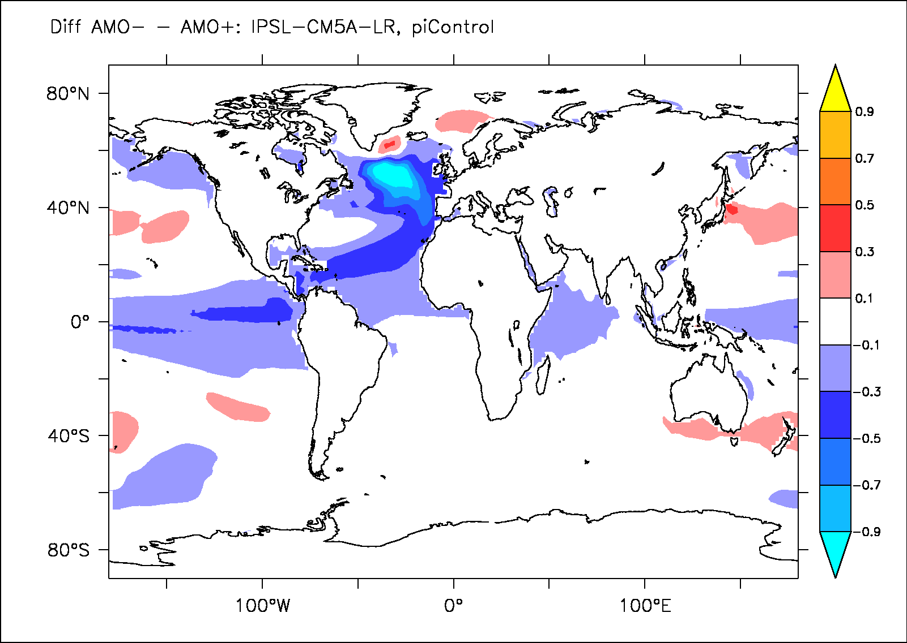
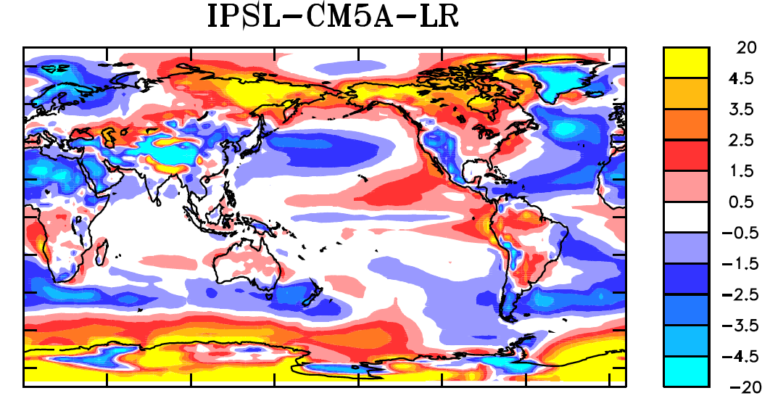
Atlantic-Pacific teleconnection
AMO- minus AMO+
Already not clear in piControl
Why? Issue wiith convection in the Atlantic (cold and warm bias)? Mechanisms at play?
Not very robust link in observations? (cf. Zanchettin et al. 2015)
Sung et al. GRL sub.
SST bias
Dufresne et al (2013)

Slide 17
Conclusion-discussion
Tropical Pacific control of Hiatus is clear in IPSL-CM5A, not the Atlantic
Why AMO-IPO link is not the same as in observations (cf. Marini & Frankignoul 2013) within piControl from IPSL-CM5A-LR
Role for the biases?
Observed relationship maybe not so significant? only a few phases change of the AMO over the instrumental era, need for longer time frame: last millennium?
Partially nudged simulations: a new MIP for DCPP (?)

Slide 18
Thank you!

Slide 19
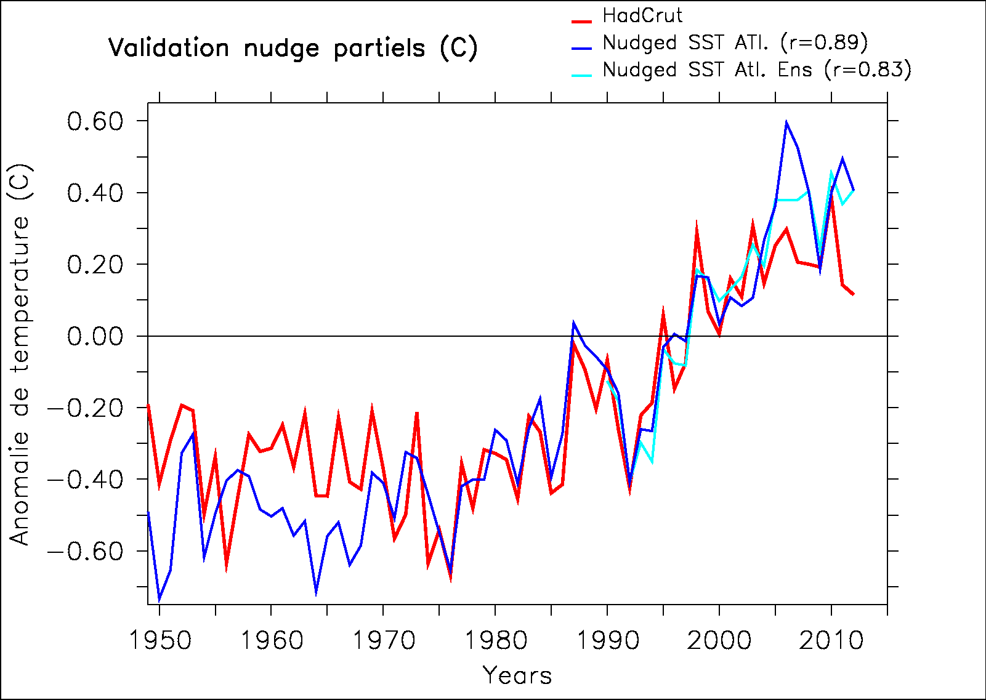
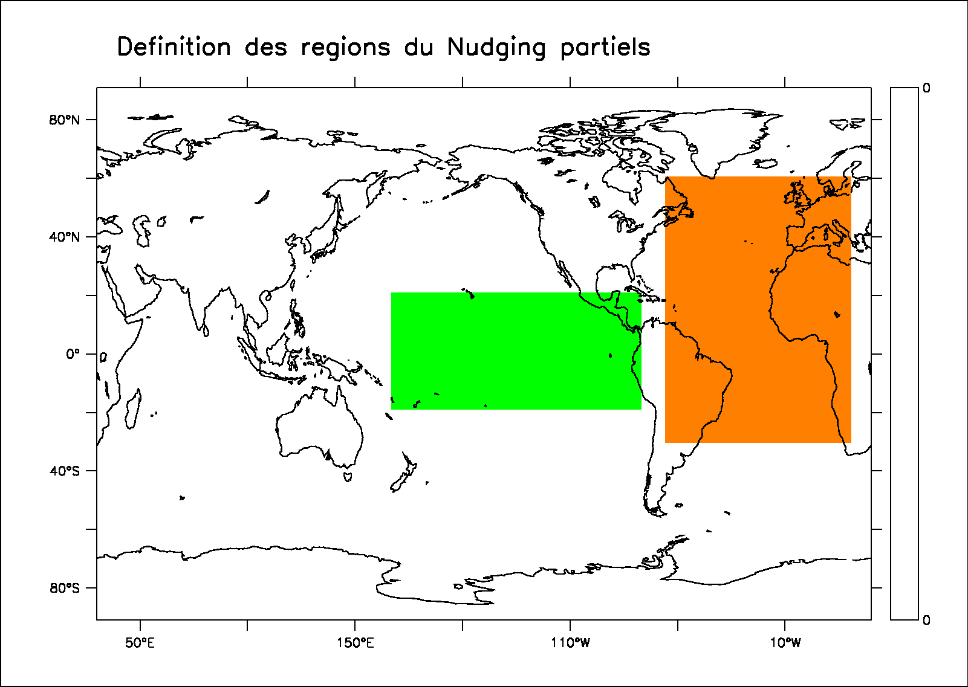
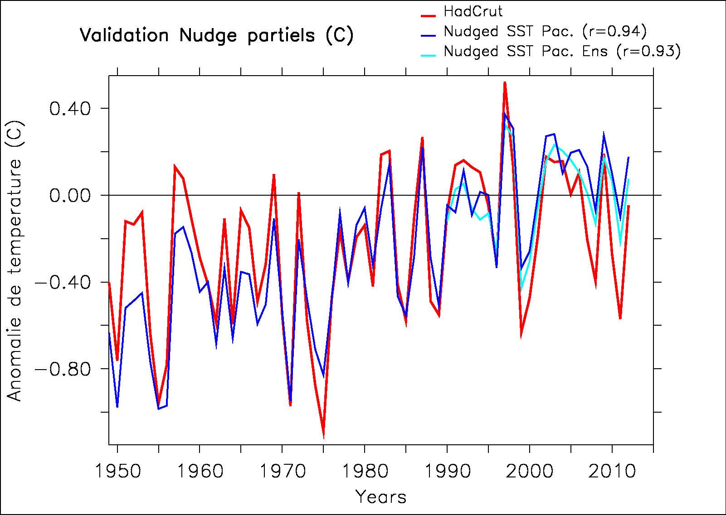
Validation nudgés partiels

