Slide 1
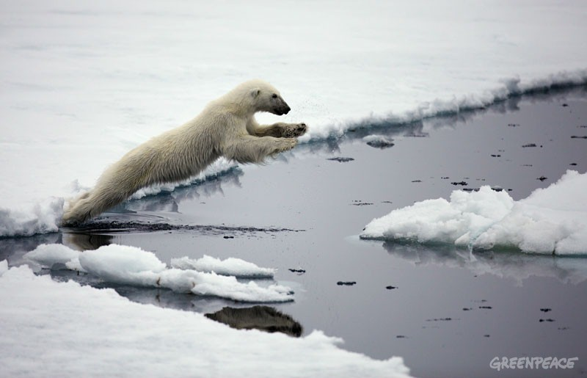
Abrupt changes in the Labrador Sea within CMIP5
Didier Swingedouw & Giovanni Sgubin
Can we find big jumps in the Labrador Sea?

Slide 2
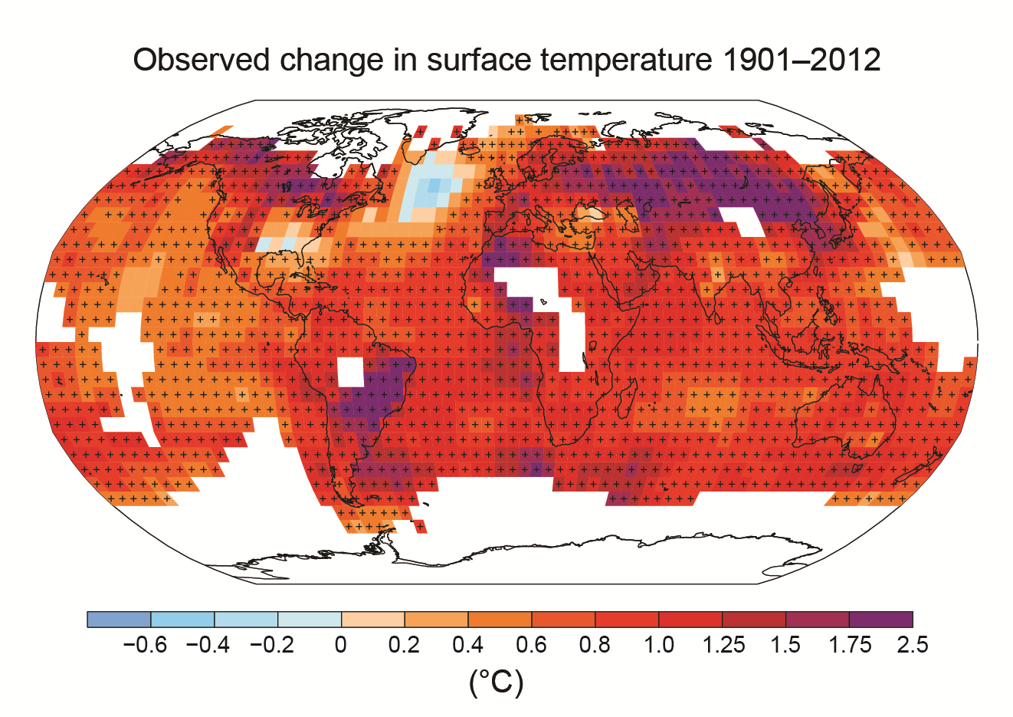

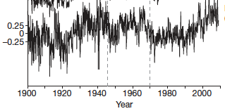
North Atlantic warming hole
Warming hole in the North Atlantic for temperature trend over the last century (IPCC-AR5 summary for policymakers)
Thompson et al. (2010): observed abrupt changes in the late 1960s, early 1970s in the North Atlantic
Drijfhout et al. (2012): oceanic adjustment to convection changes

Slide 3
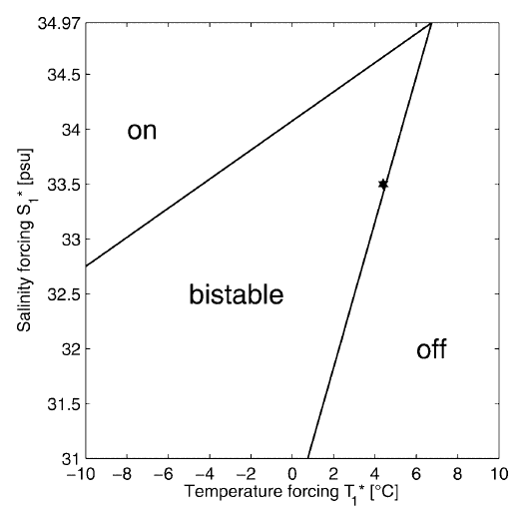
Labrador: a bistable convective sea?
Simple model from Kuhlbrodt et al. (2001) suggests that this Sea can be bistable
Also suggested in Swingedouw et al. (2007) in IPSL-CM4 OAGCM
Born & Stocker (2014) found similar behaviour in another conceptual model including gyre dynamics
Among others…
Kuhlbrodt et al. (2001)
Notes:
Based on OWS bravo data (section acorss the Labrador Sea)

Slide 4
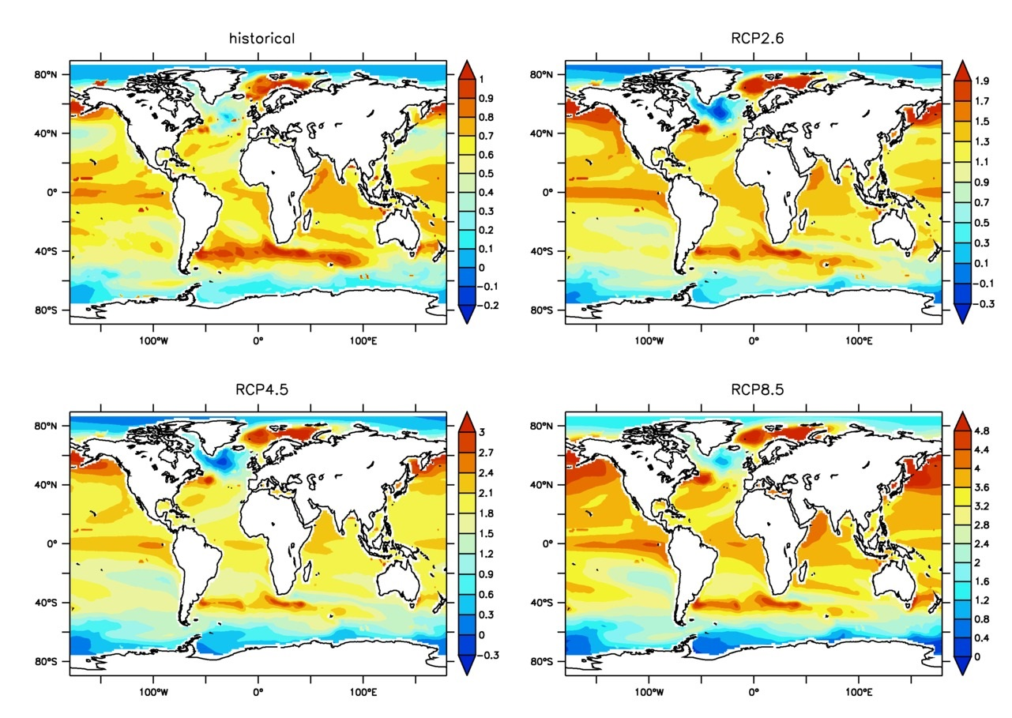
Screening of CMIP5 archives
End-beginning in CMIP5 SST ensemble mean
Analyse warming hole found within CMIP5 simulation
Select the most abrupt changes in time series following a few statistical criteria

Slide 5
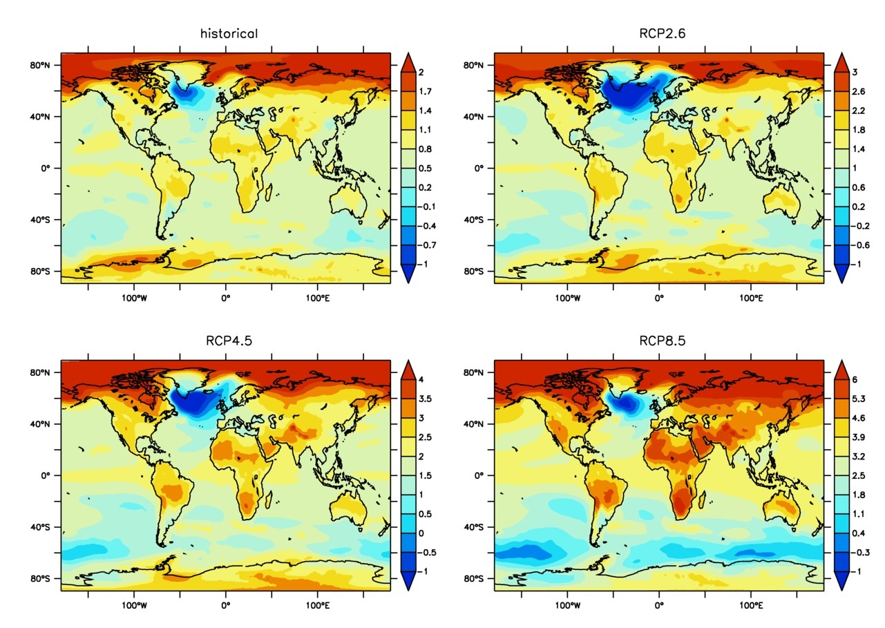
Abrupt changes happen in a few models
case | historical | RCP2.6 | RCP4.5 | RCP8.5
more warming | 43% | 23% | 18% | 26%
less warming | 57% | 50% | 64% | 74%
cooling | 20% | 27% | 18% | 9%
rapid cooling | 5% | 23% | 15% | 6%
Composite of models with rapid cooling

Slide 6
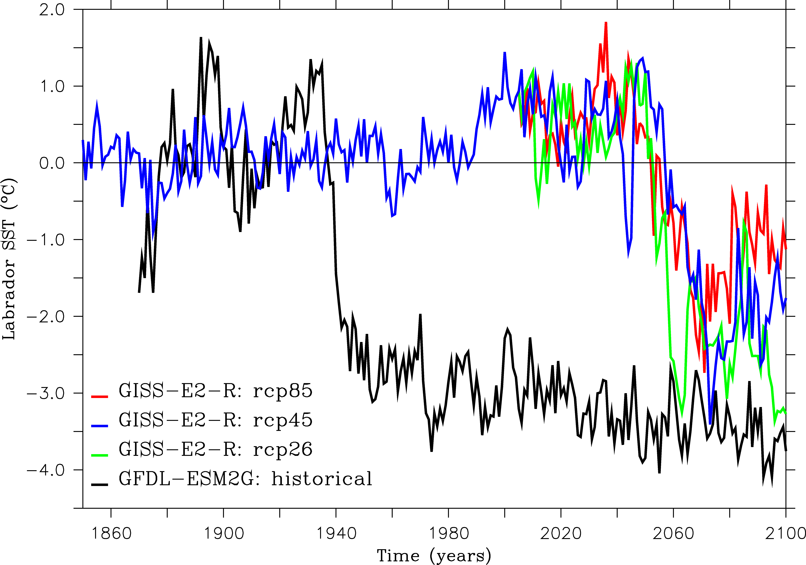
Very abrupt changes in two models

Slide 7
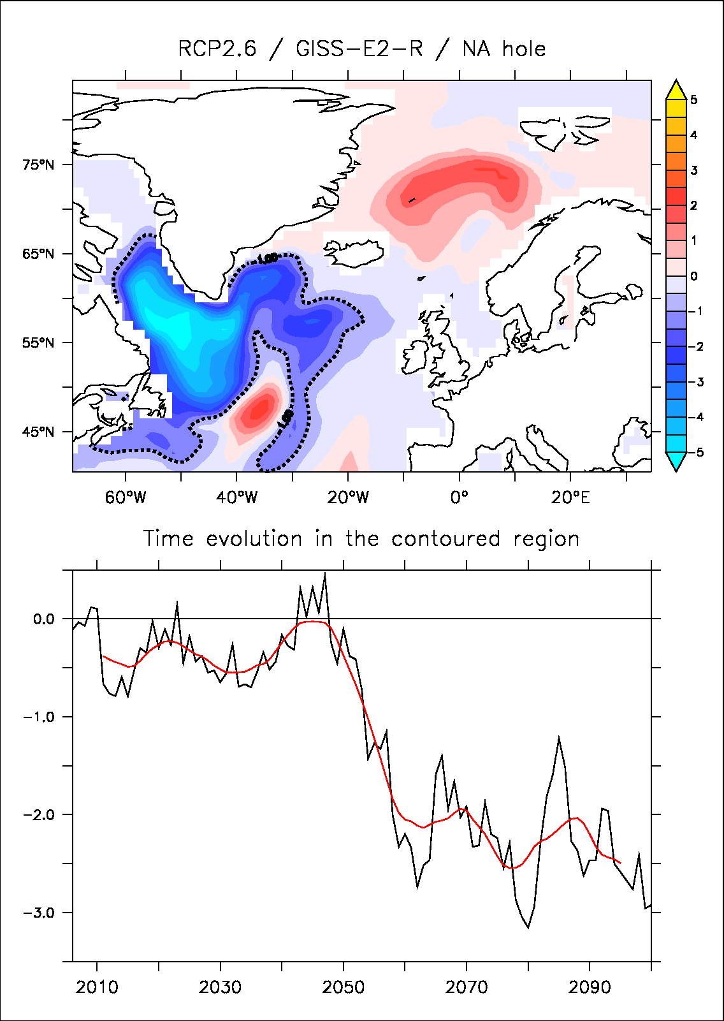
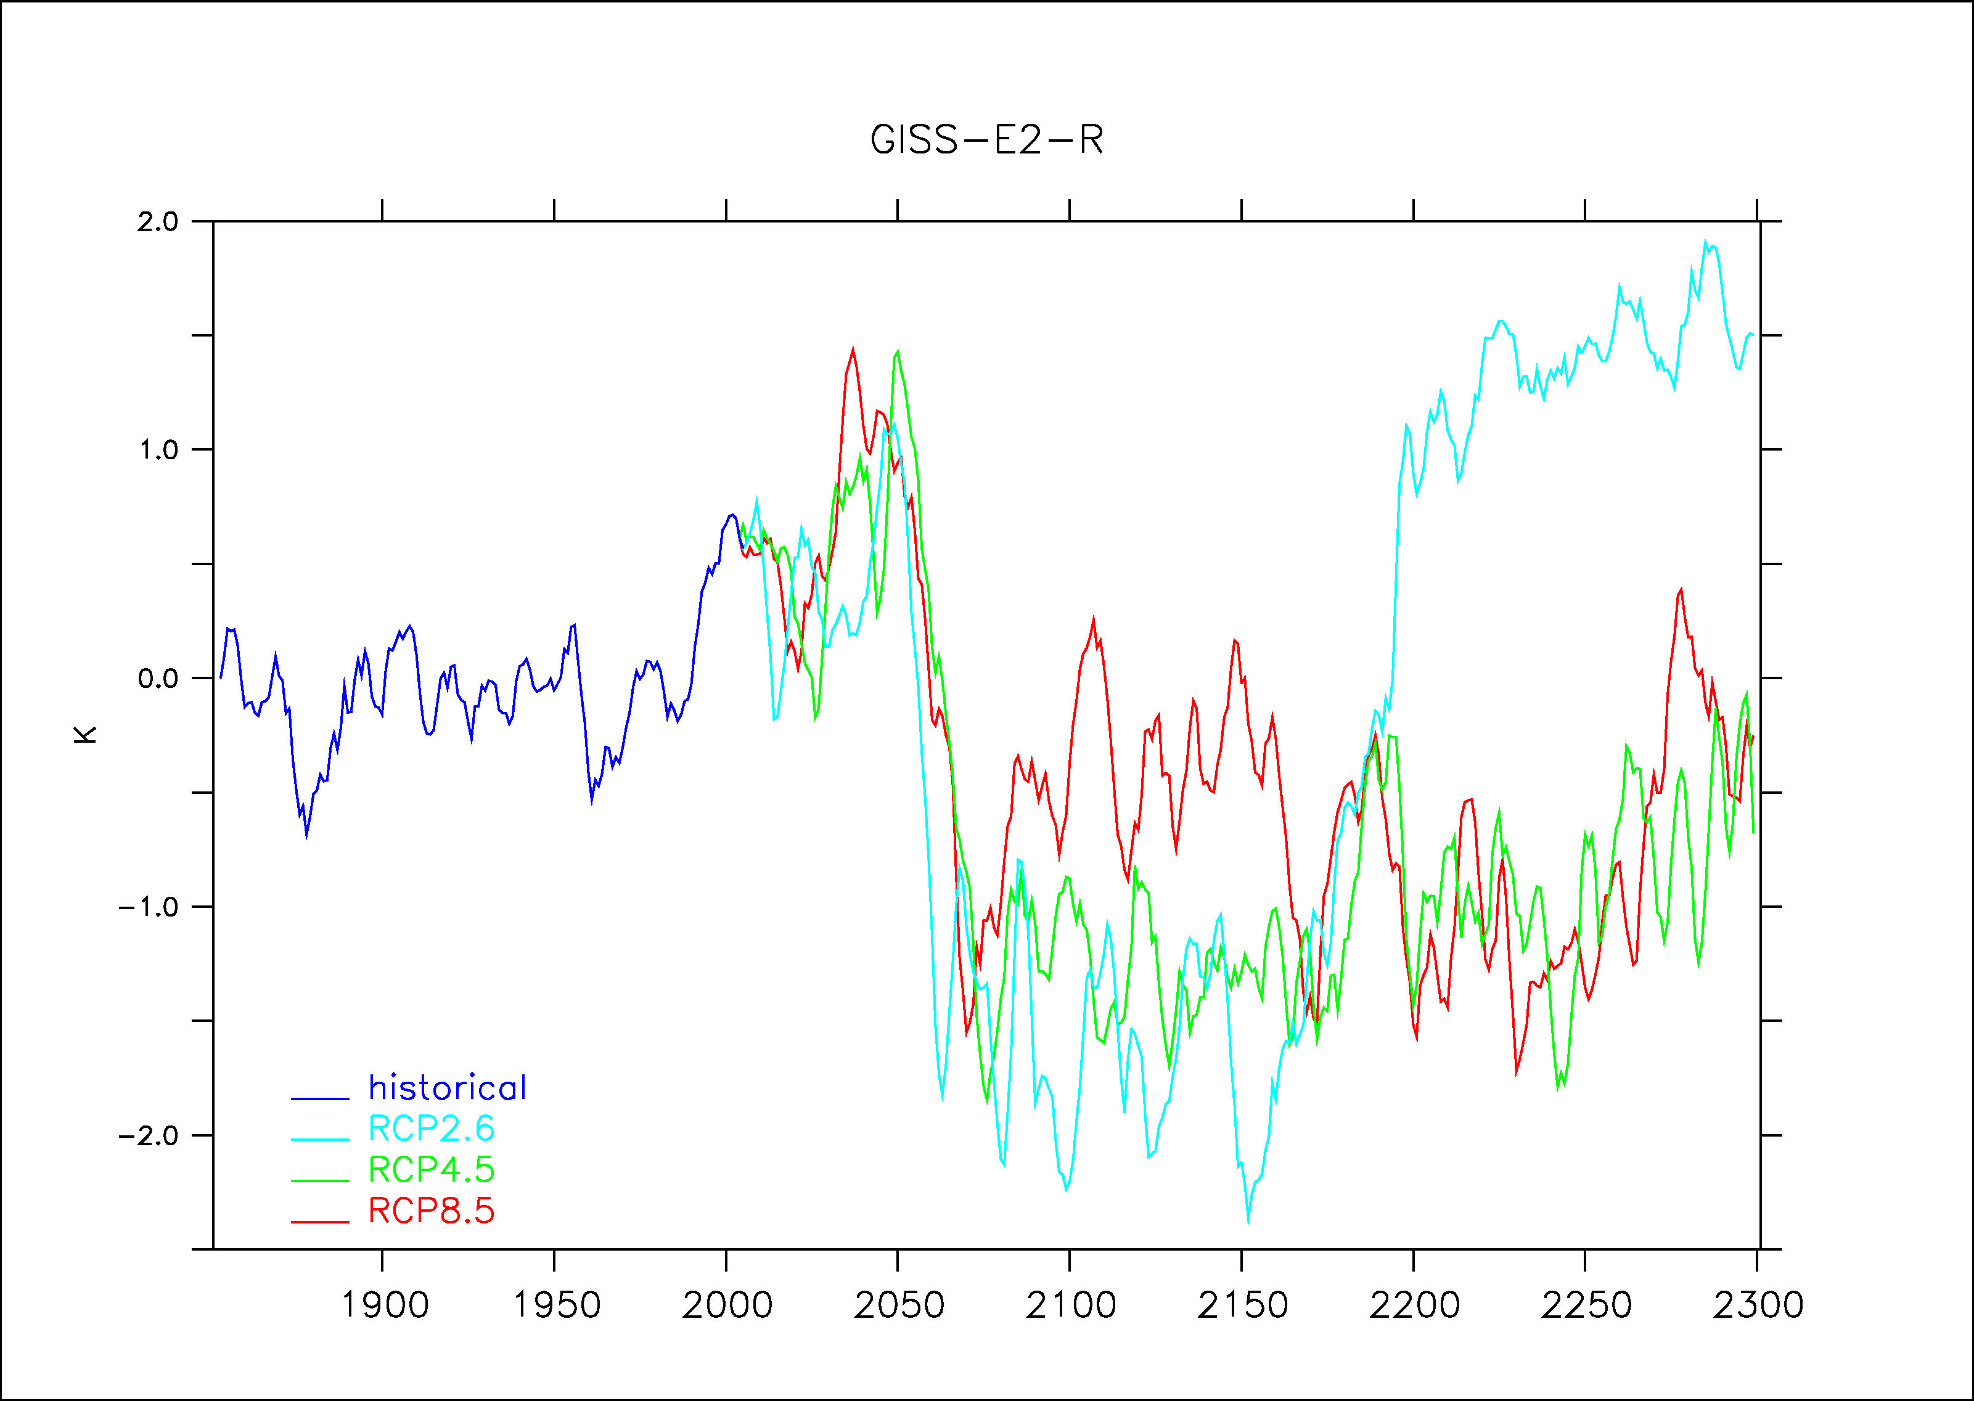
GISS-E2-R
Abrupt cooling in all the scenario around 2050!

Slide 8
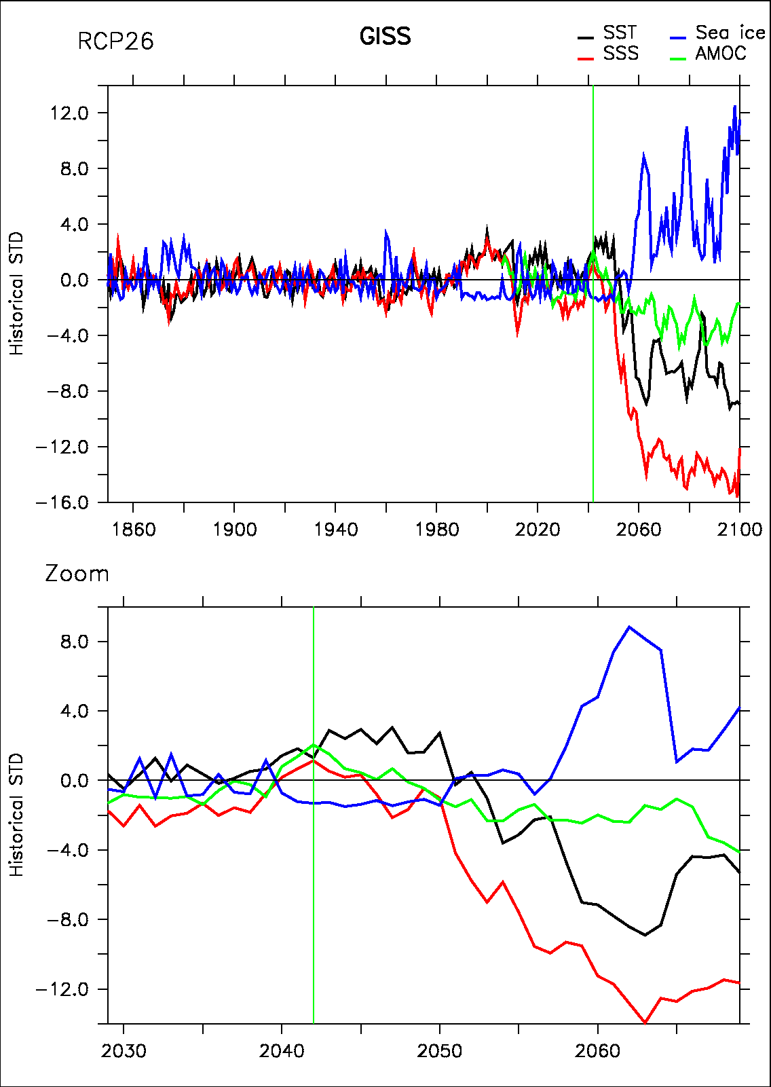
Chain of events
Rapid changes of up to 10 historical std in 10 years
Salinity is the first to start the change
Followed by SST and sea ice
AMOC changes are not big enough to explain such an abrupt event
Not lead by AMOC or gyre circulation changes, rather related to changes in “1D” convection

Slide 9
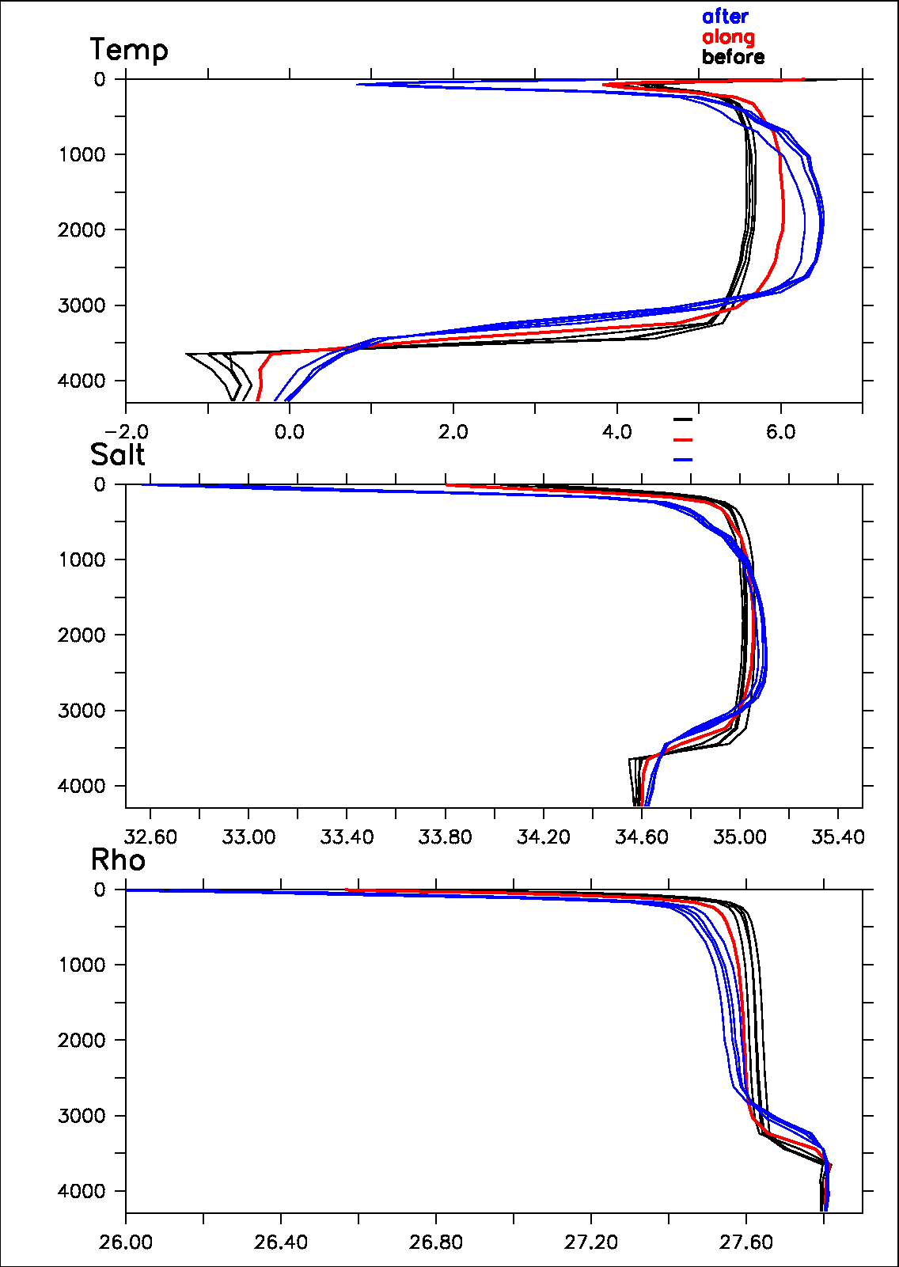
Stratification changes
Large increase in stratification after the jump
Mainly related with salinity changes at the surface
Decrease of mixed layer depth on winter may diminish total heat capacity of the active ocean layer

Slide 10
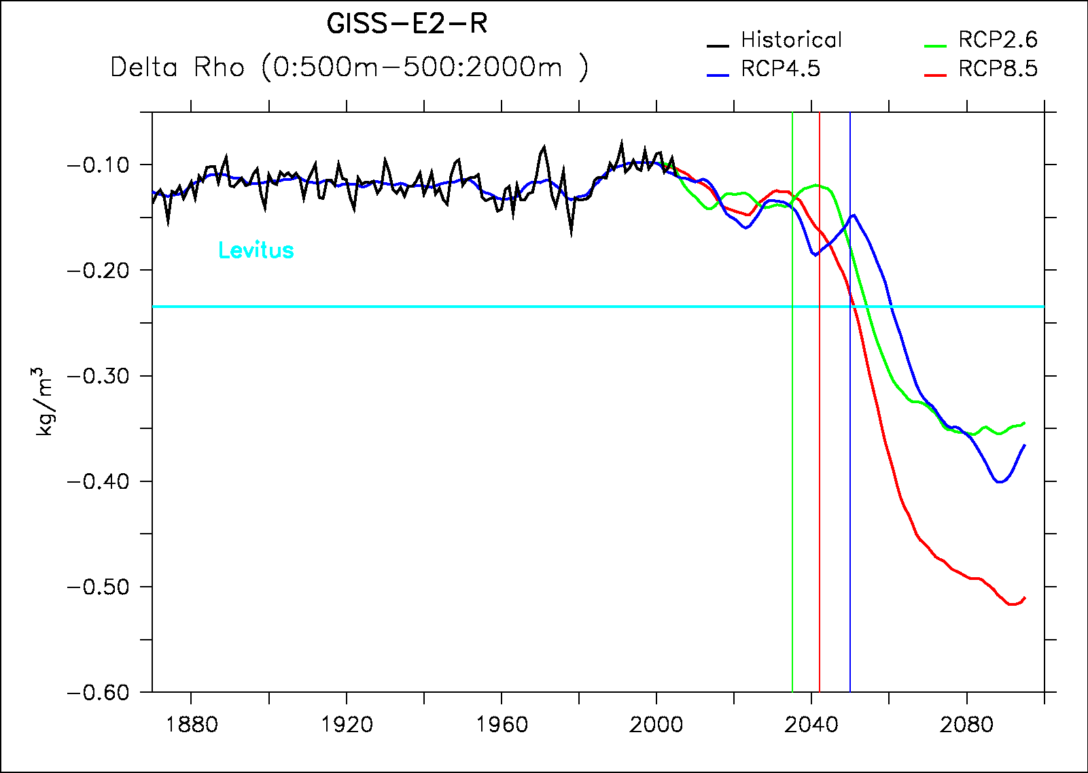
Stratification changes
Threshold=0.2

Slide 11
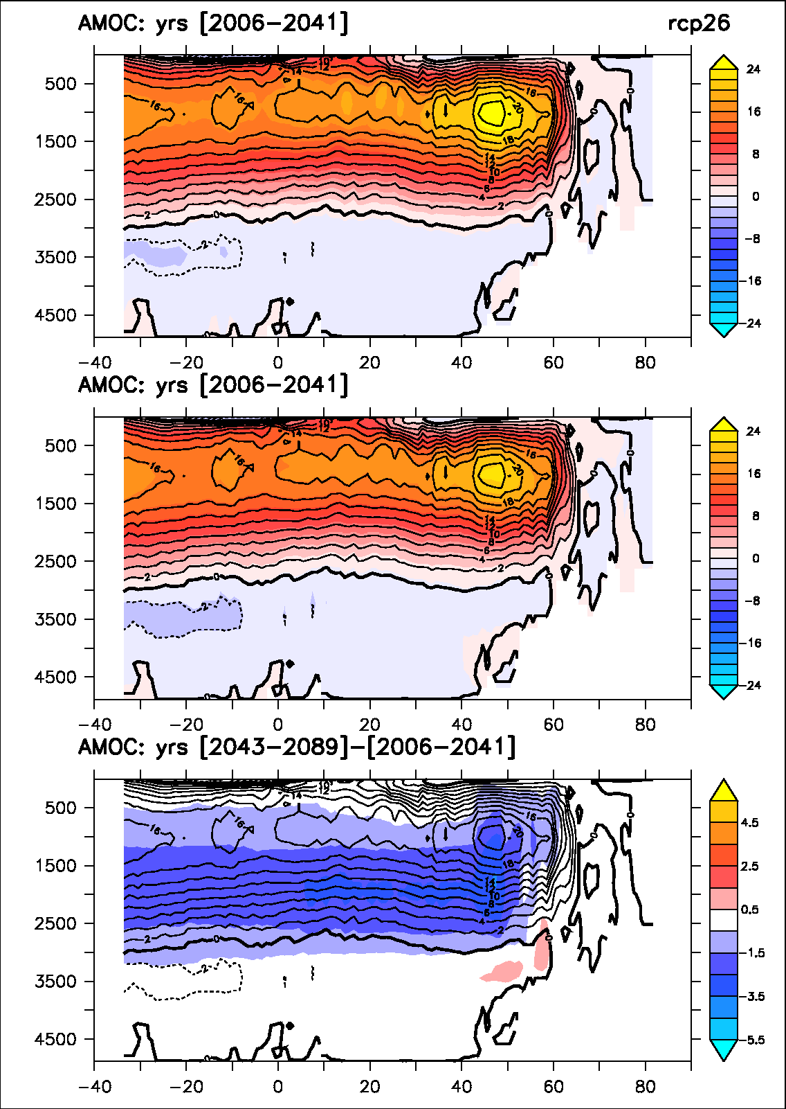
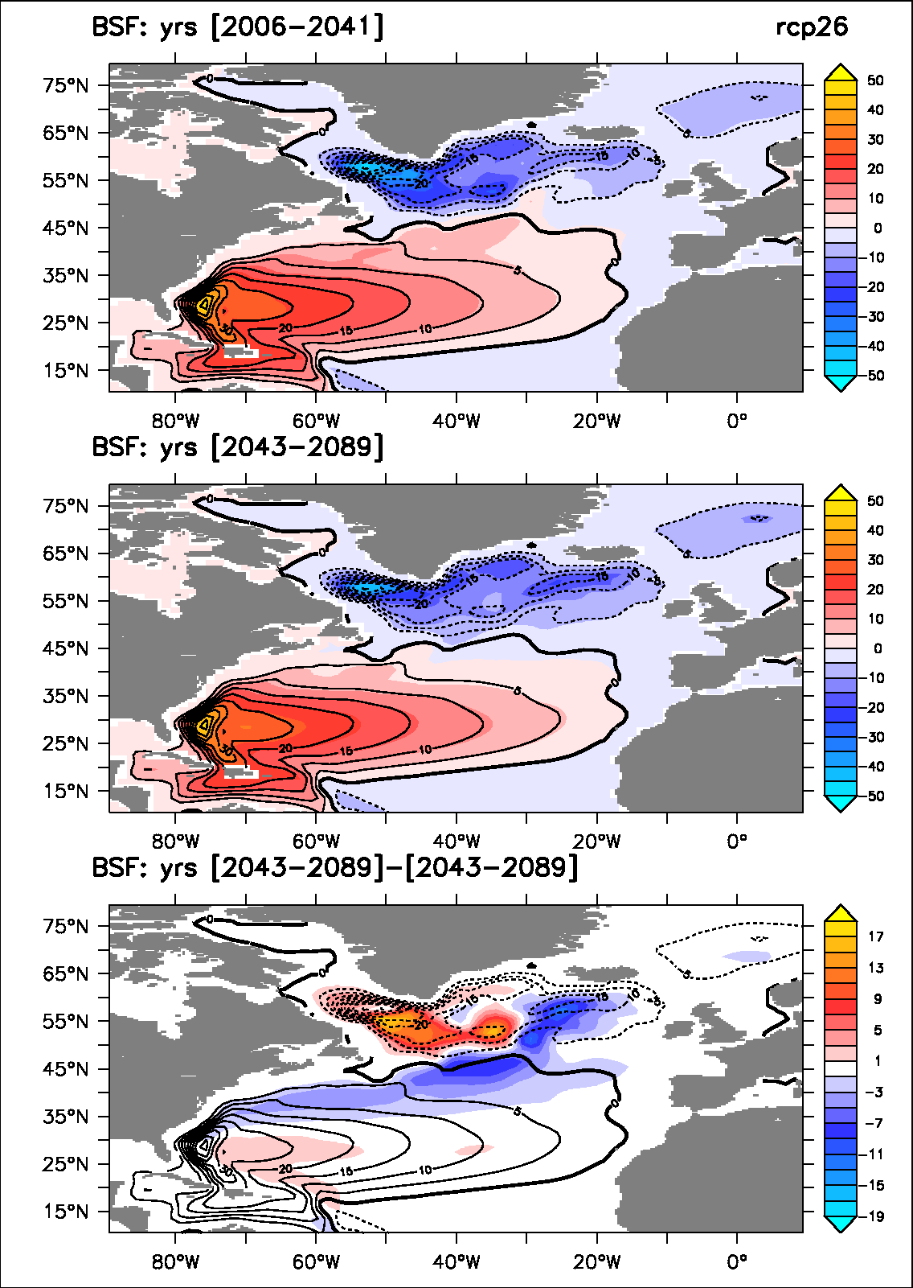
Large-scale circulation changes

Slide 12
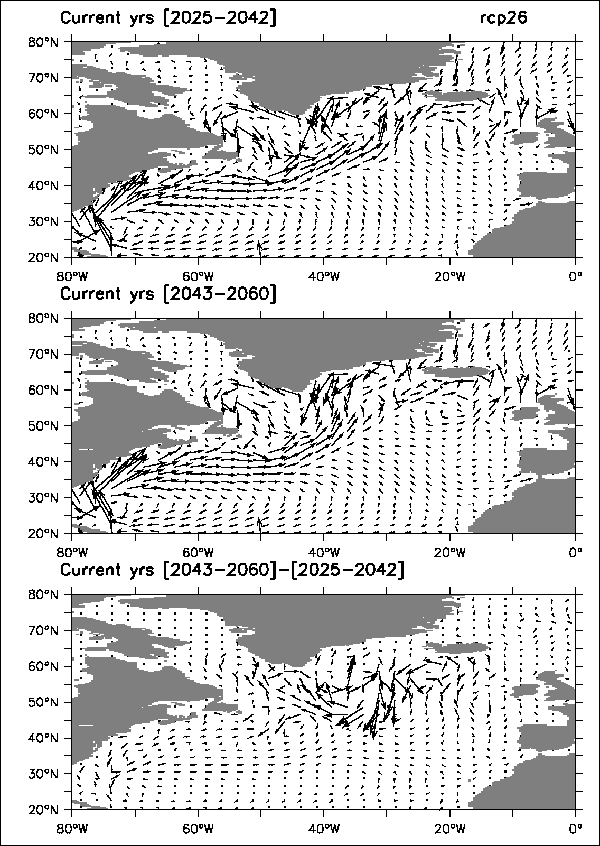
Changes in oceanic current in rcp26
North Atlantic drift is less “deflected” after the Labrador Sea convection collapse = strong positive feedback

Slide 13
GHG
Suggested mechanisms
SST
Lab. Sea
Surface
density
Stratification
SSS
+
Atlantic water import in the Lab Sea
Convection
Large atmospheric cooling over Lab Sea
Threshold
No more convection
Large sea ice formation
Strong halocline
Decreased ocean heat capacity in winter
Strong cooling in winter

Slide 14
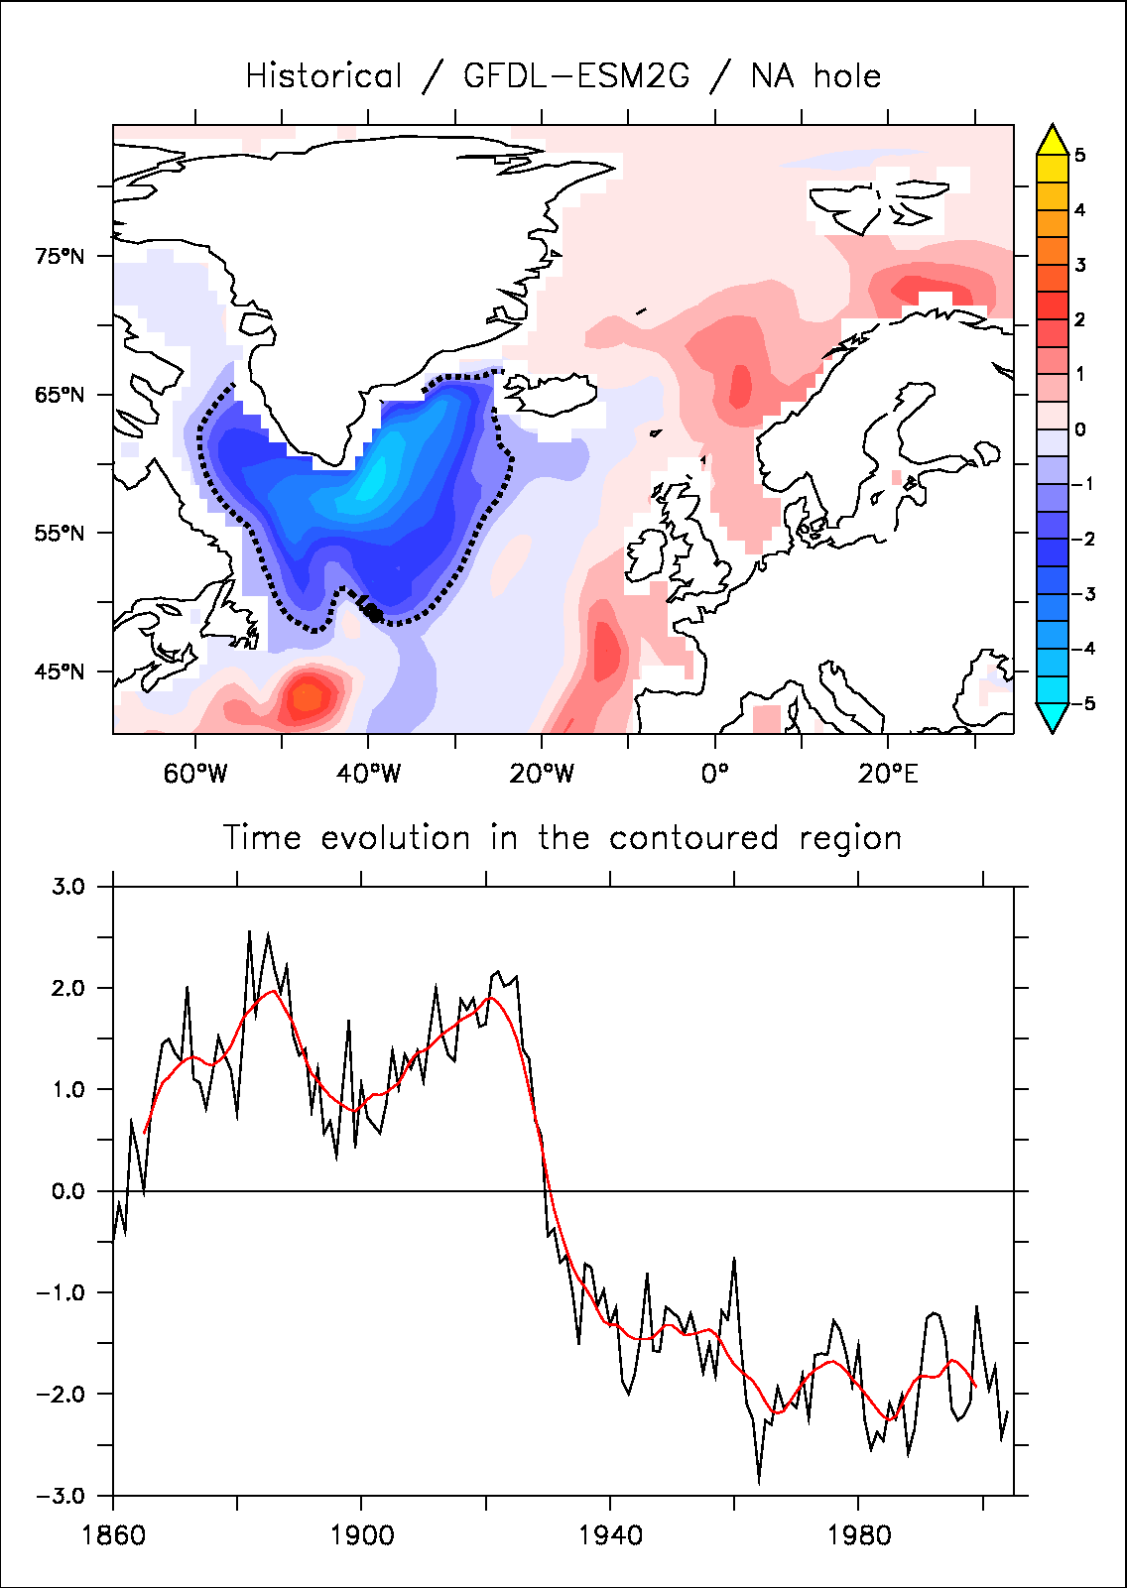
GFDL-ESM2G
The abrupt change is occurring as early as the 1930s and contrary to what has occurred in reality in the 1970s, there is no recovery in this model

Slide 15
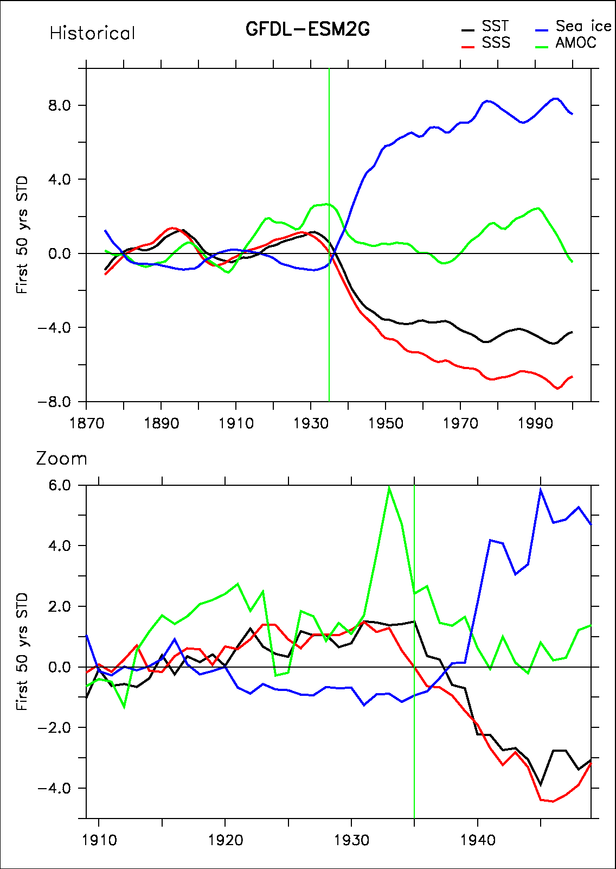
Chain of events
Once again led by SSS in the Labrador Sea….

Slide 16
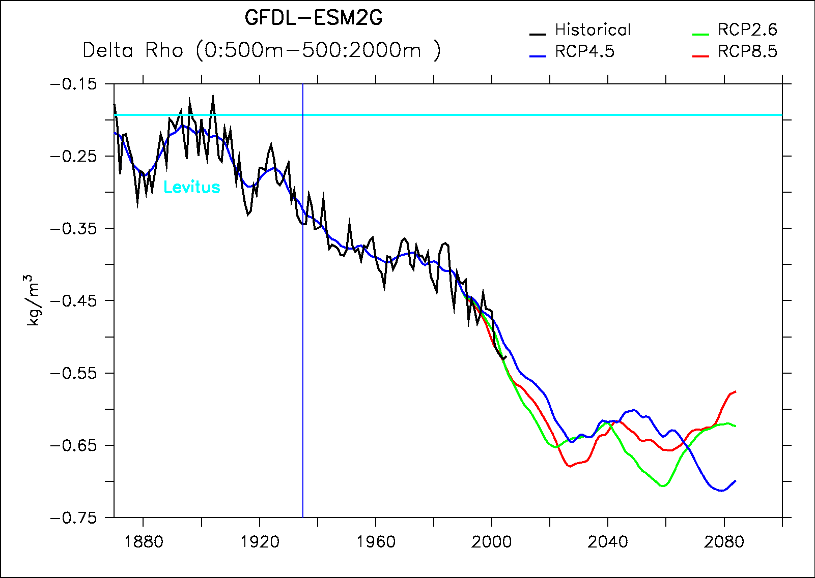
Stratification changes
Threshold=0.3

Slide 17
Perspectives
Why is it only occurring in a few models?
  Amplitude of positive feedback (circulation changes) can be model dependant
  Evaluation of the representation of North Atlantic drift in the model that do show a Labrador convection collapse (too zonal in most models…)
Looking into CMIP5 stratification in the Labrador Sea and evaluate the threshold in multi-model ensemble
Locate models on the TS diagram from Kuhlbrodt et al. (2001)
Documentation on GFDL-ESM2G and GISS-E2-R: did the inclusion of marine geochemistry play a role?
Higher resolution run?

Slide 18
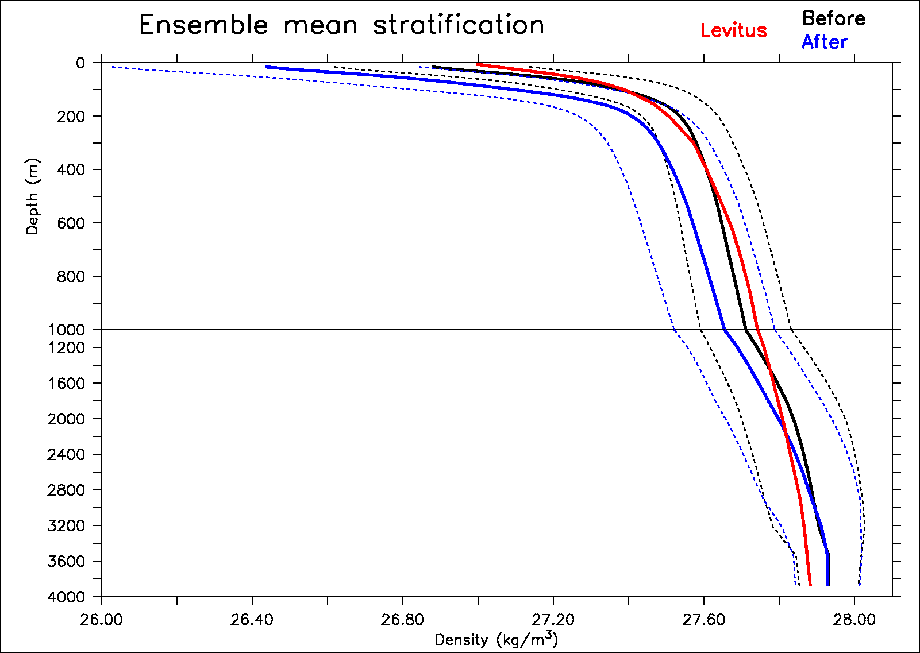
titi

Slide 19
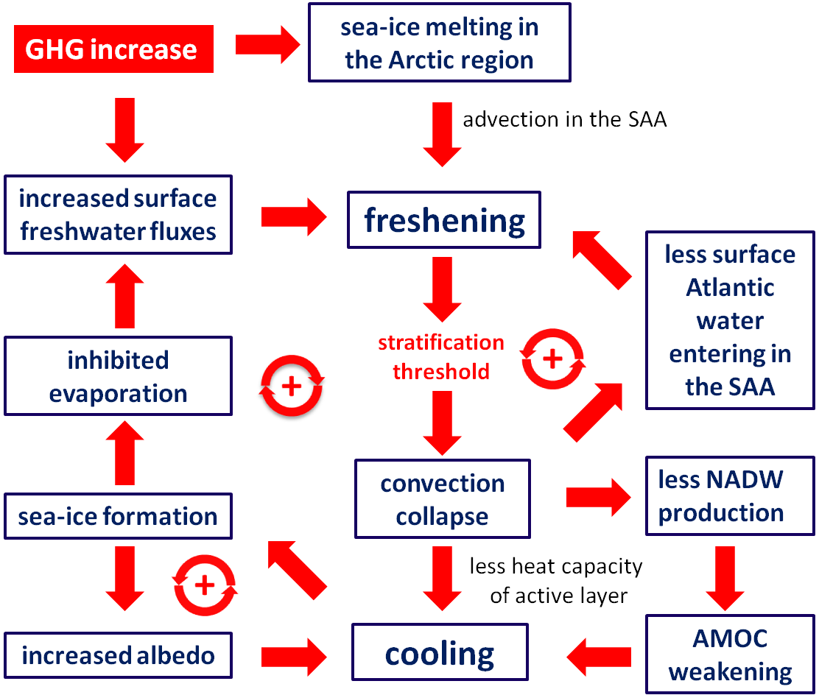

Slide 20
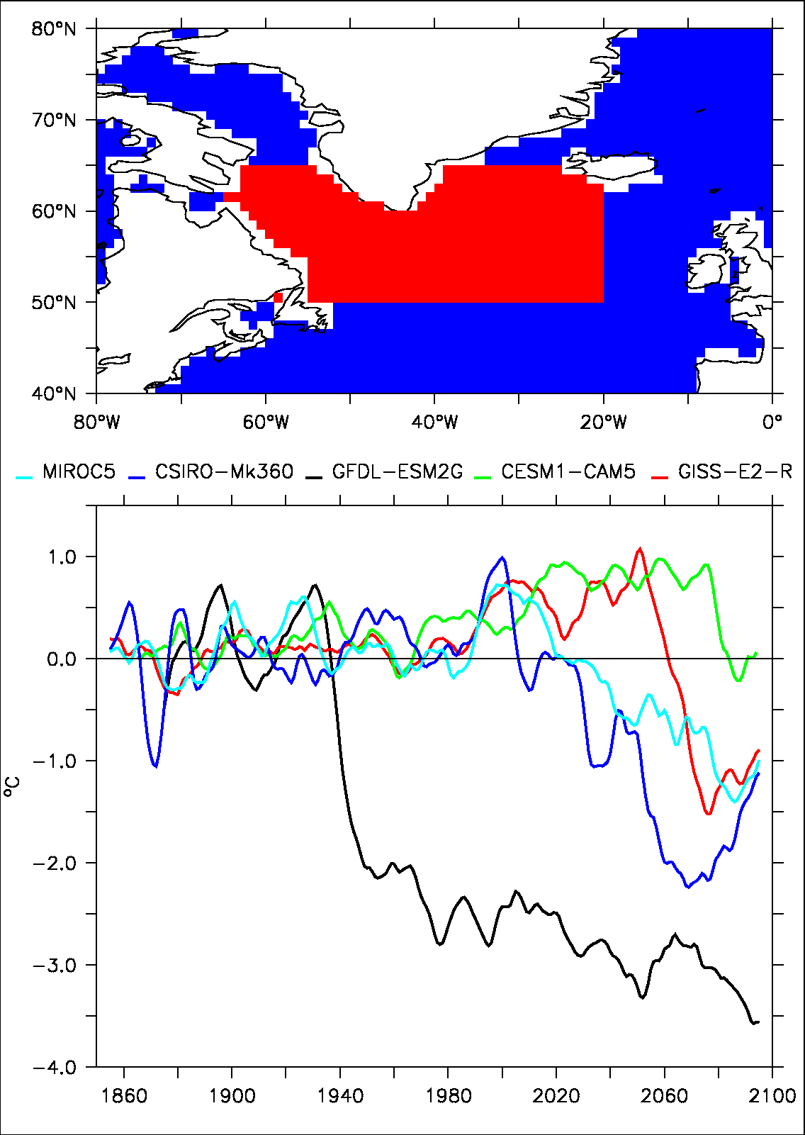

Slide 21
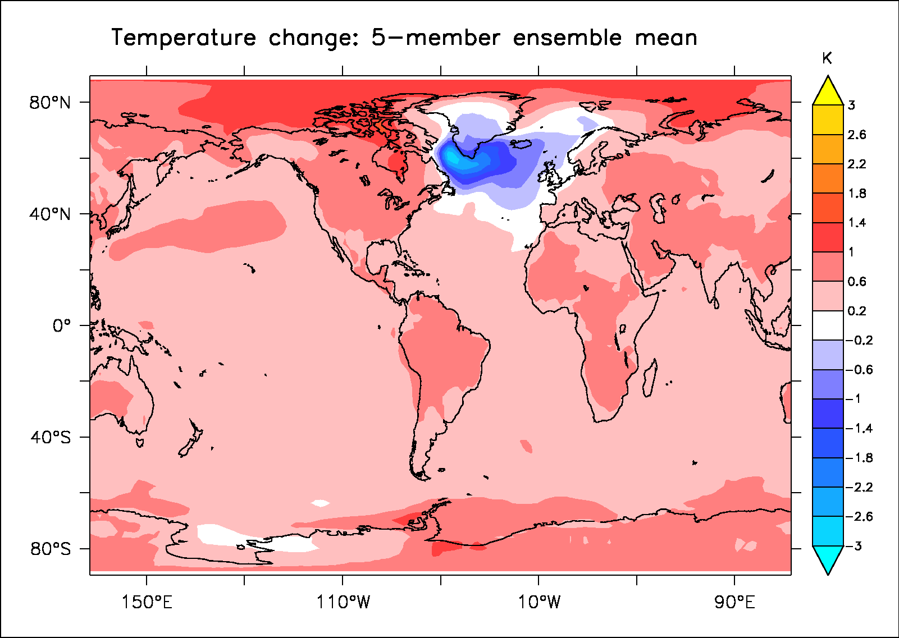
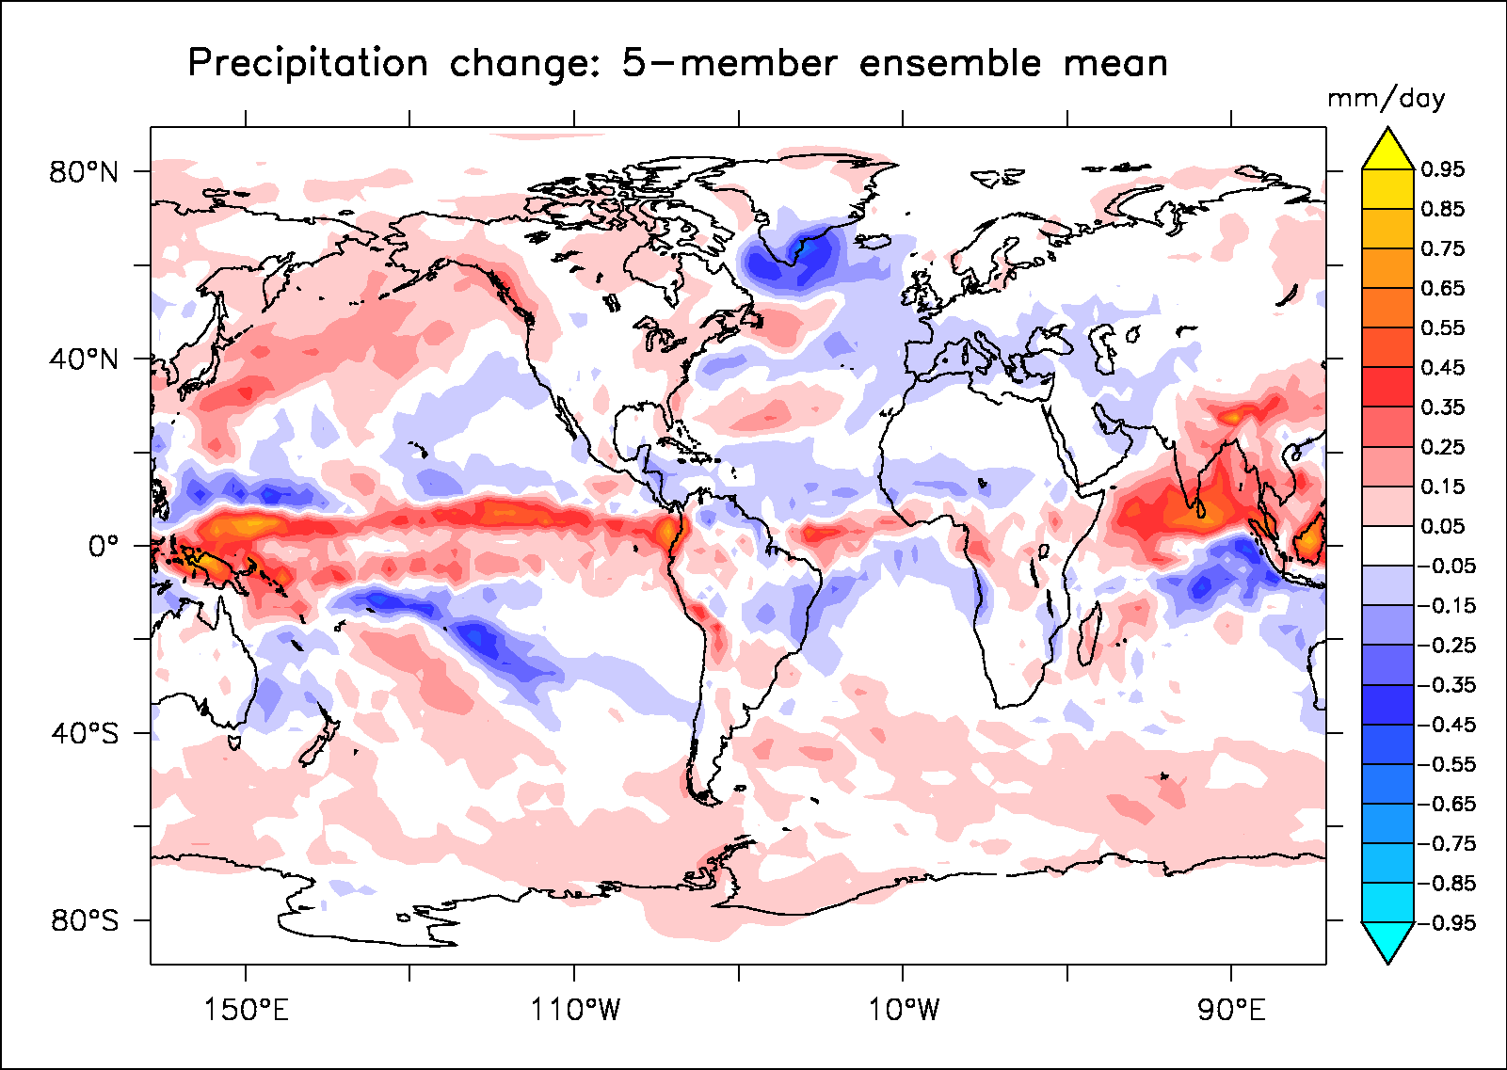
After minus before in the 5 models with abrupt changes

Slide 22
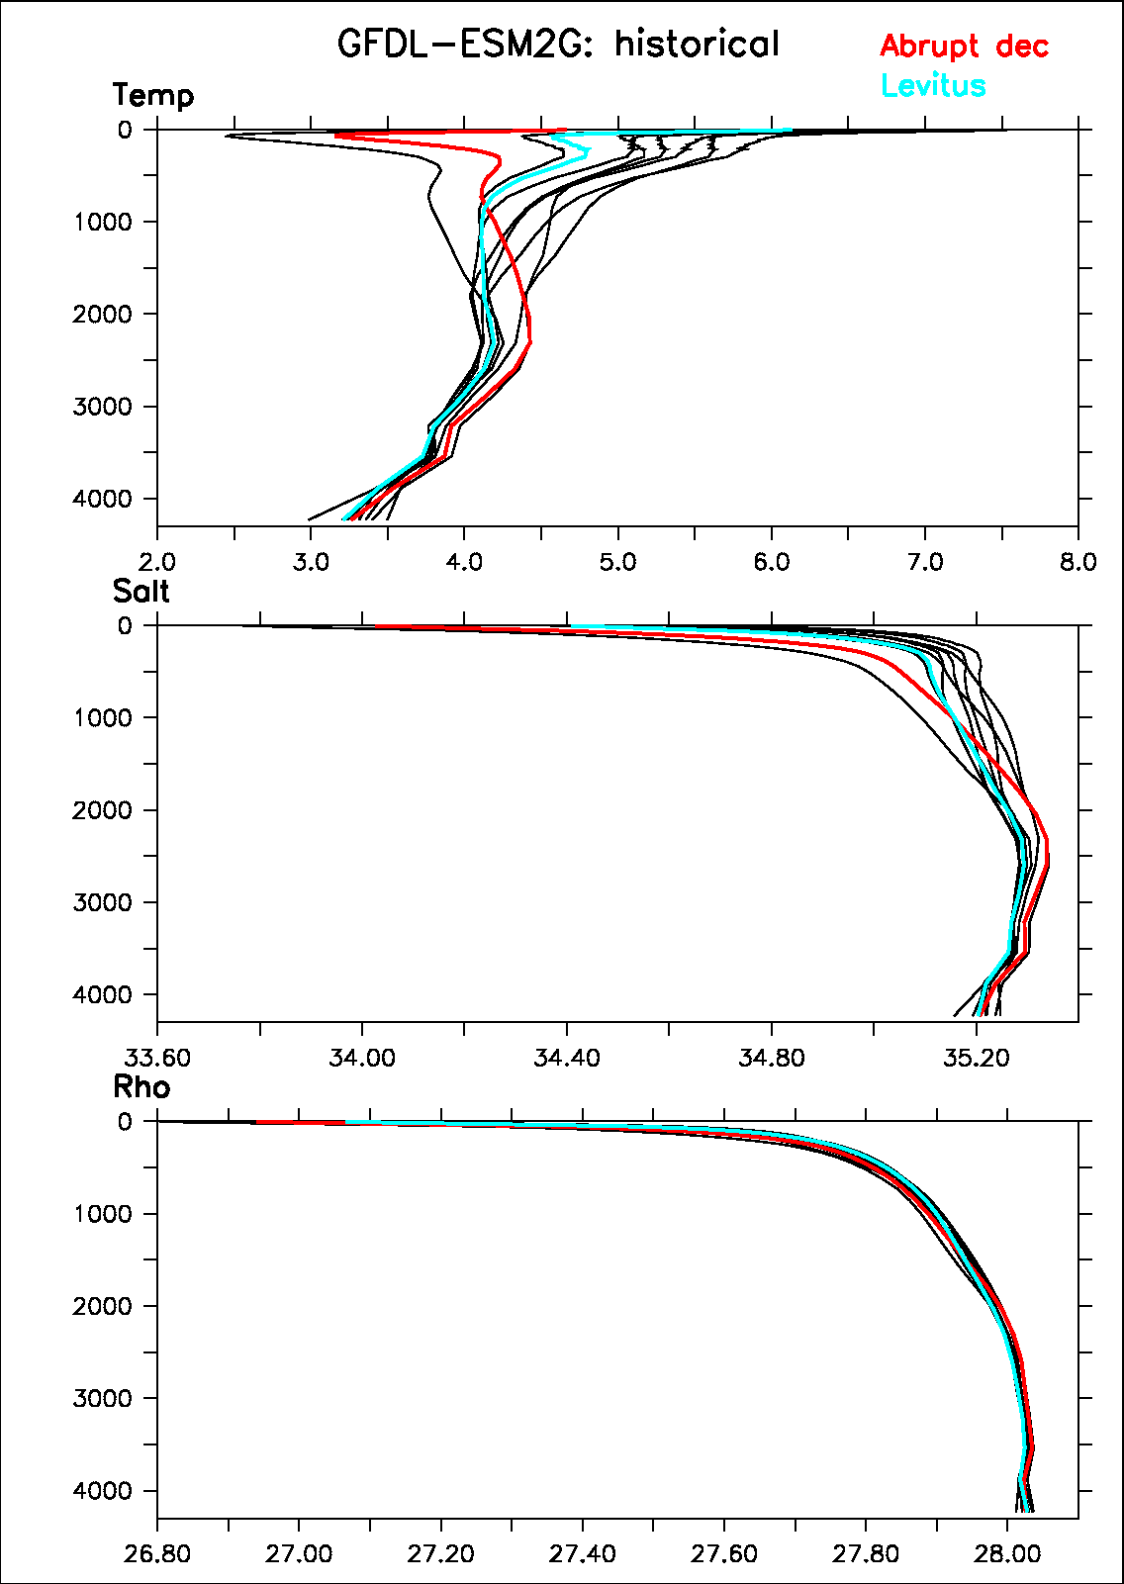
Stratification changes

Slide 23
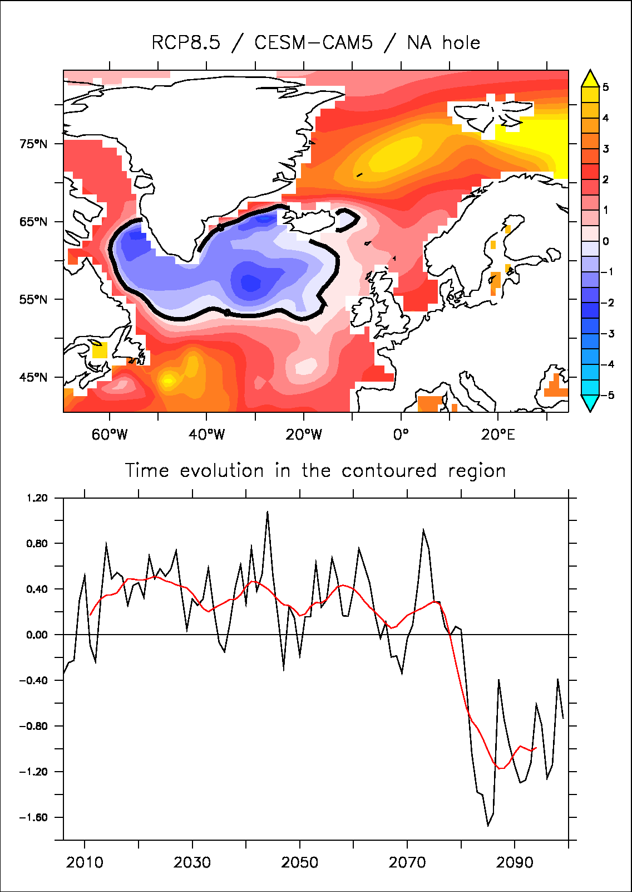
CESM1-CAM5

Slide 24
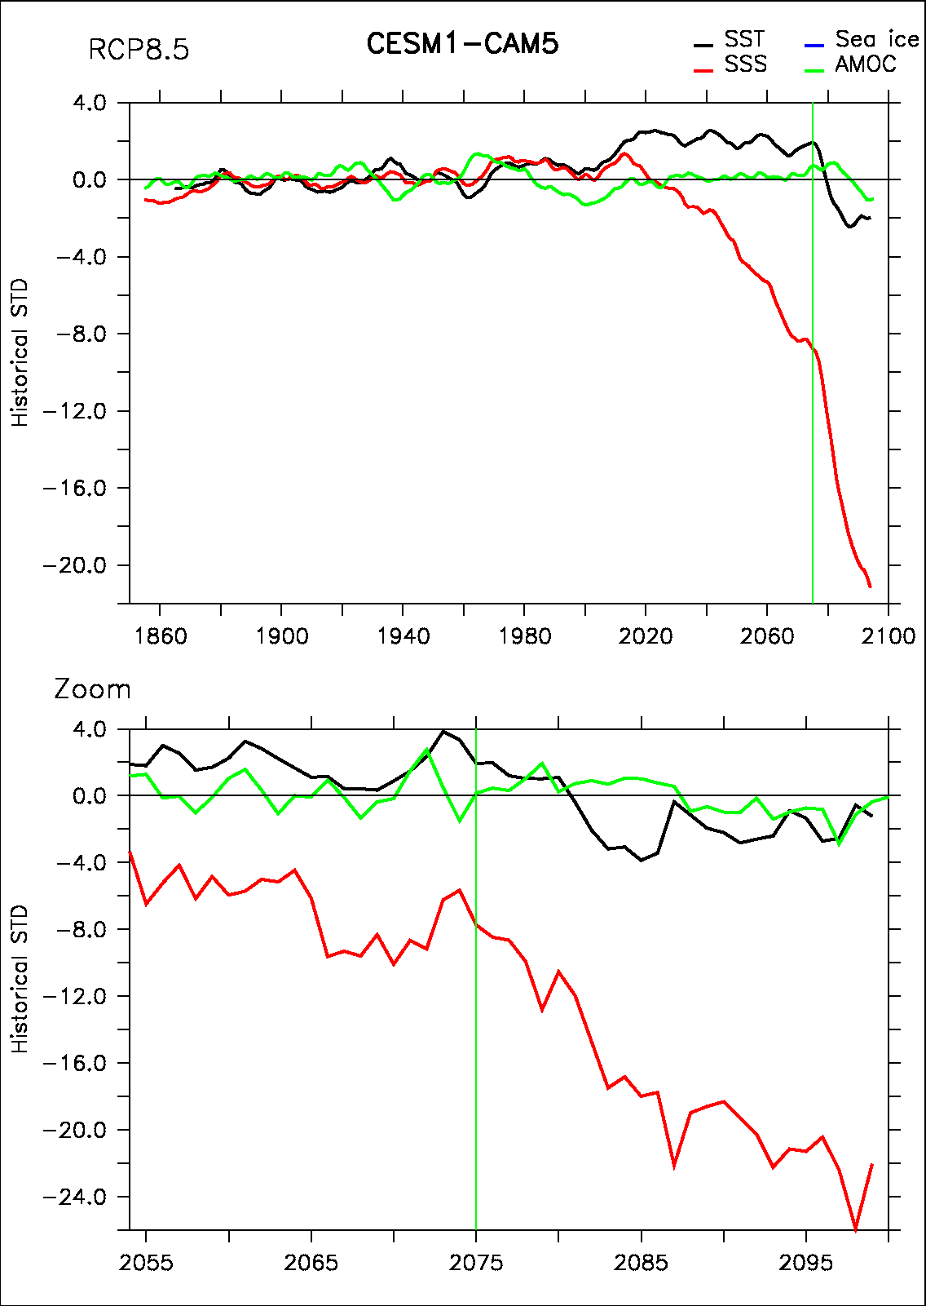
Chain of events
Once again led by SSS in the Lab Sea

Slide 25
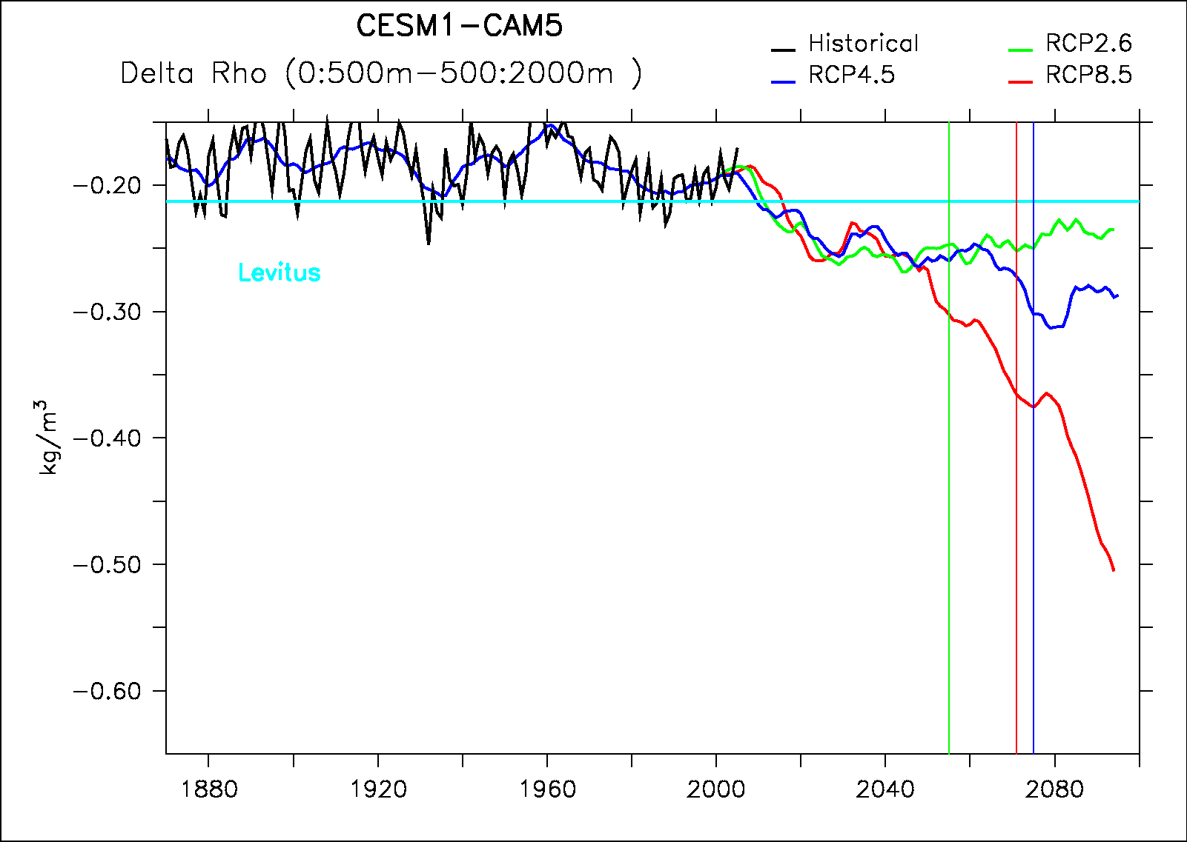
Stratification changes
Threshold=0.3

Slide 26
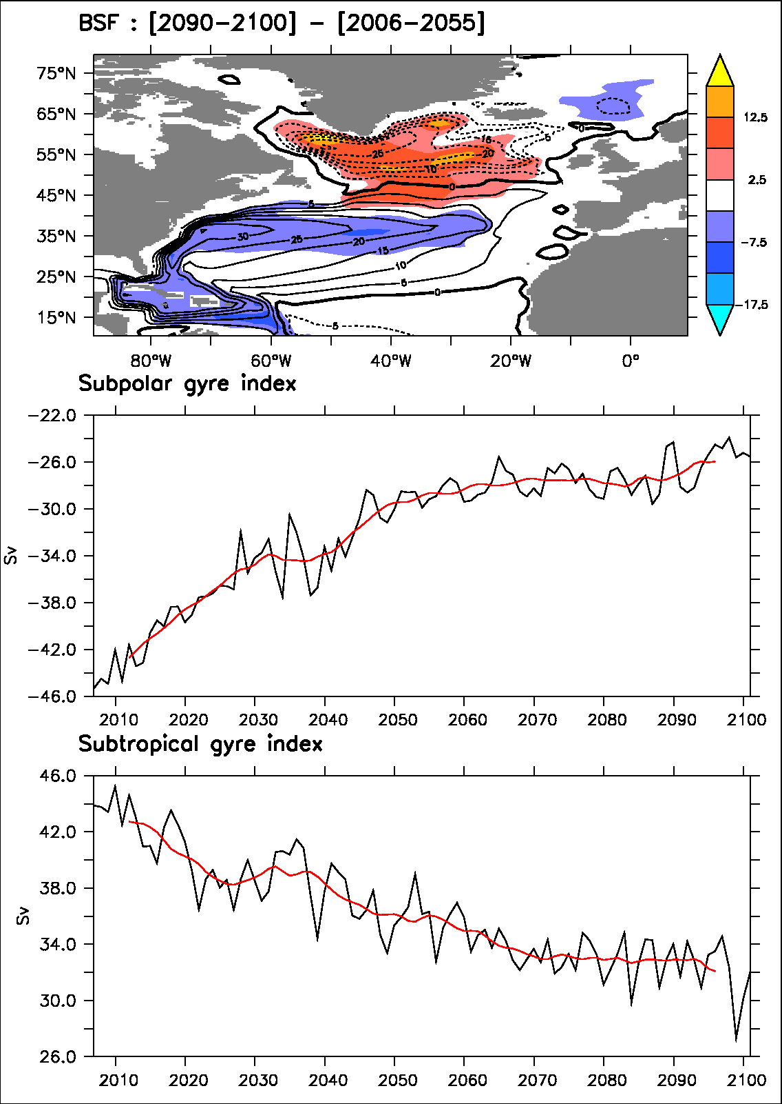
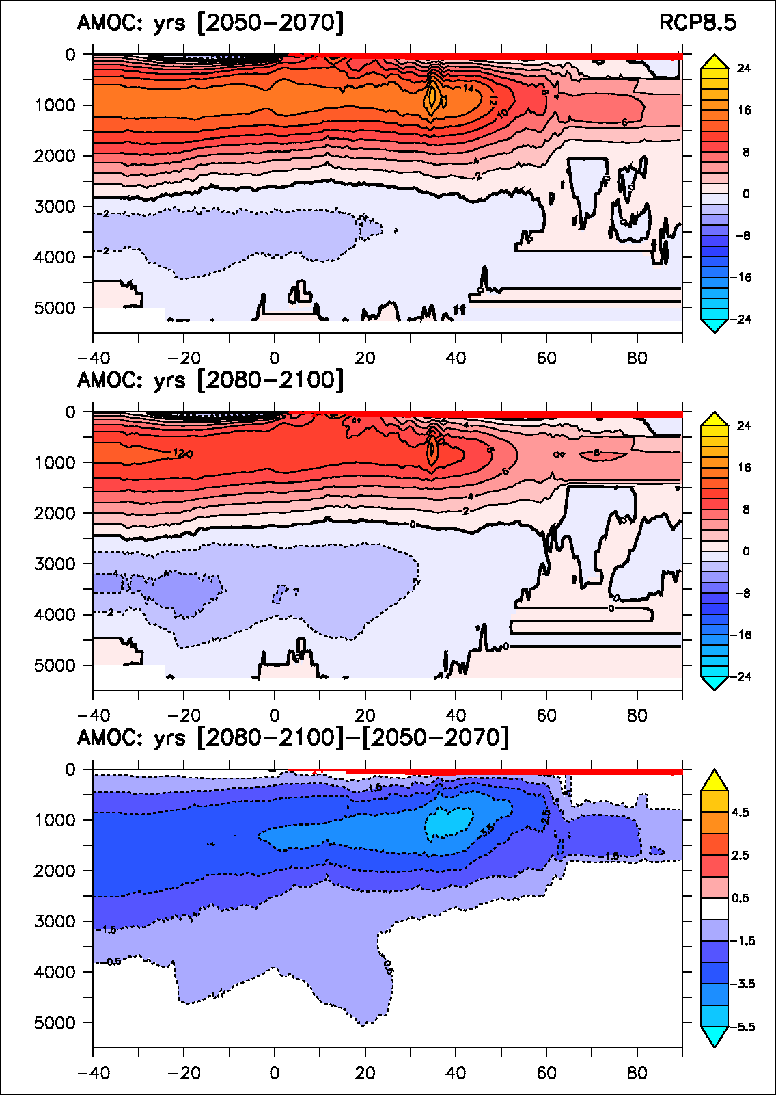
Large-scale circulation changes

